Slide 1
Urban Tree Risk Management A Comprehensive Framework Part II
Mississippi Urban Forest Council
Urban Forestry and Green Infrastructure Conference
Mississippi Museum of Natural Science
Jackson, Mississippi
February 7-8, 2012
Dudley R. Hartel, Center Manager Urban Forestry South
Athens, Georgia
Notes:
This discussion of a comprehensive risk management program that can support local management & disaster planning is based on Urban Tree Risk Management: A Community Guide to Program Design and Implementation (Chapter Two)... and will guide city & urban forest managers through the development & implementation of the current (arboricultural) industry standard program for risk management...
This presentation will delve into some of the detail of the “framework” for urban tree risk management that moves “assessment” to “mitigation” (i.e. appropriate action).
Urban Forestry South is the Southern Region’s urban & community forestry Technology Transfer Center which supports U&CF programs through state agencies and municipalities.

Slide 2
Presentation Outline – Part II
Definition - Review
The 10 Steps in Detail
Resources & Standards
Notes:
In this presentation I’ll review definitions, discuss in more detail the steps in the “guide”, and conclude with the current list of arboricultural standards related to urban tree risk management.

Slide 3
Definitions – Review
Risk... is the combination of the likelihood of an event and the severity of the potential consequences.
Hazard... Is a likely source of harm (or the consequence).
Risk Assessment... is the systematic process to identify, analyze, and evaluate tree risk.
Tree Risk Evaluation... Is the process of comparing the assessed risk against a given risk criteria to determine the significance of the risk (a key concept is “threshold”).
Urban Tree Risk Management... is the comprehensive framework for communicating, assessing, monitoring risk, and mitigating hazards associated with that risk.
Notes:
Basic definitions to understand…

Slide 4
Risk Management Program Design
A Ten Step Process
Assess the tree resource
Review current management practices
Assess fiscal and human resources
Identify program goals
Formulate a tree risk management strategy
Prioritize inspection and corrective action
Select a tree rating system
Write a comprehensive risk policy
Implement the tree risk management strategy
Evaluate program effectiveness
Notes:
From Urban Tree Risk Management (A Community Guide to Program Design and Implementation)... Jill Pokorny, 2003

Slide 5
What Do You Have
Assess the tree resource
Review management practices
Assess fiscal & human resources
Notes:
A risk management plan does not a have to be a detailed tree assessment; the “big picture” is OK.
But, can be the same baseline that supports your UF management plan. With some additional information.
May need to determine value to justify the risk and management strategies; i-Tree Eco, Streets
Assess the tree resource
A planning element & assessment:
Recent data (current inventory)
Can be complete inventory or sample
Baseline study to collect general information:
species
size classes
condition (risk associated)
maintenance needs (pruning, removal) & cost
Urban forest value (i-Tree Eco/Streets)
For urban forest management:
Written policy
Plans
Ordinances
Goals & strategies
particularly relating to public safety
Look across all for common goals
look at other community departments
Review current tree care budget:
Look at estimated costs from your assessment
deficient?
Include costs/resources for inspections
Mitigation at “higher” level
Improved establishment & young tree care as part of risk management

Slide 6
What Do You Have Assess the tree resource
A planning element & assessment:
Recent data
Can be complete inventory or sample
Baseline study to collect general information:
Species
Size classes
Condition (risk associated)
Maintenance needs & costs
Pruning, Removal, Planting
Urban forest value (i-Tree Eco/Streets)
Notes:
Not a detailed tree assessment; big picture.
Can be the same baseline that supports your UF management plan.
Determine value to justify the risk and management strategies; i-Tree Eco, Streets

Slide 7
What Do You Have Review management practices
For urban forest management:
Written policy
Plans
Ordinances
Goals & strategies
Particularly relating to public safety
Look across all for common goals
Look at other community departments
Notes:
See how various elements support or conflict.
Review public safety issues.
Include you local vegetation risk management plan (if available)

Slide 8
What Do You Have Assess fiscal & human resources
Review current tree care budget:
Look at estimated costs from your assessment
Deficient?
Include costs/resources for inspections
Mitigation at “higher” level
Improved establishment & young tree care as part of risk management
Notes:
Is your current budget adequate to begin a more comprehensive program to inspect & mitigate.

Slide 9
What Do You Want
Identify program goals
Formulate a risk strategy
Prioritize inspections & actions
Notes:
Locally, develop a “picture” of your community tree risk management program.
Disaster related UF and EM objectives should be identified.
Community working group/tree board:
What will our risk management program accomplish
Goals & strategies (get specific)
Guiding principals:
Increase public safety
Promote tree health & sustainability
Prevent hazardous defects:
Sound arboricultural practices
site
species
planting
young tree care
mature care
Corrective actions
young tree care
address target issues
prune & remove
Tree risk zones:
Trees
Roads & streets
Occupancy
people
places or sites (buildings)

Slide 10
What Do You Want Identify program goals
Community working group/tree board:
What will our risk management program accomplish
Goals & strategies (get specific)
Guiding principals:
Increase public safety
Promote tree health & sustainability
Notes:
Locally, develop a “picture” of your community tree risk management program.

Slide 11
What Do You Want Formulate a risk strategy
Prevent hazardous defects:
Sound arboricultural practices
Site
Species
Planting
Young tree care
Mature care
Corrective actions
Young tree care
Address target issues
Prune & remove
Notes:
If your assessment of practices found these elements missing, part of your strategy is to adopt necessary practices.

Slide 12
What Do You Want Prioritize inspection and corrective actions
Tree risk inspection:
Walk by (individual tree) inspections
In-depth
More costly
Drive-by
Fast
May overlook defects
Tree risk inspection schedule:
Use zones to determine frequency & type
Notes:
Match the frequency & intensity of inspection with the zone.
Same zones assist UF manager and local EM in disaster preparedness.

Slide 13
What Do You Want Prioritize inspection and corrective actions
Tree risk zones:
Trees
Roads & streets
Occupancy
People
Places or sites (buildings)
Notes:
Identify components for your zones.
A local disaster plan may have (or could use) this information.

Slide 14
Getting What You Want
Select a tree rating system
Write a risk policy
Implement the tree risk strategies
Evaluate program effectiveness
Notes:
Standardizing your risk inspections based on current arboricultural standards:
Matheny & Clark (1994)
ANSI A300 (Part 9)-2011 - Tree Risk Assessment – Tree Structure
Best Management Practices: Tree Risk Assessment
The “No target, No risk” concept applies for disaster planning also.
Importance of standardized method:
Repeatable
Reliable
Easier to maintain trained staff
Standardize record keeping & data
convenience
accuracy
Photographic Guide (12 point)
Target (0-4) – No target, No risk
Size of part (1-4)
Probability of failure (1-4)
Critical element!
The act of writing your risk policy is an important step that can refine your objectives, goals, and strategies. It makes it available to other municipal managers and staff, elected officials, and residents.
The tree risk specification that adheres to ANSI A300 (Part 9)-2011 can be the basis for this more detailed policy
Write, adopt, and enforce this policy:
Must support all other policy & documents
Community responsibility
Administration (who is responsible)
Rating system specified
Inspection methods and schedules
Process for corrective actions
Action appeals
How to handle violations of the policy
Proper implementation requires resources and demands documentation (see ANSI A300 (Part 9)-2011 Tree Risk Assessment).
Your local EM may have access to state mitigation funds for some of this work identified.
Resources:
Staff
Training
Documentation
Implementation documentation:
Inspections
Actions
Failures
Common outcomes from a well designed and implemented tree risk management plan.
These are disaster-related outcomes also.
Outcome based measurements & evaluation:
Increased public safety
Improved tree health
Indicators (for measurement):
Decline in number of high-risk trees
Reduction in number of trees needing hazard pruning
Reduction in storm damage (debris)

Slide 15
Getting What You Want Select a tree rating system
Importance of standardized method:
Repeatable
Reliable
Easier to maintain trained staff
Standardize record keeping & data
Convenience
Accuracy
Photographic Guide (12 point)
Target
Size of part
Probability of failure
Notes:
There are several to choose from..
Professionally applied
Repeatable
Reliable

Slide 16
Getting What You Want Write a risk policy
Write, adopt, and enforce this policy:
Must support all other policy & documents
Community responsibility
Administration (who is responsible)
Rating system specified
Inspection methods and schedules
Process fro corrective actions
Action appeals
How to handle violations of the policy
Notes:
Critical element!

Slide 17
Getting What You Want Implement tree risk strategy
Resources:
Staff
Training
Documentation
Implementation documentation:
Inspections
Actions
Failures
Notes:
Often the limiting factors…

Slide 18
Getting What You Want Evaluate program effectiveness
Outcome based measurements & evaluation:
Increased public safety
Improved tree health
Indicators (for measurement):
Decline in number of high-risk trees
Reduction in number of trees needing hazard pruning
Reduction in storm damage (debris)
Notes:
Evaluate, adjust, repeat…

Slide 19
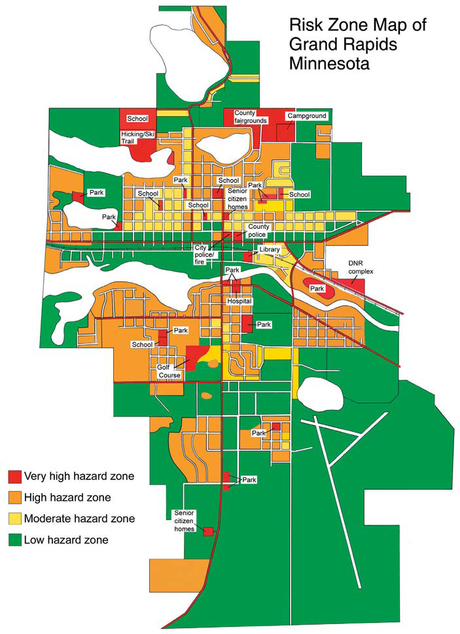
Getting What You Want Prioritize inspection and corrective actions
Notes:
The risk zone map.

Slide 20
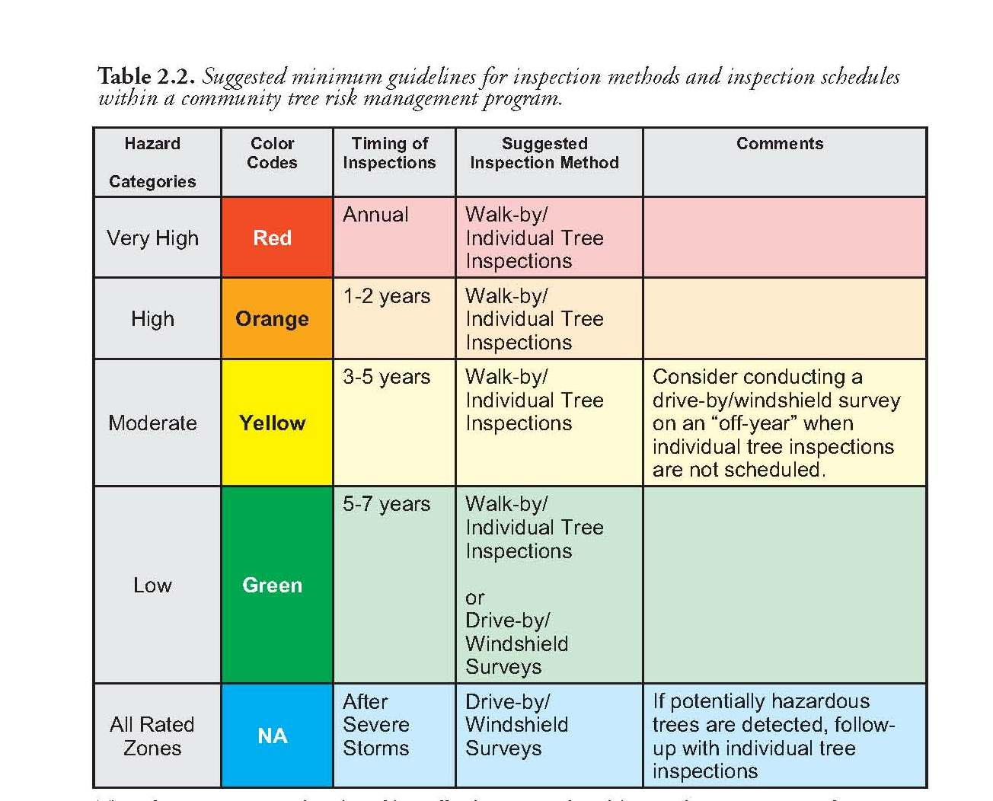
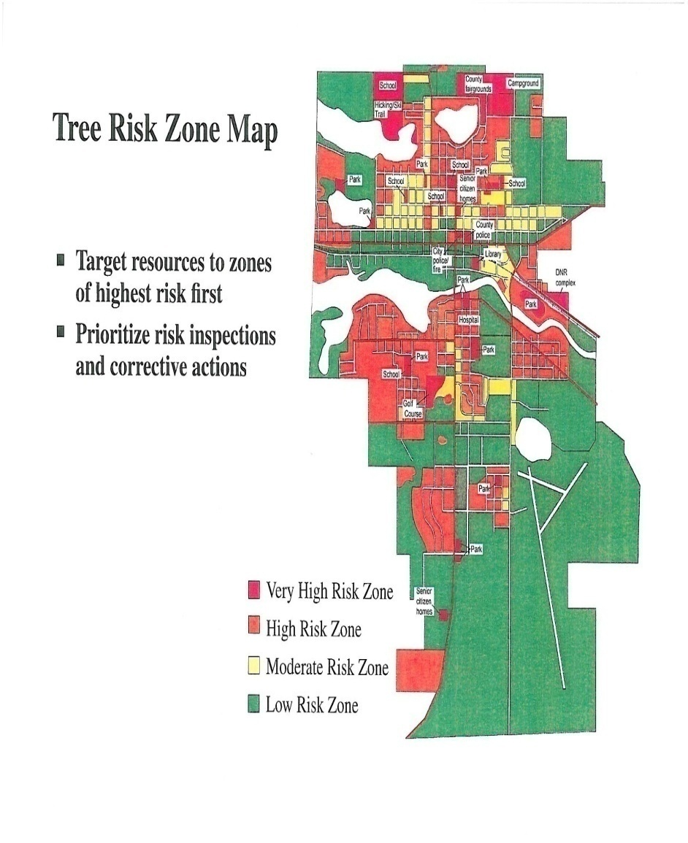
Inspection Guidelines and Schedule
Notes:
Set inspection schedule based on risk zone classification (where have we heard this before!).
20

Slide 21
Urban Tree Risk Management A Comprehensive Framework
Questions!
Dudley R. Hartel, Center Manager Urban Forestry South
Athens, Georgia
Notes:
Any questions on the ten steps...

Slide 22
Tree Risk Plan: Outcomes
Urban forest management
Other municipal staff (roads, parks, sidewalks, electric)
Local Emergency Management
Elected officials
Residents
Notes:
Implementation of an urban tree risk management program can benefit more than the urban forest manager.
The EM link.

Slide 23
Risk Mitigation Results
Reduced claims as they relate to trees by 72%
Reduced work order complaints and/or request for services by over 55%
Reduced 911 and overtime expenditures for tree cleanup by over 69%
Five year period 2001-2006
Columbus, Georgia (R. Barker)
Notes:
Measured results from an aggressive tree risk management program in Columbus, Georgia (from Rachel Barker).

Slide 24
Urban Tree Risk Management A Comprehensive Framework
Questions!
Dudley R. Hartel, Center Manager Urban Forestry South
Athens, Georgia
Notes:
Any questions on the ten steps...

Slide 25
Resources: Tree Risk Management
Urban Tree Risk Management: A Community Guide to Program Design and Implementation – NA-TP-030-03 – Jill D. Pokorny, USDA Forest Service, St. Paul, MN - 2003
Primer on Risk Analysis: decision Making Under Uncertainty (Chapter 1) – CRC Press - Charles Yoe - 2012
ANSI A300 (Part 9)-2011 Tree Risk Assessment a. Tree Structure Assessment – TCIA - 2011
Best Management Practices: Tree Risk Assessment – ISA – T. Smiley, N. Matheny, S. Lilly – 2012
A Photographic Guide to the Evaluation of Hazard Trees in Urban Areas (2nd Edition) – ISA – N. Matheny, J. Clark – 1994
Guide for Plant Appraisal (9th Edition) – ISA for CTLA – 2000
Storms Over the Urban Forest (2nd Edition) – L. Burban – USDA Forest Service - 1994
Notes:
Use current arboricultural standards when developing your urban tree risk management plan…

Slide 26
Urban Tree Risk Management A Comprehensive Framework
Discussion & Questions!
Dudley R. Hartel, Center Manager Urban Forestry South
Athens, Georgia
Notes:
Any final questions or comments about this introduction to urban tree risk management?

Slide 27
Dudley R. Hartel
Center Manager, Urban Forestry South
Athens, Georgia
(706) 559-4236 office
dhartel@fs.fed.us
www.UrbanForestrySouth.org
Notes:
A PDF of this presentation will be at www.UrbanForestrySouth.org .
“Quick Search” with ‘urban tree risk’ (no quotes).

Slide 28
Risk Management Program Design
A Ten Step Process
Assess the tree resource
Review current management practices
Assess fiscal and human resources
Identify program goals
Formulate a tree risk management strategy
Prioritize inspection and corrective action
Select a tree rating system
Write a comprehensive risk policy
Implement the tree risk management strategy
Evaluate program effectiveness
Notes:
The 10 steps to tree risk management; a detailed presentation outline.
The Urban Tree Risk Index (UTRI) that we discuss later in the presentation is a modification of this approach to provide important vegetation and debris information necessary to a local disaster plan.
Steps 1, 4, 5, 6 implement the UTRI model for urban tree risk management to support local EM.

Slide 29
Disaster Planning Cycle
UF, Risk, & Disaster Management
Disaster Plans
Pre-Storm Mitigation
Disaster Event
Now
Later
UTRI or Risk Plan
Notes:
An urban forest management workflow (or timeline) that uses UTRI or Urban Tree Risk Management to support local disaster planning:
disaster planning at the local level (county)
disaster plan
vegetation plan
debris plan
risk management
UTRI (the “fast track” to local disaster planning for vegetation)
Urban Tree Risk Management (Pokorny)
pre-storm mitigation based on priority areas established by urban tree risk management
work on mitigation until disaster strikes!
reassess tree risk or UTRI over a short horizon (3-5 years)
Disaster Plans may include:
County Disaster Plan (general, umbrella plan)
Pre-Hazard Mitigation Plan
UTRI fits in here
State pre-hazard mitigation grants
Vegetation Plan
Debris Management Plan
UTRI fits in here (planning for debris staging areas)

Slide 30
Disaster Planning Cycle
UF, Risk, & Disaster Management
Disaster Event
Response
Recovery
Now
End of Cycle
UTRI or Risk Plan
Notes:
An urban forest management workflow (or timeline) that uses UTRI or Urban Tree Risk Management to support local disaster planning:
during disaster response
UTRI information is used for debris management (i.e. pile location, estimates of volume)
could assist with UFST deployment (particularly reconnaissance)
during recovery
UTRI indexed road segments help determine & guide replanting
post-recovery
disaster planning cycle repeats
UTRI or Urban Tree Risk Management is updated

Slide 31
Summarize Process
Urban Forest Management
Tree inventory & general management plans
Urban Tree Risk Management (Pokorny)
Disaster Planning
Vegetation Management
Mitigation Plan
Pre-storm mitigation
Tree Risk Assessments
Pruning
Removals
Planting
Disaster Event!
Disaster Response/Recovery
Debris
Assess Risk
Mitigation (Pruning, Removals)
Post-Disaster
Planning
Reevaluate (Risk Assessments)
Mitigation (Pruning, Removals, Planting)
Disaster Planning Cycle
Notes:
The last two graphics presented in a different format…
The disaster process outlined with urban forest management (including risk) involve.
UF management can feed the disaster planning cycle, or if lacking, the UTRI (“fast track”) can be used.

