Slide 1
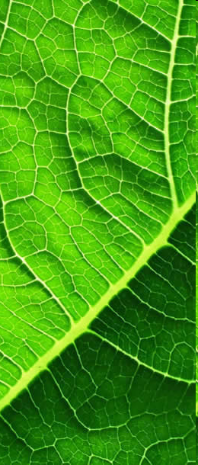
Urban Tree Risk Management A Comprehensive Framework Part I
Mississippi Urban Forest Council
Urban Forestry and Green Infrastructure Conference
Mississippi Museum of Natural Science
Jackson, Mississippi
February 7-8, 2012
Dudley R. Hartel, Center Manager Urban Forestry South
Athens, Georgia
Notes:
This discussion of a comprehensive risk management program that can support local management & disaster planning is based on Urban Tree Risk Management: A Community Guide to Program Design and Implementation (Chapter Two)... and will guide city & urban forest managers through the development & implementation of the current (arboricultural) industry standard program for risk management...
Have any of you seen a tree and thought “that looks dangerous?” or “that might hurt someone?”
If so, you did a risk assessment… What action was taken after your assessment?
This presentation will outline the “framework” for urban tree risk management that moves “assessment” to “mitigation” (i.e. appropriate action).
Urban Forestry South is the Southern Region’s urban & community forestry Technology Transfer Center which supports U&CF programs through state agencies and municipalities.

Slide 2
Presentation Outline – Part I
Definitions
Planning & Management – Tree Risk
The 10 Steps
Resources & Standards
Summarize the Risk Management Framework
Notes:
In this presentation I’ll define the topic of tree risk, discuss tree risk management in a broader context, introduce the steps in the “guide”, and conclude with the current list of arboricultural standards related to urban tree risk management. I’ll conclude with a definition of urban tree risk management.

Slide 3
Definitions
Risk... is the combination of the likelihood of an event and the severity of the potential consequences.
In the context of trees, risk is the likelihood of a conflict or tree failure occurring and affecting a target, and the severity of the associated consequences – injury, damage, disruption.
Notes:
Risk (from ISA BMP: Tree Risk Assessment)…
Probabilities involved
An event
Consequences (harm) with some level of severity (or concern)
Conflict… e.g. tree obstructs stop sign visibility at intersection, or tree limbs/branches touching power distribution lines

Slide 4
Definitions
Hazard... Is a likely source of harm (or the consequence).
In relation to trees, a hazard is the tree part(s) identified as a likely source of harm.
Notes:
Hazard (from ISA BMP: Tree Risk Assessment)…
What is the likely source (e.g. limb, branch, whole tree) of the assessed harm (i.e. consequence)

Slide 5
Definitions
Risk Assessment... is the systematic process to identify, analyze, and evaluate tree risk.
... is the process of inspecting and evaluating the structural condition of trees and the harm that could occur when a failure occurs.
Tree Risk Evaluation... Is the process of comparing the assessed risk against a given risk criteria to determine the significance of the risk (a key concept is “threshold”).
Notes:
Risk assessment is the “next” step after the urban tree risk management framework ”sets the stage”…
Assessment and evaluation (from ISA BMP: Tree Risk Assessment)…
Systematic process
Identify
Analyze
Evaluate
There are standards (i.e. ANSI A300 Part 9) that should be followed when developing this assessment process
Risk Evaluation (from ISA BMP: Tree Risk Assessment)…
Comparing the assessed risk to your experience and/or expectations (i.e. risk threshold; how much harm is acceptable to you)

Slide 6
Urban Tree Risk Management A Comprehensive Framework
Questions!
Dudley R. Hartel, Center Manager Urban Forestry South
Athens, Georgia
Notes:
Any questions or comments...

Slide 7
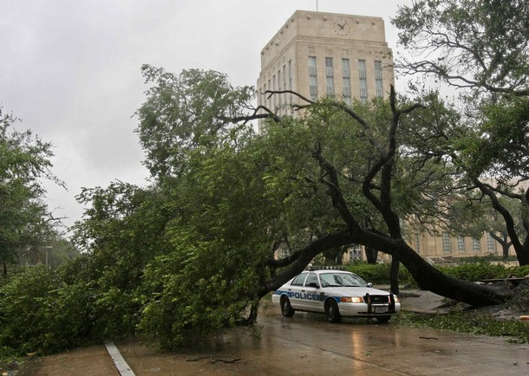
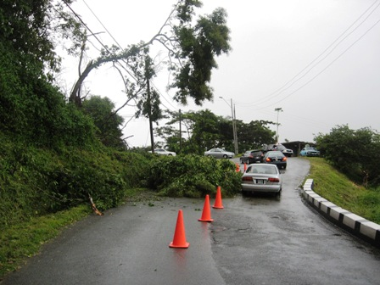
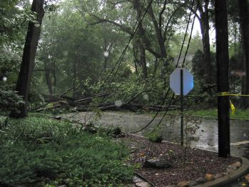
Why Manage Tree Risk
To avoid consequences...
Notes:
Assess and mitigate to avoid consequences…
Damage
Interruption
Injury

Slide 8
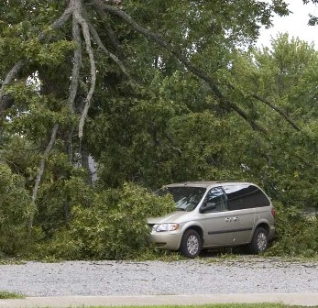
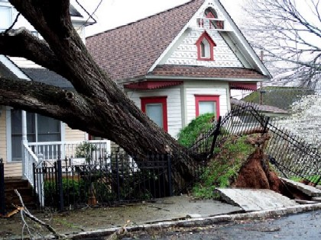
Why Manage Tree Risk
Eliminate urban forestry “feast and famine”...
Notes:
Take care of trees (i.e. management) on your own schedule…
Budget implications
Workforce scheduling implications

Slide 9
Fairly Common UF Workflow
Find Problem Mitigate
Find Problem Mitigate
Find Problem Mitigate
Dealing with problems as they occur
Now
Later
Notes:
A common approach to urban forest management (workflow or timeline):
deal with problems as they arise (i.e. “putting out fires”)
May be appropriate for very small management areas or ownerships, or as the tree resource changes over time (i.e. there are ways to rationalize this approach!).

Slide 10
Management and Planning Cycle
UF Management Workflow
Inventory & Plan
Management
Management
Now
End of Cycle
Notes:
A recommended urban forest management workflow (or timeline):
inventory the resource of interest (i.e. entire city, a park)
develop a management plan
with short-term action plan for a specific time period (i.e. cycle)
plan will have long-term goals, objectives, and strategies
manage your urban tree resource over the management/planning cycle
tree planting
mulching
young tree pruning
pruning mid-aged to mature trees
removals (for a variety of reasons; problems (i.e. risk), construction, redesign)
special areas or purposes (riparian areas, parks, watershed protection, carbon, pedestrian amenities)

Slide 11
Management and Planning Cycle
UF & Risk Management
Inventory & Plan
Management
Management
Now
End of Cycle
Assess Risk Plan
Notes:
An urban forest management workflow (or timeline) that adds Urban Tree Risk Management:
inventory the resource of interest (i.e. entire city, a park)
develop a management plan
with short-term action plan for a specific time period (i.e. cycle)
plan will have long-term goals, objectives, and strategies
manage your urban tree resource over the management/planning cycle
tree planting
mulching
young tree pruning
pruning mid-aged to mature trees
removals (for a variety of reasons; problems (i.e. risk), construction, redesign)
risk mitigation
special areas or purposes (riparian areas, parks, watershed protection, carbon, pedestrian amenities)
inventory and develop a separate risk management plan
this feeds into your management cycle
the risk management cycle may be shorter than your urban forest management cycle

Slide 12
Tree Risk Management
Communities can deal with risk & their identified hazards in several ways:
Risk Avoidance
Risk Management
Your community decides how to management trees to reduce undesirable consequences.
Notes:
Cities that choose risk avoidance either ignore those risks (i.e. “act of god”), or will eliminate all risk in the area of interest by removing all trees; others will manage tree risk so that benefits of the trees can be retained with some acceptable level of risk that is within the communities threshold of concern.
It is NOT necessary to practice risk avoidance in order to manage your urban forest, be better prepared for disasters, and maintain UF ecosystem services.

Slide 13
Urban Tree Risk Management A Comprehensive Framework
Questions!
Dudley R. Hartel, Center Manager Urban Forestry South
Athens, Georgia
Notes:
Any questions or comments...

Slide 14
Risk Management Program Design
A Ten Step Process
Assess the tree resource
Review current management practices
Assess fiscal and human resources
Identify program goals
Formulate a tree risk management strategy
Prioritize inspection and corrective action
Select a tree rating system
Write a comprehensive risk policy
Implement the tree risk management strategy
Evaluate program effectiveness
Notes:
From Urban Tree Risk Management (A Community Guide to Program Design and Implementation)... Jill Pokorny, 2003

Slide 15
What Do You Have
Assess the tree resource
Review management practices
Assess fiscal & human resources
Notes:
A risk management plan does not a have to be a detailed tree assessment; the “big picture” is OK.
But, can be the same baseline that supports your UF management plan. With some additional information.
May need to determine value to justify the risk and management strategies; i-Tree Eco, Streets
Assess the tree resource
A planning element & assessment:
Recent data (current inventory)
Can be complete inventory or sample
Baseline study to collect general information:
species
size classes
condition (risk associated)
maintenance needs (pruning, removal) & cost
Urban forest value (i-Tree Eco/Streets)
For urban forest management:
Written policy
Plans
Ordinances
Goals & strategies
particularly relating to public safety
Look across all for common goals
look at other community departments
Review current tree care budget:
Look at estimated costs from your assessment
deficient?
Include costs/resources for inspections
Mitigation at “higher” level
Improved establishment & young tree care as part of risk management

Slide 16
What Do You Want
Identify program goals
Formulate a risk strategy
Prioritize inspections & actions
Notes:
Locally, develop a “picture” of your community tree risk management program.
Disaster related UF and EM objectives should be identified.
Community working group/tree board:
What will our risk management program accomplish
Goals & strategies (get specific)
Guiding principals:
Increase public safety
Promote tree health & sustainability
Prevent hazardous defects:
Sound arboricultural practices
site
species
planting
young tree care
mature care
Corrective actions
young tree care
address target issues
prune & remove
Tree risk zones:
Trees
Roads & streets
Occupancy
people
places or sites (buildings)

Slide 17
Getting What You Want
Select a tree rating system
Write a risk policy
Implement the tree risk strategies
Evaluate program effectiveness
Notes:
Standardizing your risk inspections based on current arboricultural standards:
Matheny & Clark (1994)
ANSI A300 (Part 9)-2011 - Tree Risk Assessment – Tree Structure
Best Management Practices: Tree Risk Assessment
The “No target, No risk” concept applies for disaster planning also.
Importance of standardized method:
Repeatable
Reliable
Easier to maintain trained staff
Standardize record keeping & data
convenience
accuracy
Photographic Guide (12 point)
Target (0-4) – No target, No risk
Size of part (1-4)
Probability of failure (1-4)
Critical element!
The act of writing your risk policy is an important step that can refine your objectives, goals, and strategies. It makes it available to other municipal managers and staff, elected officials, and residents.
The tree risk specification that adheres to ANSI A300 (Part 9)-2011 can be the basis for this more detailed policy
Write, adopt, and enforce this policy:
Must support all other policy & documents
Community responsibility
Administration (who is responsible)
Rating system specified
Inspection methods and schedules
Process for corrective actions
Action appeals
How to handle violations of the policy
Proper implementation requires resources and demands documentation (see ANSI A300 (Part 9)-2011 Tree Risk Assessment).
Your local EM may have access to state mitigation funds for some of this work identified.
Resources:
Staff
Training
Documentation
Implementation documentation:
Inspections
Actions
Failures
Common outcomes from a well designed and implemented tree risk management plan.
These are disaster-related outcomes also.
Outcome based measurements & evaluation:
Increased public safety
Improved tree health
Indicators (for measurement):
Decline in number of high-risk trees
Reduction in number of trees needing hazard pruning
Reduction in storm damage (debris)

Slide 18
Urban Tree Risk Management A Comprehensive Framework
Questions!
Dudley R. Hartel, Center Manager Urban Forestry South
Athens, Georgia
Notes:
Any questions on the ten steps...

Slide 19
Resources: Tree Risk Management
Urban Tree Risk Management: A Community Guide to Program Design and Implementation – NA-TP-030-03 – Jill D. Pokorny, USDA Forest Service, St. Paul, MN - 2003
Primer on Risk Analysis: decision Making Under Uncertainty (Chapter 1) – CRC Press - Charles Yoe - 2012
ANSI A300 (Part 9)-2011 Tree Risk Assessment a. Tree Structure Assessment – TCIA - 2011
Best Management Practices: Tree Risk Assessment – ISA – T. Smiley, N. Matheny, S. Lilly – 2012
A Photographic Guide to the Evaluation of Hazard Trees in Urban Areas (2nd Edition) – ISA – N. Matheny, J. Clark – 1994
Guide for Plant Appraisal (9th Edition) – ISA for CTLA – 2000
Storms Over the Urban Forest (2nd Edition) – L. Burban – USDA Forest Service - 1994
Notes:
Use current arboricultural standards when developing your urban tree risk management plan…

Slide 20
Risk Management – ISO 31010
Communication
Monitoring
Assessment
Notes:
Current standards for risk assessment and management are based on ISO 31010 components:
Communication and consultation
Risk assessment
Monitoring and review

Slide 21
Definitions
Urban Tree Risk Management... is the comprehensive framework for communicating, assessing, monitoring risk, and mitigating hazards associated with that risk.
Notes:
Urban Tree Risk Management defined (drh 2012)…
Comprehensive “framework” (i.e. steps to follow, the recipe)
Communication of risk (to managers, public)
Tree risk assessment by qualified, trained, and experienced arborists or urban foresters
Monitoring risk (i.e. temporal, repetitive, observant)
Evaluating hazards (to your threshold) and mitigating those hazards
Important concept is: prioritization

Slide 22
Urban Tree Risk Management A Comprehensive Framework
Discussion & Questions!
Dudley R. Hartel, Center Manager Urban Forestry South
Athens, Georgia
Notes:
Any final questions or comments about this introduction to urban tree risk management?

Slide 23
Dudley R. Hartel
Center Manager, Urban Forestry South
Athens, Georgia
(706) 559-4236 office
dhartel@fs.fed.us
www.UrbanForestrySouth.org
Notes:
A PDF of this presentation will be at www.UrbanForestrySouth.org .
“Quick Search” with ‘urban tree risk’ (no quotes).

