Slide 1


Extending the Bare Root Tree Planting Window in the South
Using a Gravel Bed to Grow Fibrous Root Systems
Eric Kuehler
Technology Transfer Specialist
U.S. Forest Service
ekuehler@fs.fed.us
Notes:
The current state of the economy has forced many municipalities to cut back on their urban forest operating budgets. With fewer dollars, urban foresters are having to reduce the number of trees being planted annually. Planting bare root trees is an inexpensive method of tree planting, however, here in the South, we only have a couple of months in the winter to plant these types of trees. This presentation is designed to show a method of growing bare-root planting stock to extend the planting season and help a city plant more trees for less money.

Slide 2
Presentation Overview
Benefits/limitations of bare root tree planting
Bare root tree planting project results
Gravel bed construction / costs
Growing and maintaining trees in a gravel bed
Out-planting trees from the gravel bed
Preliminary results from August 2011 planting

Slide 3
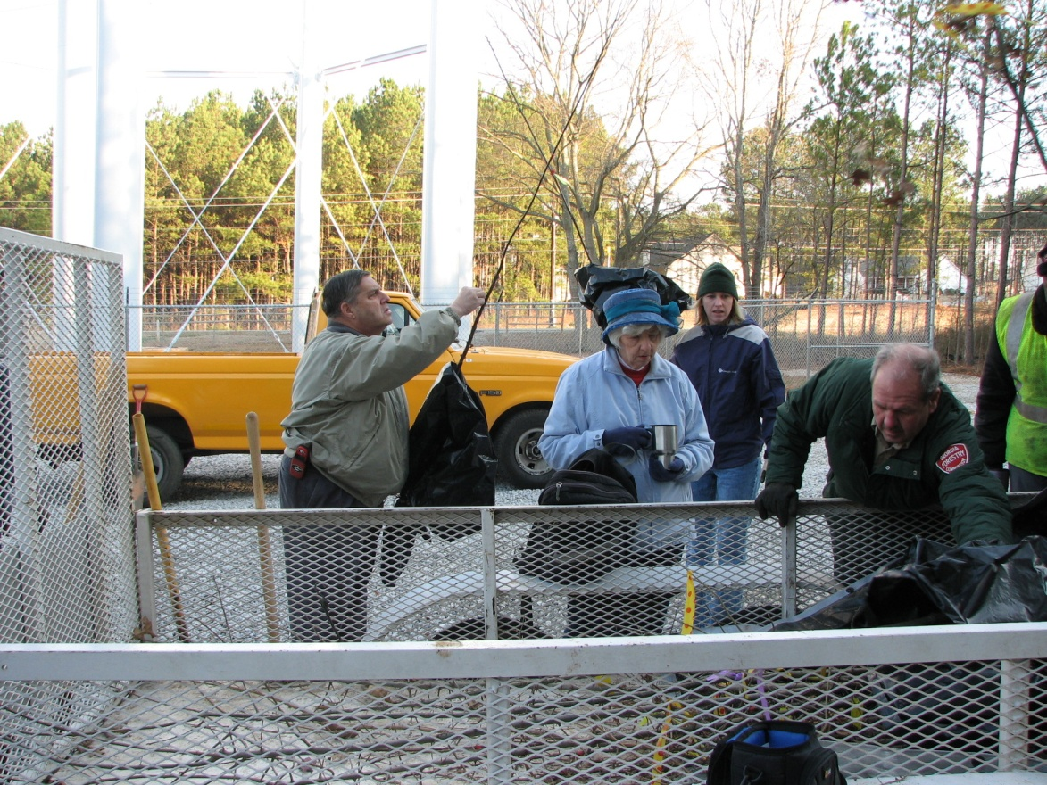
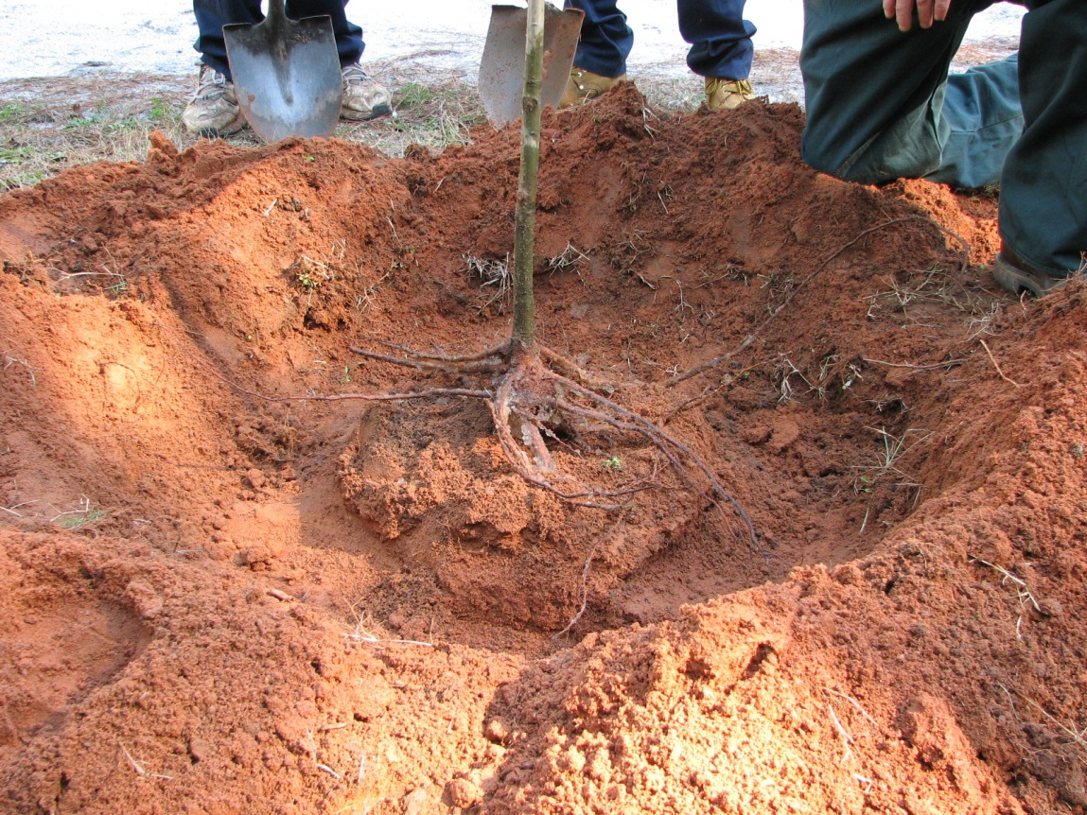
Benefits of Bare Root Trees
Inexpensive
  < $15 / tree
  Lower installation costs
  More trees planted
Easier to plant
  Lightweight
  No heavy equipment
Greater root mass
Root problems corrected
  Root collar exposed
  Girdling roots removed
  Root placement at planting
Notes:
Bare root trees (or liners) are much less expensive from the nursery than B&B or container-grown trees. Because they are light-weight, it costs less to transport and plant and thus more trees can be planted for less money. Bare root trees generally retain greater root mass than B&B and do not have the root-circling problems that container-grown trees have. With bare-root trees, the root collar can be easily identified, unlike with B&B or container trees, so that a tree can be planted at the proper depth. Root problems can be corrected at time of planting and roots can be positioned easily to ensure maximum anchoring ability.

Slide 4
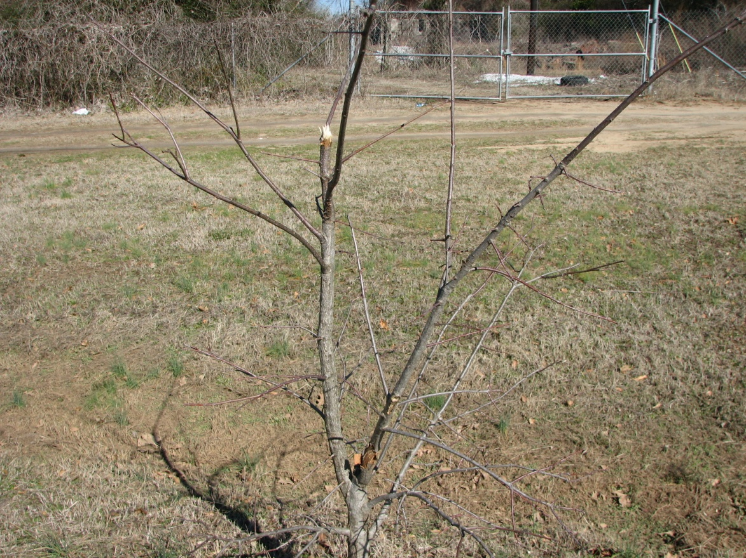
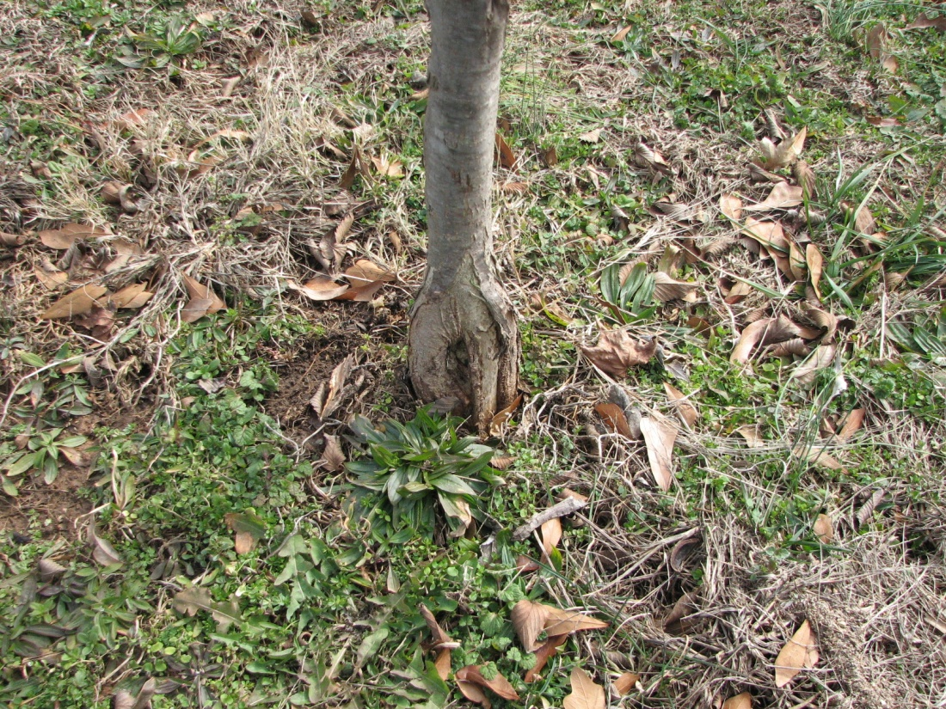
Limitations of Bare Root Trees
Smaller diameter usually
  < 1.5” caliper
Increased vandalism
  Because of smaller size
Maintenance neglect
  Mower damage
  Trimmer damage
Limited planting window
  Lifting from nursery based on dormancy
  Periodic winter warm spells
Notes:
As with any tree-planting method, there are limitations. Bare-root trees are generally smaller than other trees which could result in greater incidences of vandalism and general maintenance neglect from lawn maintenance equipment. Traditionally, bare-root tree availability is limited by time of dormancy. Here in the South, warm autumns can push full dormancy into December or January. We also have periods of warm winter weather that can affect bare-root planting. Trees can begin to break bud or roots can dry out. This can take a lot of planning and coordination.

Slide 5
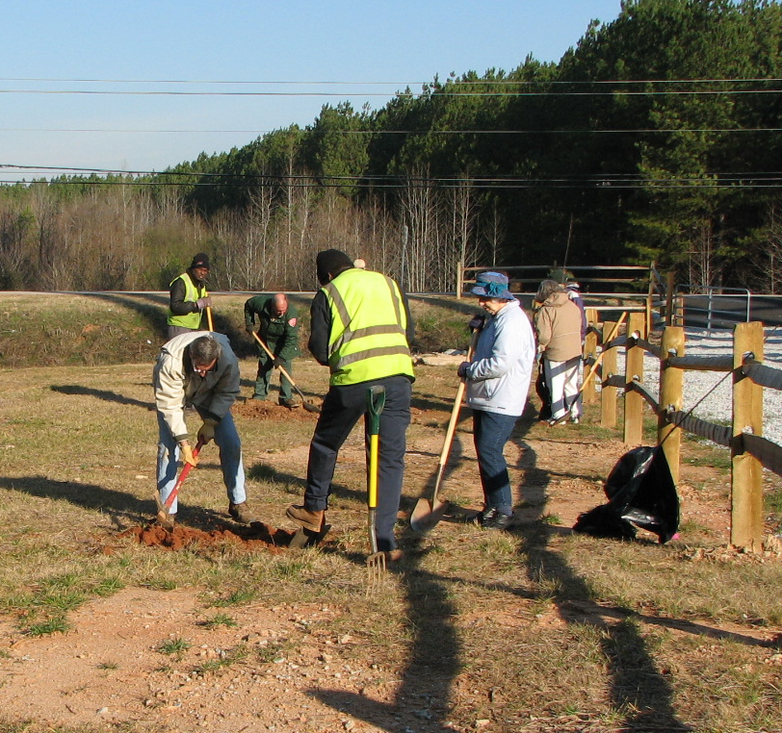
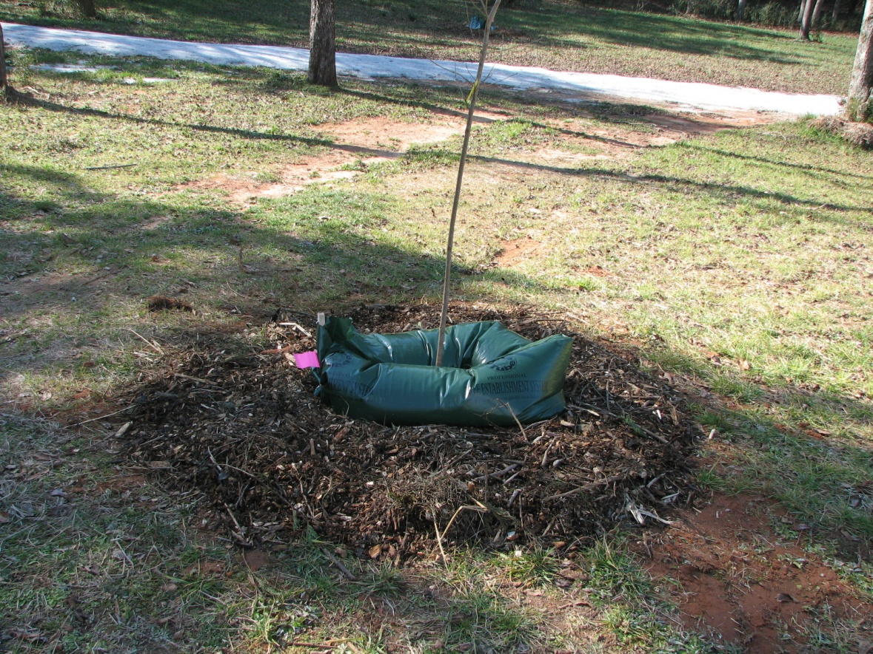
5-Year Bare Root Tree Planting Project
GA Forestry Commission
6 GA municipalities
20 trees / city
City ID planting sites
Tree planting by
  USFS
  GFC
  City / tree board
City maintained trees
Annual measurements
Notes:
I want to share with you a 5-year bare-root tree planting project that was conducted in six GA communities with the help of the GA Forestry Commission. We planted 20 bare-root trees in each of these communities. Bare-root trees were obtained from the nursery and taken directly to each community. The city identified the planting sites. The Forest Service, GFC, city personnel, and volunteers planted the trees. Each community provided tree maintenance (or not) as they would normally. The USFS and GFC provided annual growth/condition measurements.

Slide 6
5-Year Bare Root Tree Planting Project
Results
Survivability rate
  Species dependent
  Maint. dependent
  Climate dependent
  Site dependent
    High foot traffic areas
    Dog parks
Species | N | % survival
Overcup oak | 20 | 80
Black gum | 4 | 75
Shumard oak | 23 | 74
Red maple | 13 | 69
Chinese elm | 12 | 67
Scarlet oak | 16 | 56
White oak | 4 | 50
Willow oak | 7 | 29
Nuttall oak | 12 | 25
TOTAL | 116 | 59
Notes:
Here are some results. Survivability overall was about 60%. Some species did better than others. Survival seemed to be dependant on the level of maintenance received, climatic conditions, and where they were planted. Willow and nuttall oaks did not survive very well, but this may have been due to a late-season heavy freeze after bud-break. The nursery from where we acquired these trees also experienced heavy losses with these species after this event. Tree planted in high-foot traffic areas also did not do well due to vandalism, soil compaction, and/or reduced quality of care due to lawn maintenance.

Slide 7
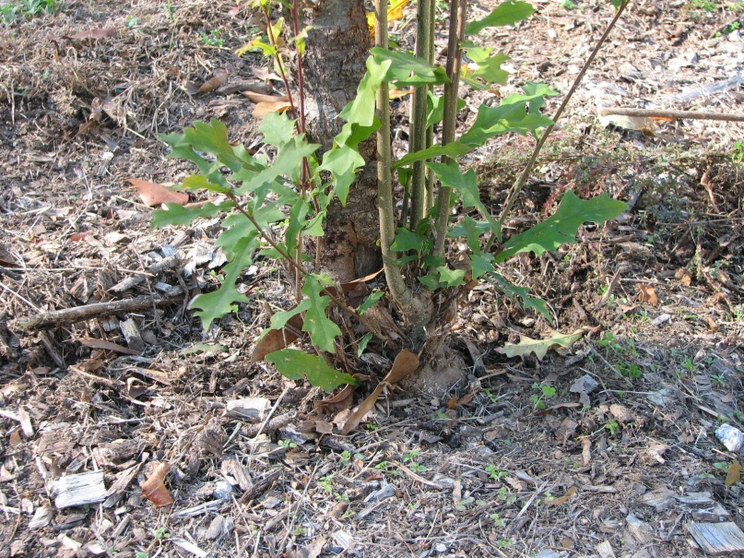
5-Year Bare Root Tree Planting Project
Results
Avg caliper size
  Species dependent
  Maint. dependent
Notes:
By year 5, average caliper size was about 4 inches. Obviously, this is dependant on species, but it also seemed to depend on the level of tree care maintenance (or reduced level of lawn maintenance i.e. string-trimmer damage along the stem).

Slide 8
5-Year Bare Root Tree Planting Project
Results
Notes:
By year 5, we were seeing an average annual diameter increment of over one inch. By year 5, many of those mal-treated, weaker trees were dead and no longer being included in the study data.

Slide 9
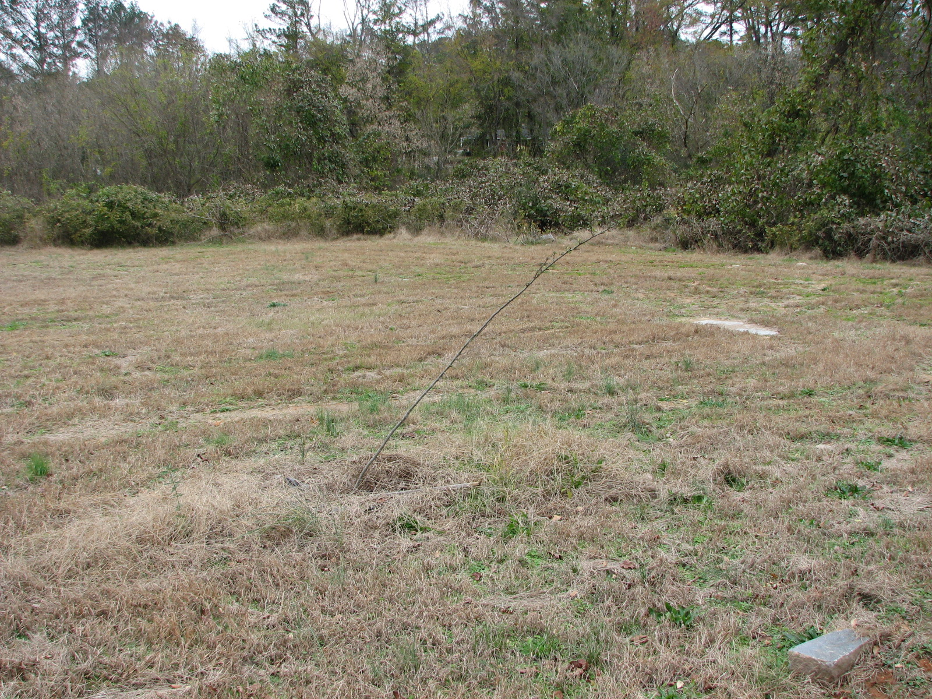
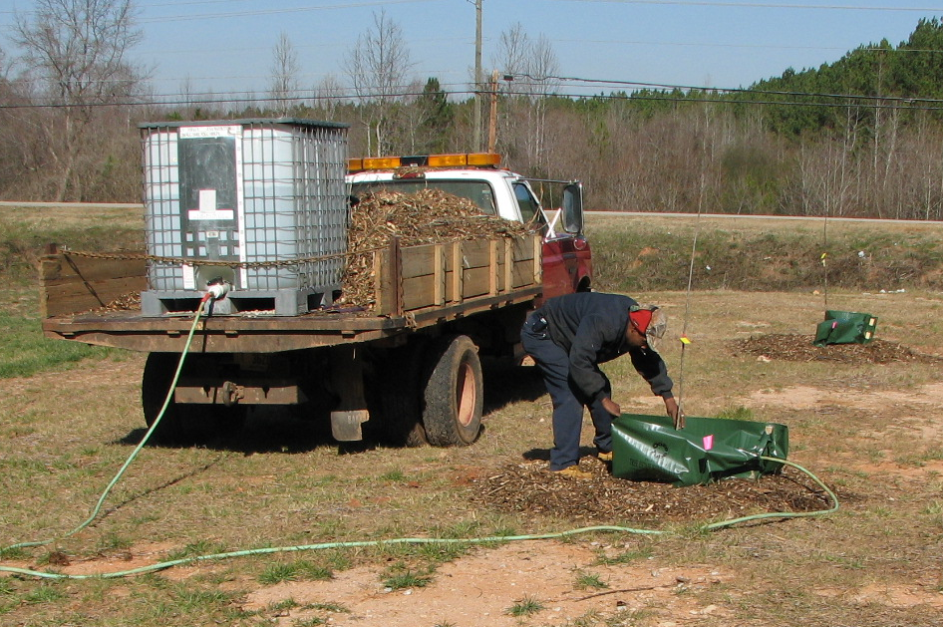
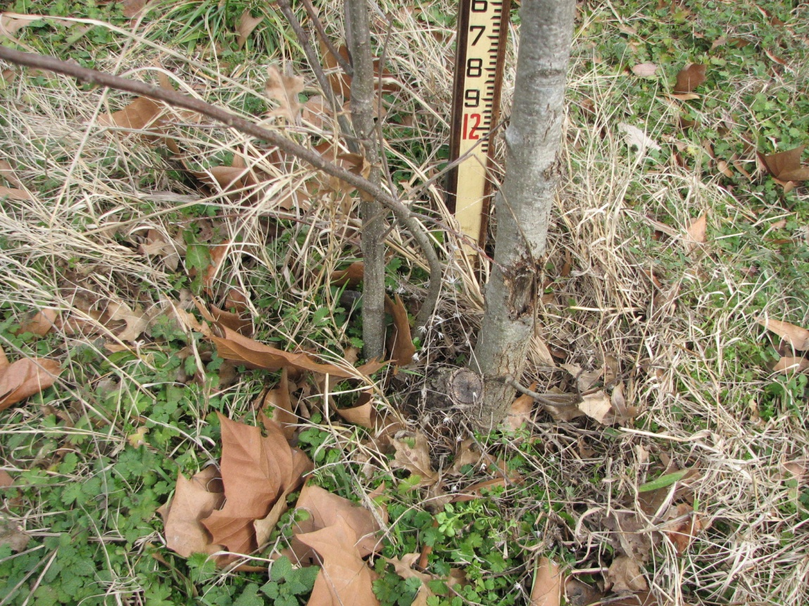
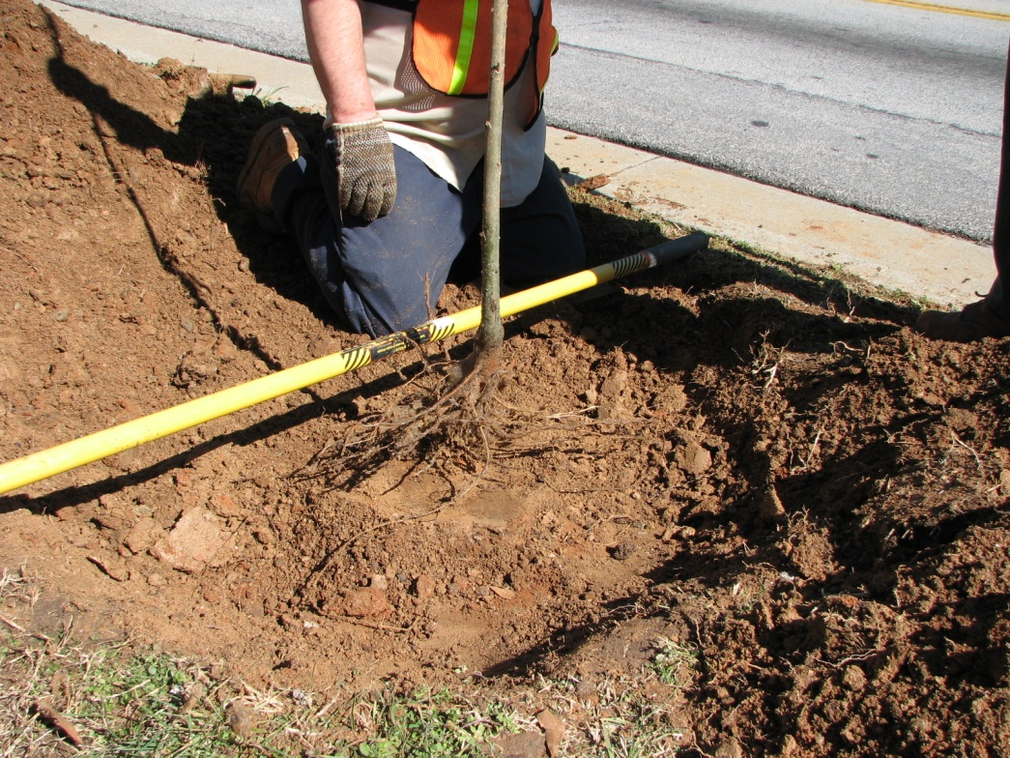
5-Year Bare Root Tree Planting Project
Lessons Learned
Know which species can withstand bare rooting in your area
Choose sites with good soil conditions
Protect stem bases
Avoid high foot traffic areas (i.e. parks)
Provide high-quality maintenance
Notes:
So the lessons that we learned from this study included:
Know which species are best for bare-root planting in your area (seek advise from local extension office rather than the nursery because the nursery may sell you something that they want to sell rather than what does well).
Choose sites with good soil conditions. If you have to use a pick to dig your hole, don’t plant there.
Use stem guards to prevent trimmer damage where you have no control over the level of lawn care around trees
Don’t plant bare-root trees in high traffic areas like parks or sports complexes
Provide high-quality maintenance at least for the first 5 years.

Slide 10
Presentation Overview
Benefits/limitations of bare root tree planting
Bare root tree planting project results
Gravel bed construction / costs
Growing and maintaining trees in a gravel bed
Out-planting trees from gravel bed
Preliminary results from August 2011 planting
Notes:
Hopefully, I have convinced you that bare-root tree planting is a viable option to other methods of tree planting. Now I would like to show you the gravel bed method of growing your own seedlings with increased root systems to allow you to out-plant at times of the year other than in January or February.

Slide 11
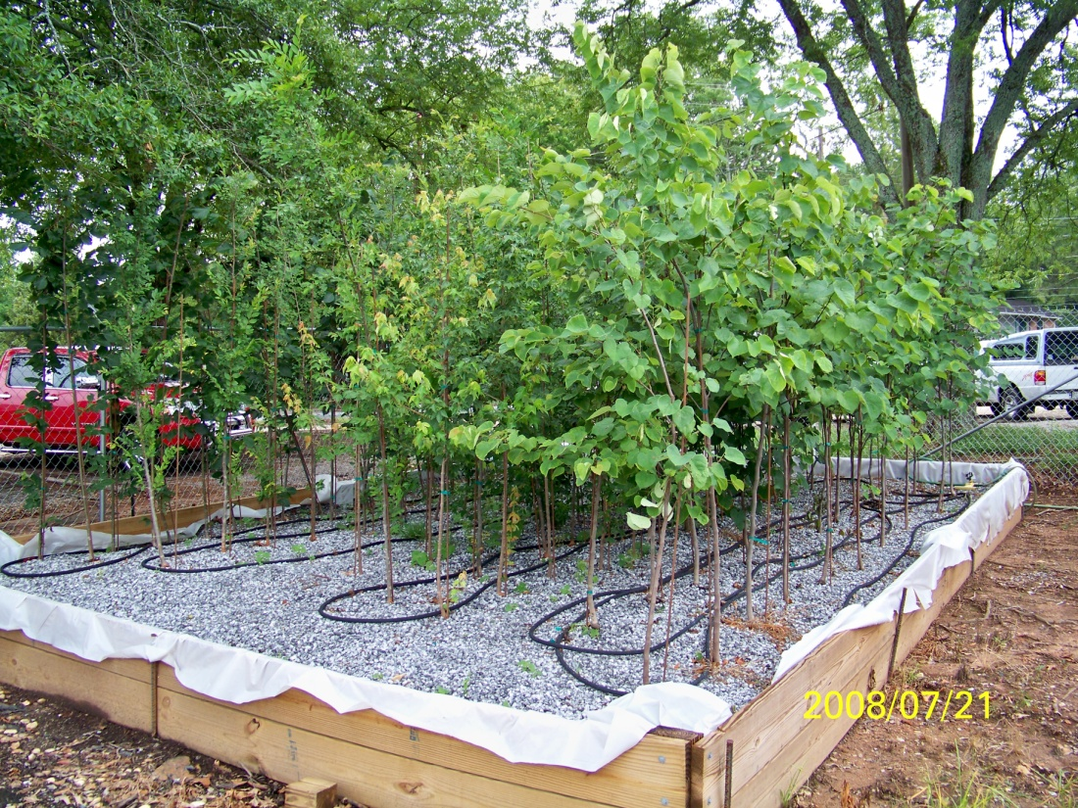
Gravel Bed Explanation
What is it?
  Missouri Gravel Bed
    Chris Starbuck
  Hydroponics
  Raised-bed/below ground
Why use it?
  Root development
    Abundant fibrous roots
  Reduce shock
  Ease of out-planting
Notes:
This method of growing bare-root trees was developed by Chris Starbuck at the University of Missouri. This is basically a form of hydroponics to grow fibrous root systems. The bed can be above- or below-ground.
The basic concept is to grow abundant, fibrous roots to your trees to reduce transplant shock at time of planting and to ensure proper planting depth and root orientation.

Slide 12
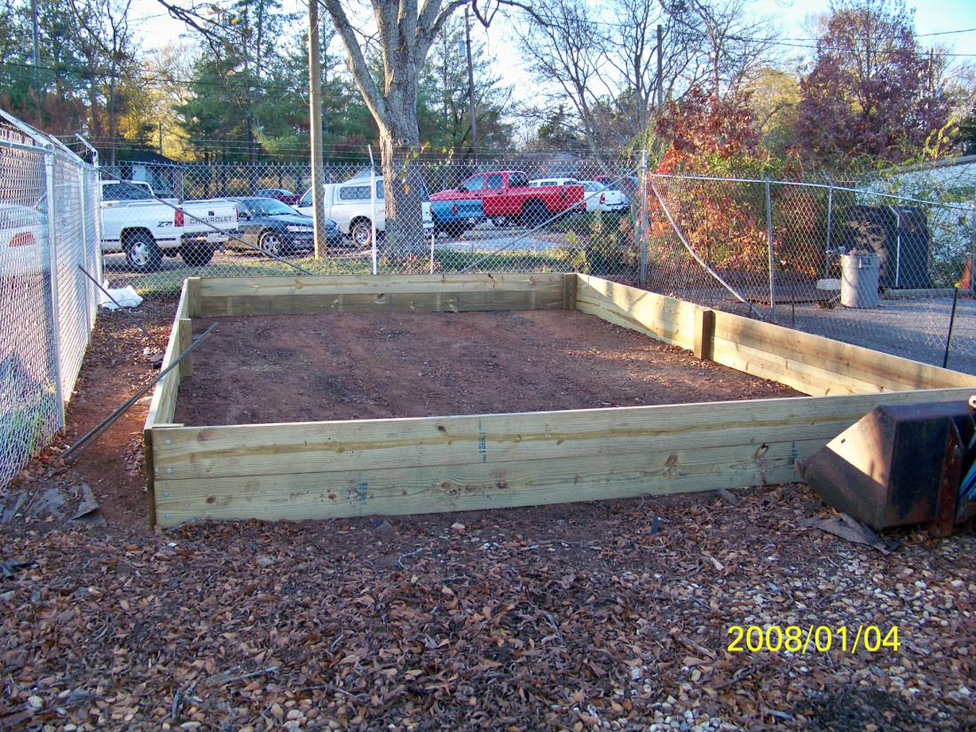
Gravel Bed Construction
24’ x 16’ x 18” frame
  12’/16’ treated 2x10
  Linked with treated 4x6
  Rebar to hold shape
Lined with 6 mil plastic
4” galvanized lag bolts
½” soaker hose
  375’
Water timer
Osmocote (14-14-14)
Notes:
At the Athens/Clarke County Landscape Services facility, we constructed a 24’ by 16’ bed using stacked, treated 2x10’s to give a bed depth 18”. We tied the sides together using treated 4x6 and rebar was used to prevent warping of sides after filled with gravel. The bed was lined with a 6 mil plastic to help hold moisture. Soaker hoses and a $30 timer was used to maintain moisture levels. We also used a complete, slow-release fertilizer to ensure adequate plant growth/function.

Slide 13
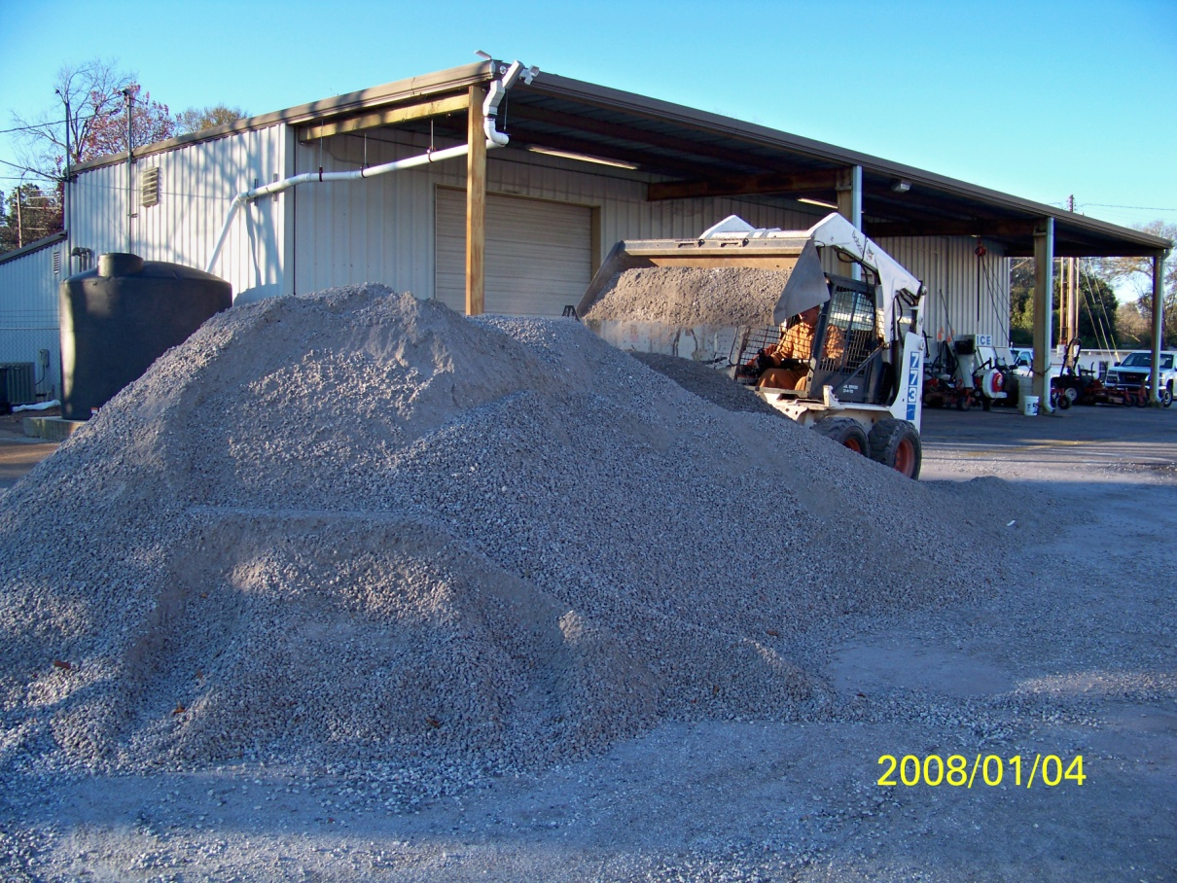
Gravel Bed Construction
½” pea gravel
  Ask for river rock
  #67 crushed granite
  21 yd³ (30 tons)
M10 sand
  Moisture retention
  Asked for 4 tons
  Delivered 10 tons
Hydrogel
  4 - 5 lbs.
  Moisture retention
Notes:
The gravel fill was about 30 tons of ½” (#67) crushed granite. I ordered pea gravel, thinking that I would get river rock. Make sure you ask for river rock and not just pea gravel because the supplier’s terminology and your terminology may not be the same. We also used course sand to help with moisture retention. I asked for four tons, but 10 tons was delivered (and purchased). This is one limitation to managing a project from a distance. We also used a very small quantity of fine-grain hydrogel in the mix to help with moisture retention.

Slide 14
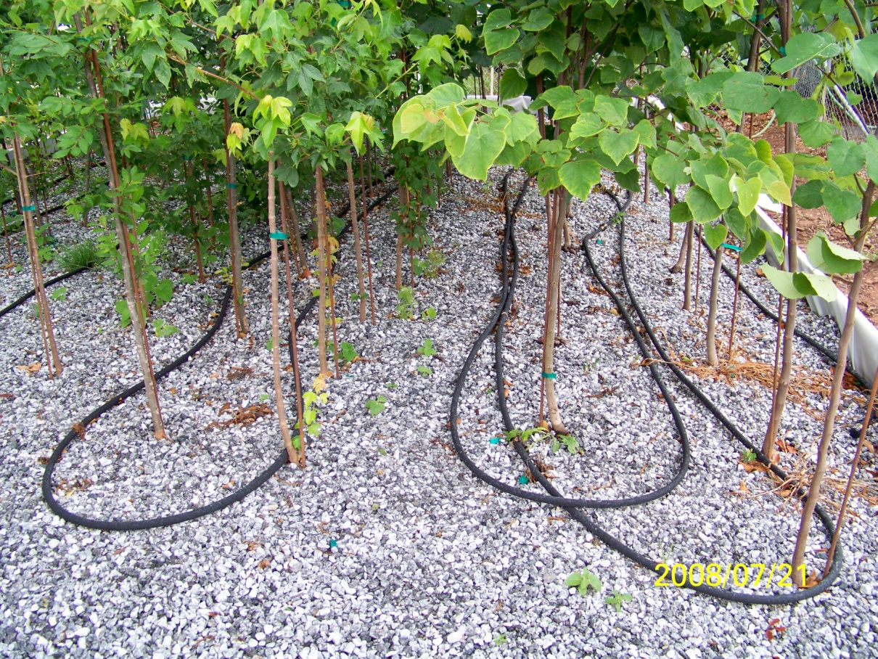
Plant Material
Princeton elm
  30 @ $10 each
‘Bosque’ Chinese elm
  20 @ $8 each
‘Aeryn’ trident maple
  20 @ $10 each
Eastern redbud
  30 @ $8 each
0.66” – 0.75” caliper
Notes:
From a local nursery that provided bare-root planting stock to the public, we purchased 30 each Princeton elm and eastern red bud, and 20 each Chinese elm and trident maple. All trees were between 2/3 to ¾ inches at caliper.

Slide 15
Gravel Bed Material Costs
Material Type | Cost
Framing and miscellaneous supplies lumber, liner, bolts, fertilizer, water hose, timer | $ 525
Fill material rock and sand | $ 625
Plant material | $ 900
Total | $ 2050
Notes:
The cost for this bed (not including labor) was around $2000.

Slide 16
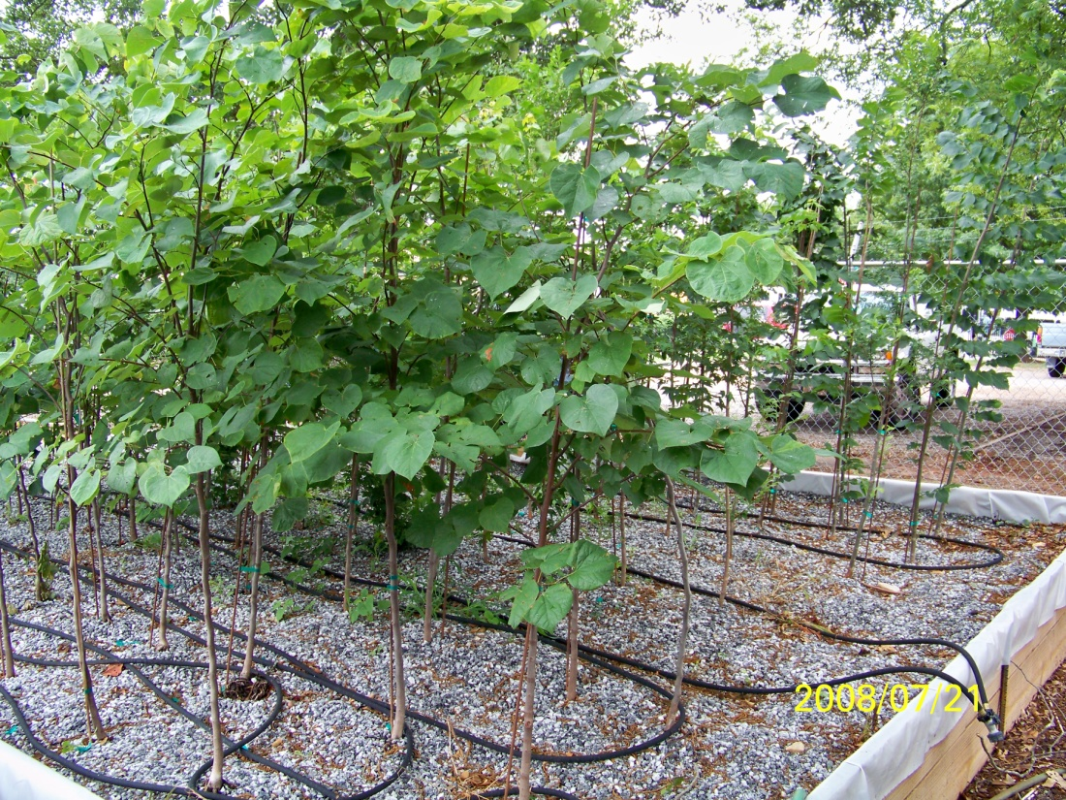
Growing and Maintaining Trees
Gravel = macropores
Water requirements
  4 times per day
  3-4 minutes per cycle
Nutrient requirements
  Slow release fertilizer
    Osmocote 14-14-14
  2 applications per year
    May – 3 lbs/1000 ft²
    August – 1.5 lbs/1000 ft²
Notes:
Because of the macropores inherent from using gravel as a growth medium, water and nutrients needed to be supplied. We used a 3 to 4 minute water cycle four times per day and we provided slow-release fertilizer twice during the growing season. In May, we applied complete fertilizer at a rate of 3 lbs N per 1000 sq. ft. In August, we supplemented that initial fertilization with 1.5 lbs N per 1000.

Slide 17
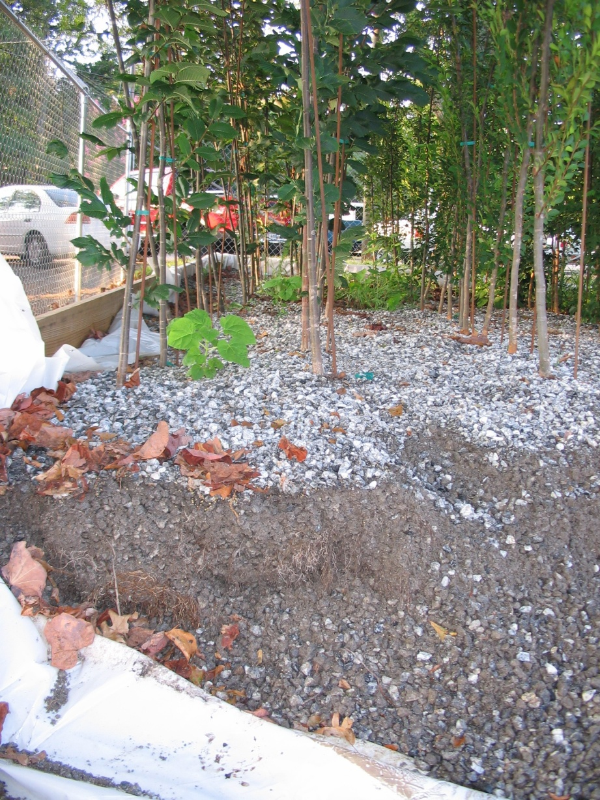
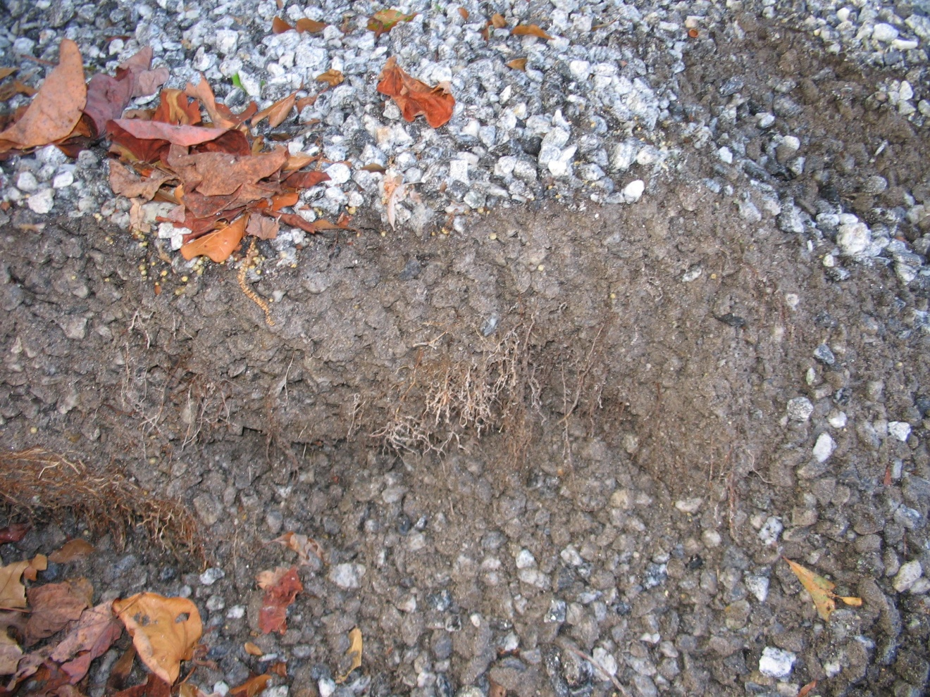
Lifting Operation - August 24, 2011
  Removal of framing
Notes:
Although later than we had originally anticipated, we lifted our first set of trees to be out-planted in August. After removing a portion of the wooden frame so that a bobcat could gain access to the selected trees, we saw that roots had grown to the frame some 24” from the first row of trees.

Slide 18
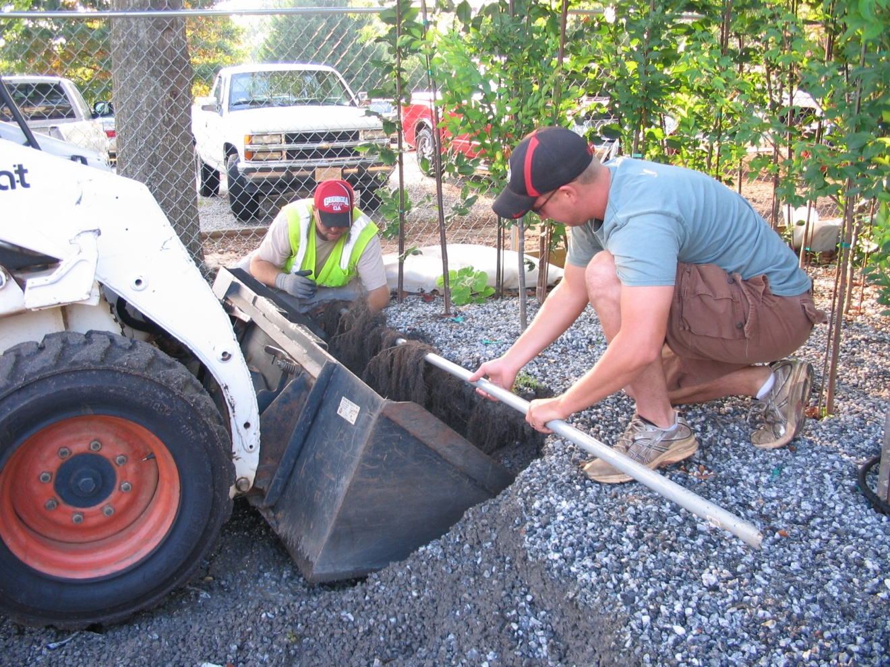
Lifting Operation - August 24, 2011
Bobcat with front-end bucket – not very efficient
Notes:
We tried using a bobcat with a bucket to lift our trees, but roots got in the way and the gravel too heavy for the equipment. We had to remove small amounts of the gravel to get at the trees. It was not very efficient. Here we had to hold roots out of the way to prevent them from being damaged or severed while lifting.

Slide 19
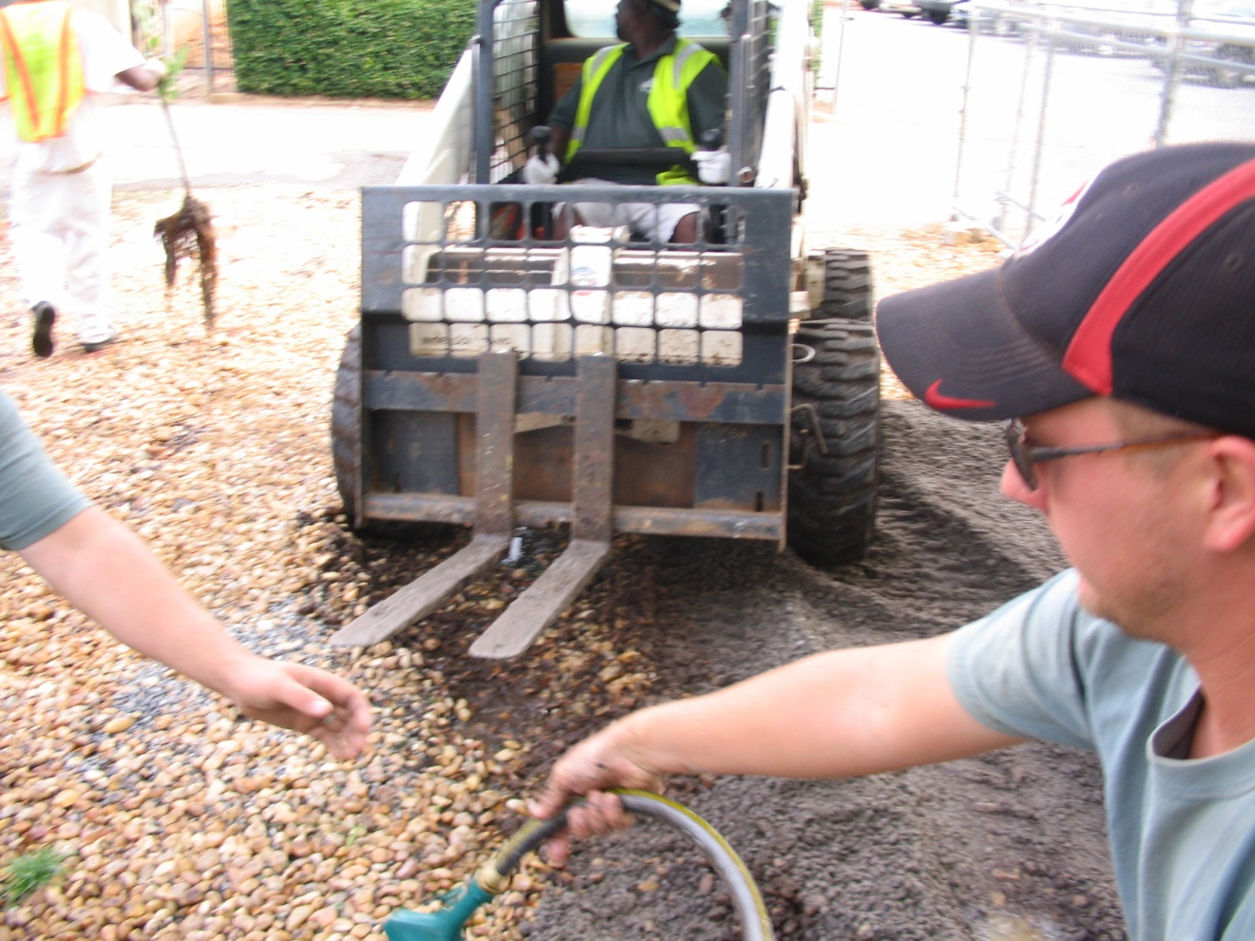
Lifting Operation - August 24, 2011
Replaced bucket with lifting tines
Notes:
We decided to change the bucket for lifting tines to improve lifting efficiency.

Slide 20
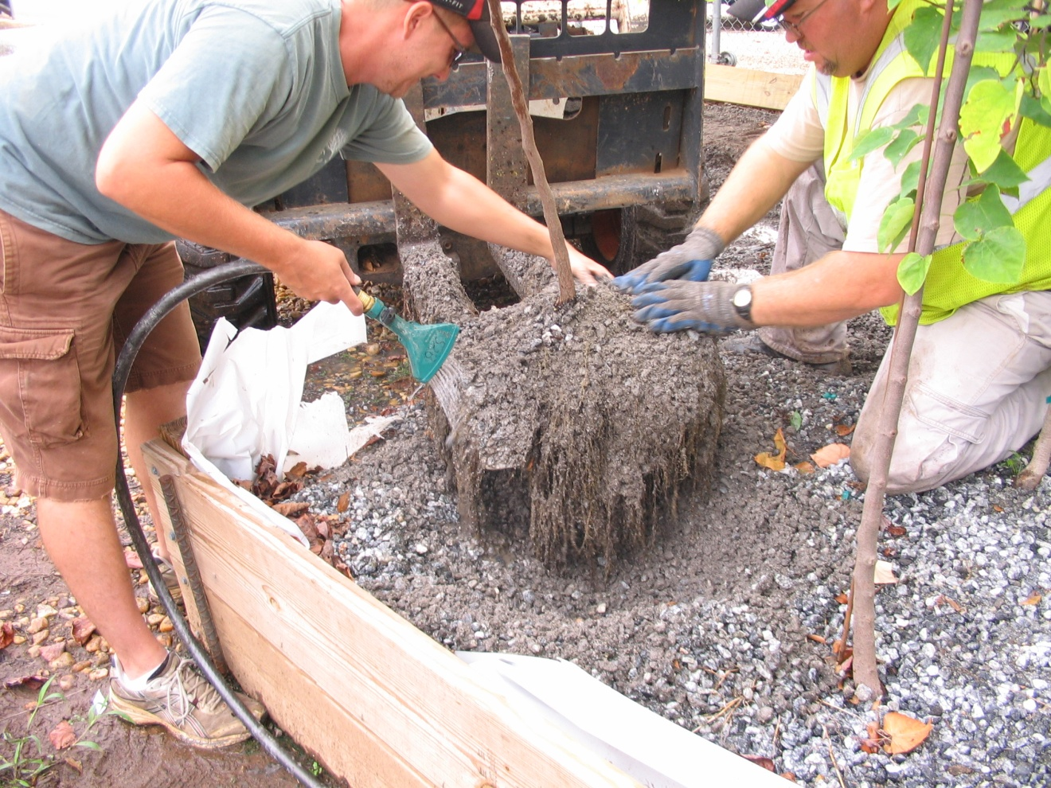
Lifting Operation - August 24, 2011
Copious amounts of water needed to remove gravel from roots
Notes:
We improved our efficiency for lifting, but as we anticipated, the gravel because of its angular structure was contained by the fibrous roots. We had to use a lot of water to help remove as much of the rocks as possible.

Slide 21
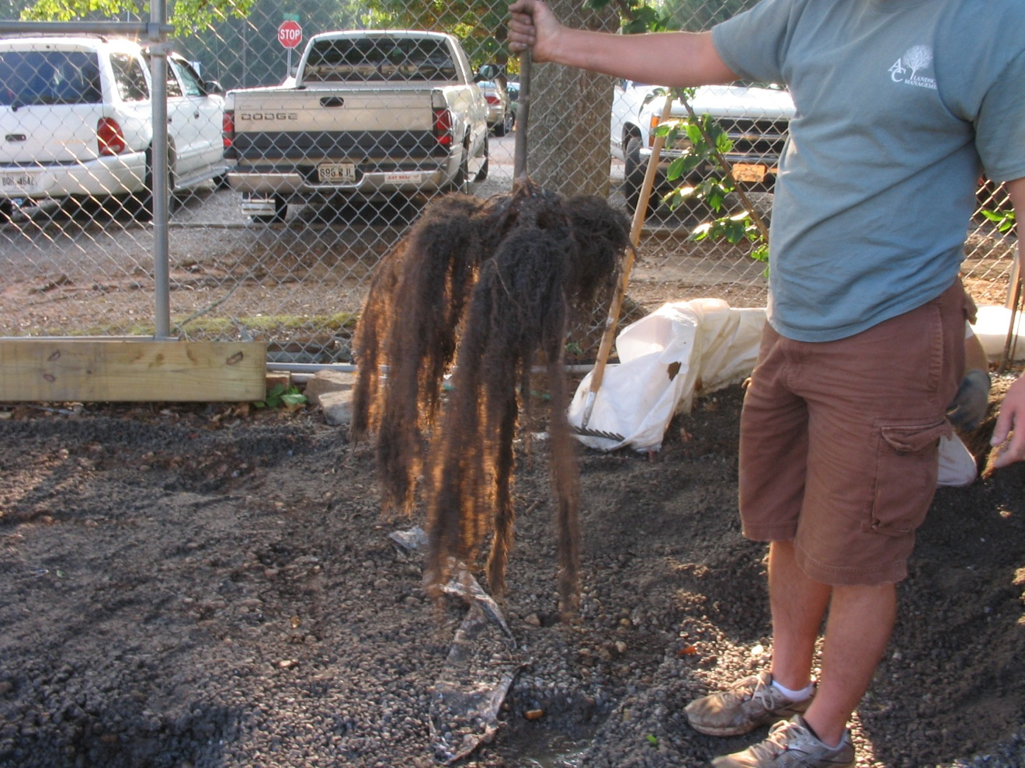
Lifting Operation - August 24, 2011
Typical root structure of lifted trees
Princeton elm
Notes:
Here is a typical root system for the lifted trees. This particular tree is Princeton elm.

Slide 22
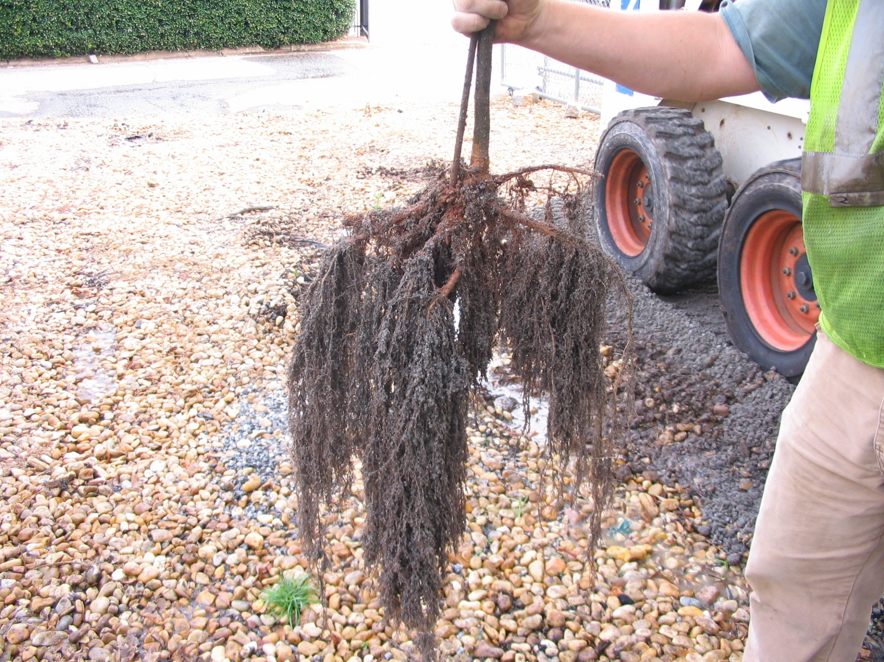
Trident Maple
Notes:
Here is a root system for trident maple

Slide 23
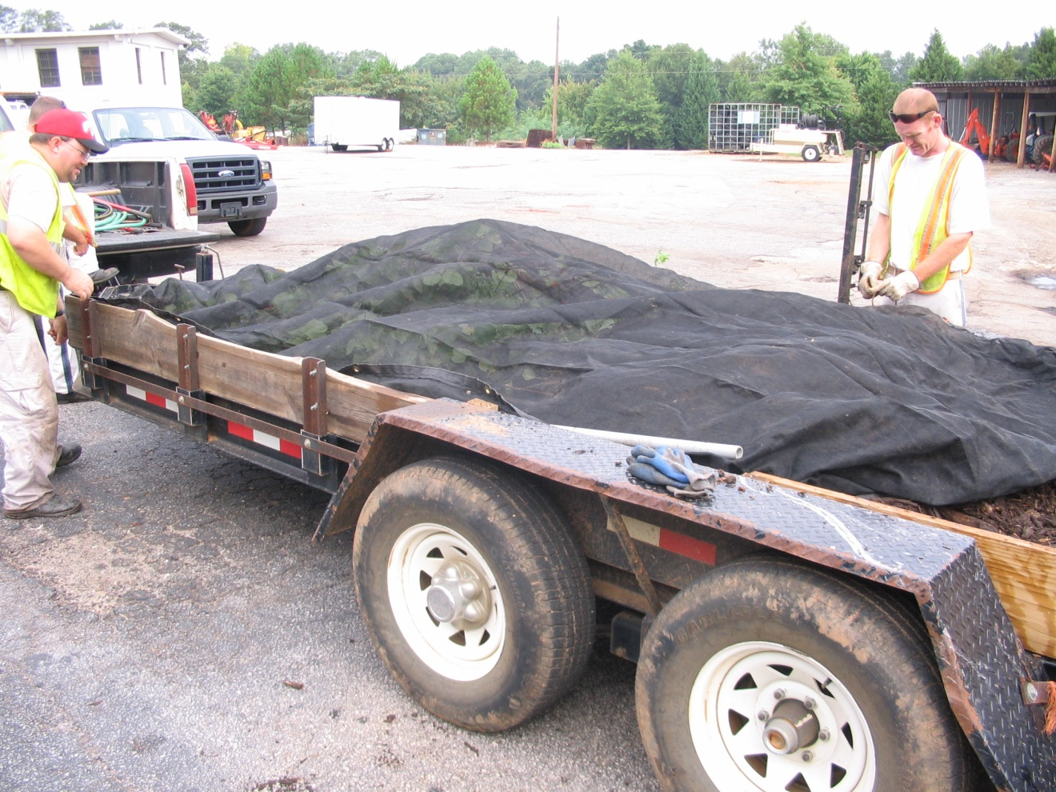
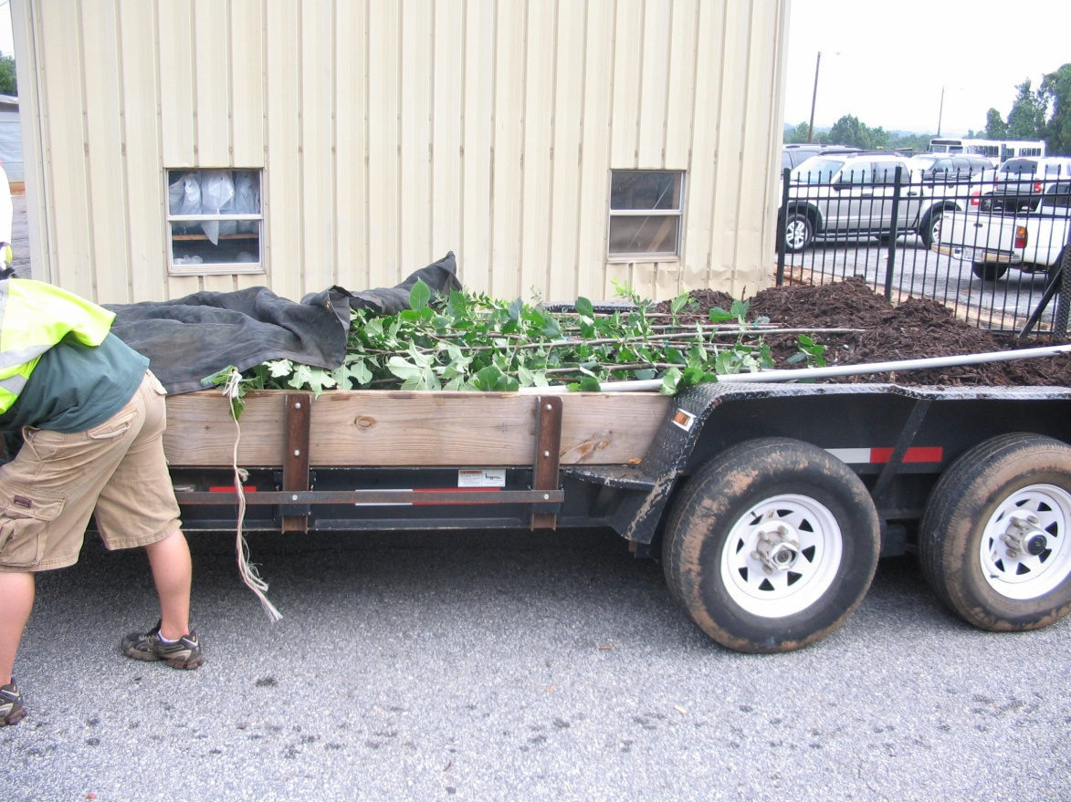
Moving trees to the planting site
Roots were covered with moist mulch
Trees were protected from the wind
Notes:
To prevent desiccation of roots while transporting the trees to their out-planting location, roots were covered with moist mulch and the tree leaves were protected from the wind with landscape cloth.

Slide 24
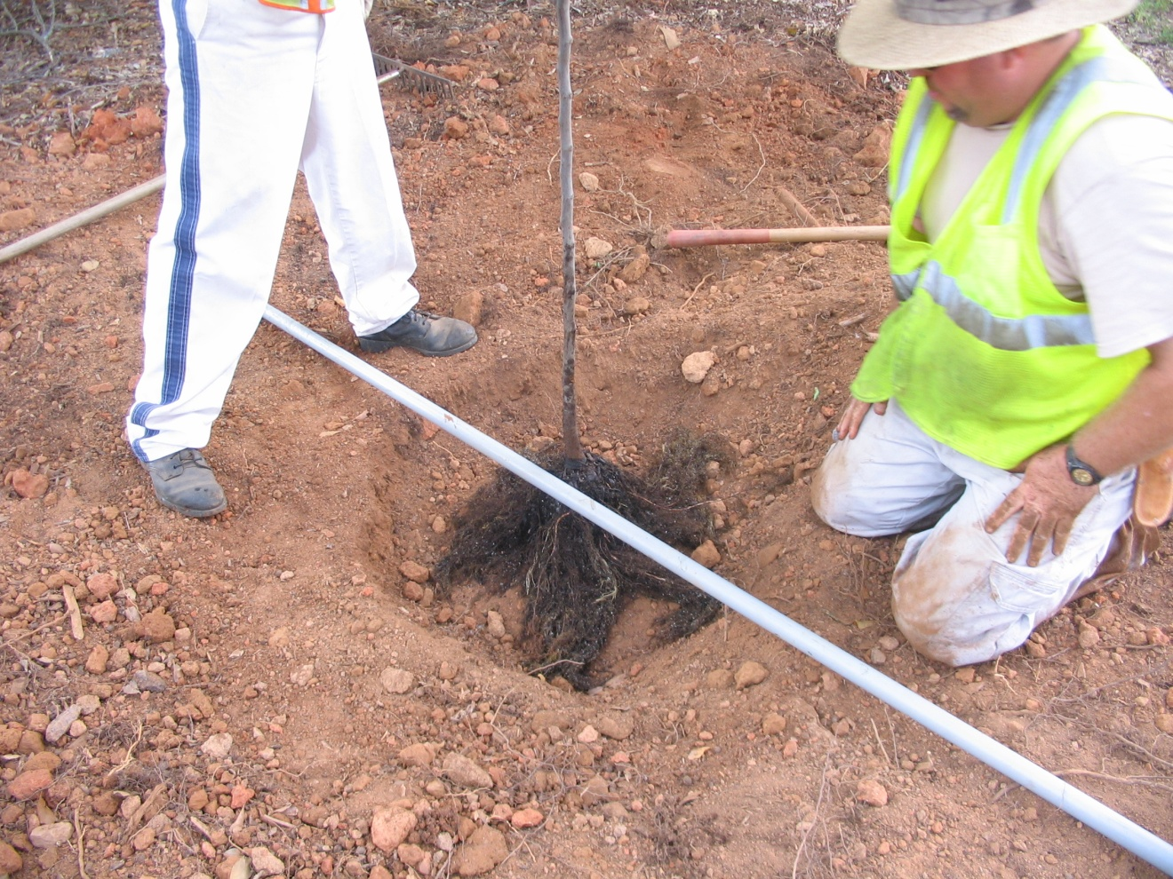
Planting operation – August 24, 2011
Very dry conditions
Ensure adequate soil moisture before planting
Notes:
The soil conditions at the planting location were very dry. I would recommend providing moisture to the soil before putting the roots in the planting holes. I would also recommend building a soil-pyramid in the center of the hole to make sure the root collar stays above grade while the remaining roots buried deeper in the soil profile.

Slide 25
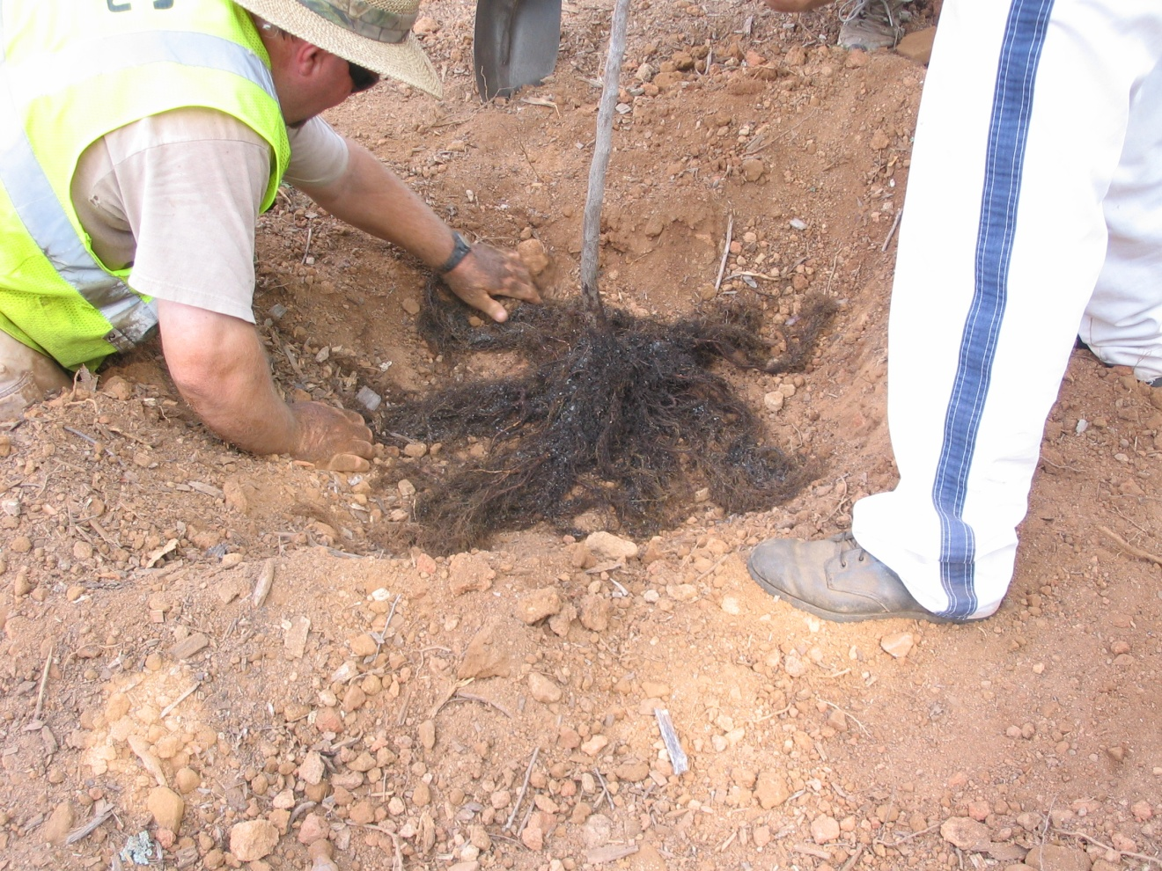
Planting operation – August 24, 2011
Position roots to avoid kinks or circling roots
Notes:
Ensure there are no circling or kinked roots by positioning them in the planting hole.

Slide 26
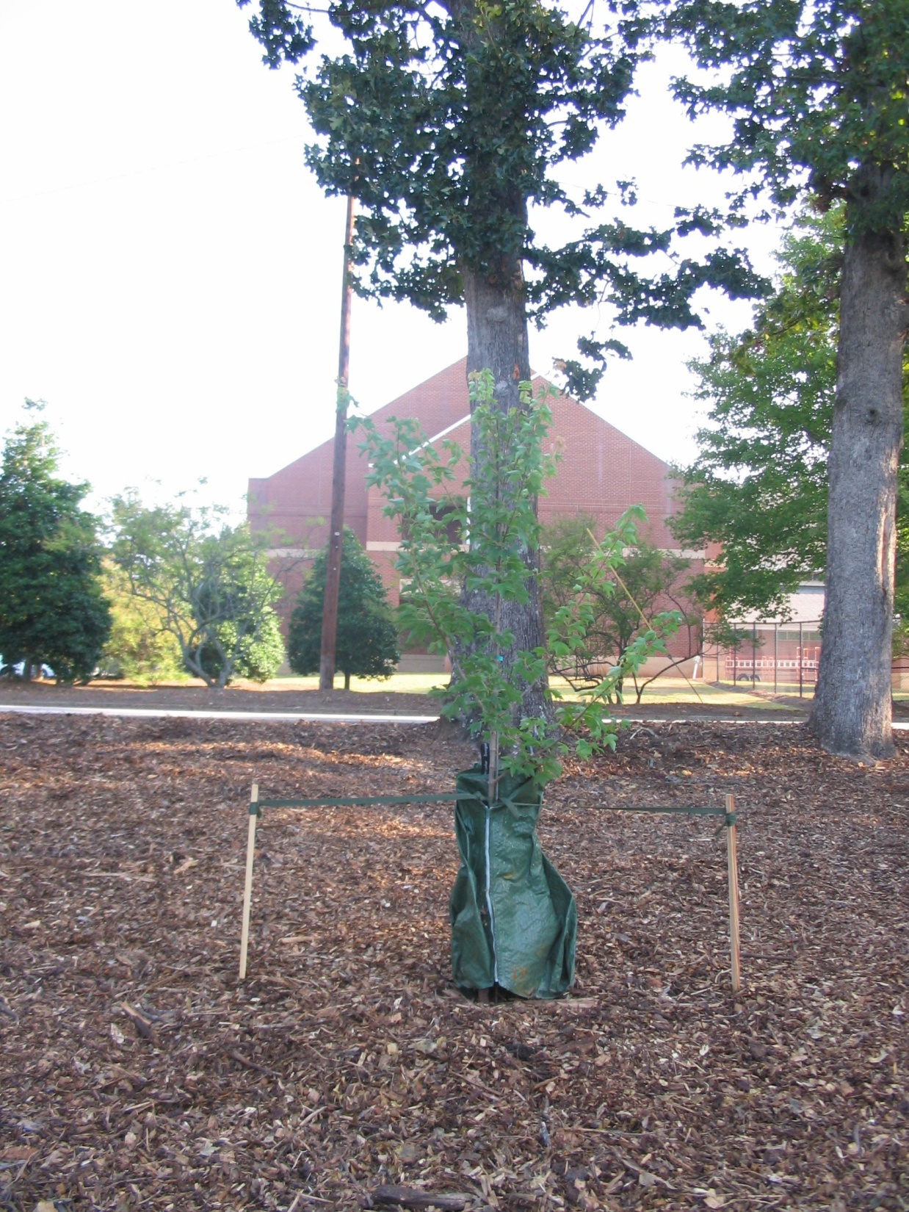
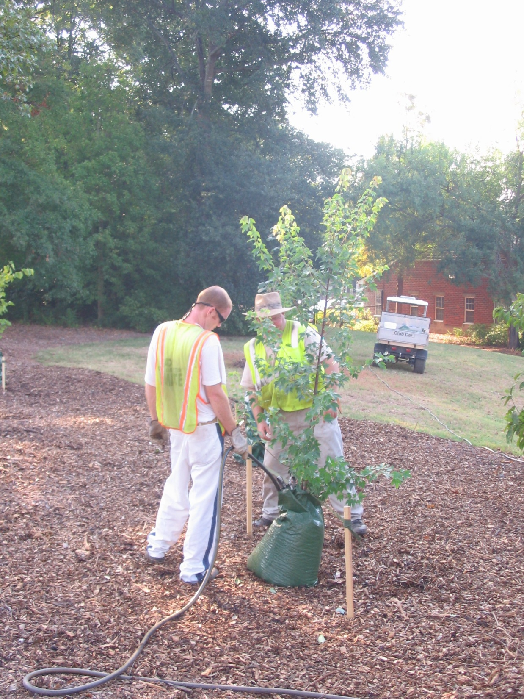
Notes:
Finish off by mulching, staking, and watering. I prefer a lower profile watering bag to avoid unnecessary pressure against the tree’s stem.

Slide 27
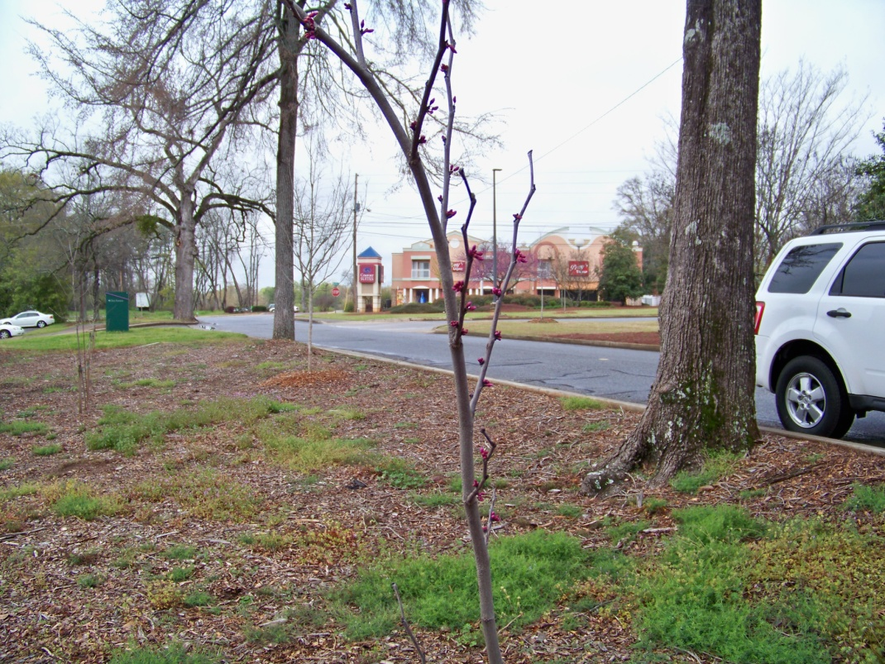
Gravel Bed Preliminary Results
Princeton elm – 8
Trident maple – 3
Chinese elm – 4
Eastern redbud – 3
100% survival as of 2/12
Avg HT = 7.7’
Avg caliper = 0.8”
Severe redbud damage in bed
March out-planting
Notes:
As of Feb. 2012, we observed 100% survival of those trees planted in August. The average height for all out-planted trees was 9.1’ and the average caliper diameter was 0.8”. After out-planting last August, the bed irrigation system was inadvertently turned off for two weeks resulting in severe crown dieback for the redbuds.
Nine American elm and 7 Chinese elm were planted this March in a couple of parks around Athens. Some of the Chinese elm had begun to leaf-out. We will follow their progress to see if this has an effect on their survivability.

Slide 28
Review Lessons Learned
Use river rock
  Granite holds onto roots too tightly
Use less sand in the gravel bed
  For helping with moisture retention only
Ensure field-grown liners
  For better root structure/orientation
  Do not use “bare-rooted” container trees
Reduce solar intensity with shade cloth
Monitor gravel bed moisture levels often
Ensure adequate soil moisture before planting

Slide 29
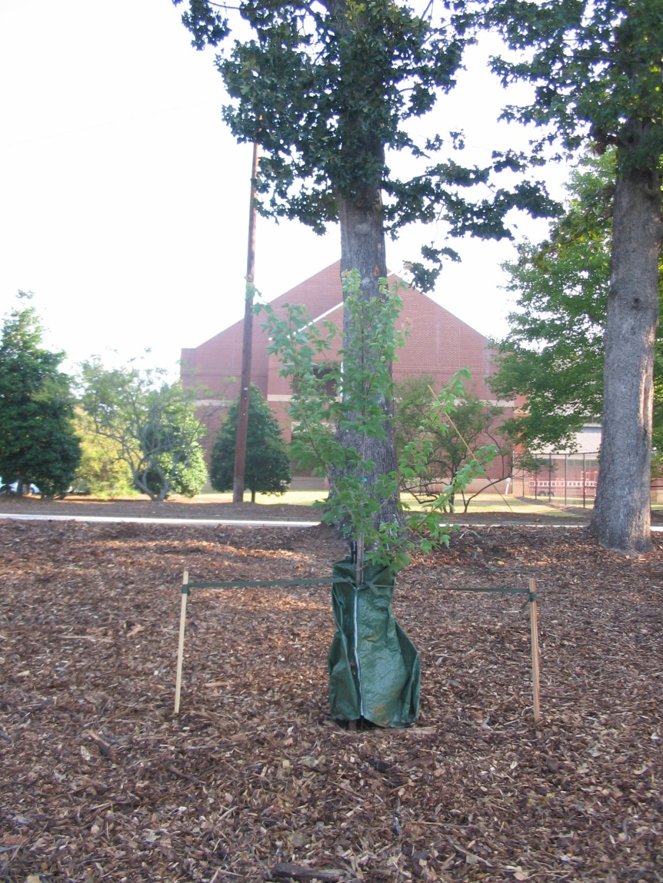
Future Plans
Out-plant remaining trees later this year
  Late-May or early June
Annual measurements
  Diameter, HT, condition
Reconstruct gravel bed
  Using river rock
  Less sand
Grow smaller seedlings from GFC
Test larger trees grown in bed

Slide 30
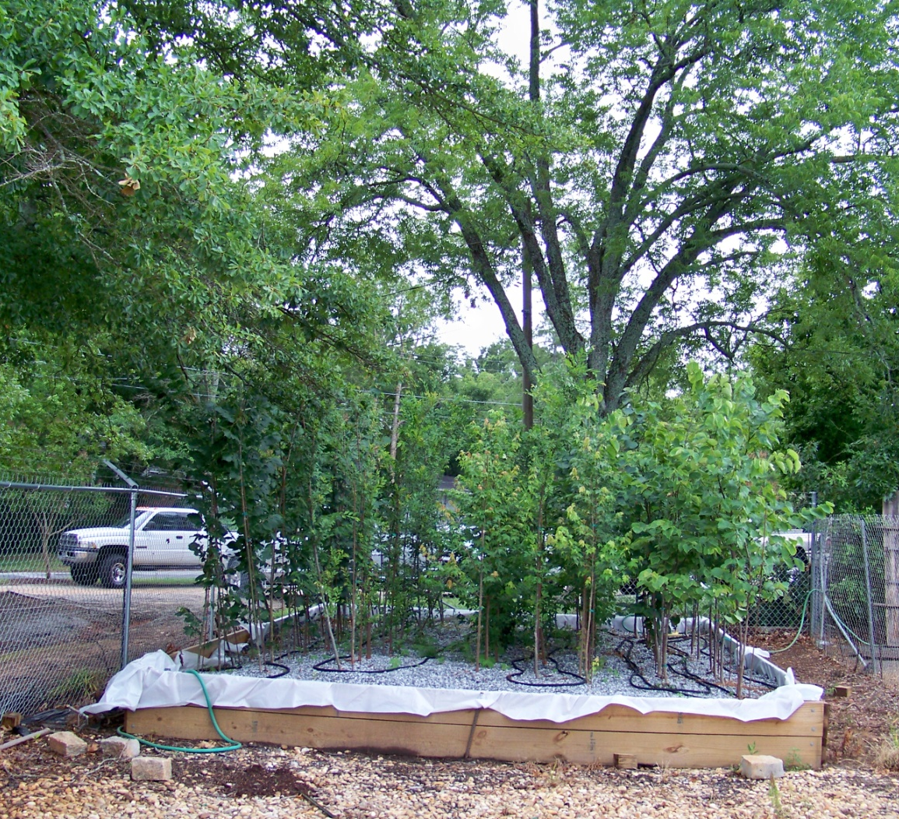
Acknowledgements
Andrew Saunders
  Athens Urban Forester
Roger Cauthen
  ACC Director of Landscape Services

Slide 31
Extending the Bare Root Tree Planting Window in the South
Using a Gravel Bed to Grow Fibrous Root Systems
Eric Kuehler
Urban Forestry South
U.S. Forest Service
ekuehler@fs.fed.us

