Slide 1



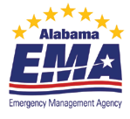

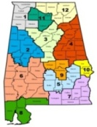

Vegetative Risk Management Plan Template
Details for Development by Section
Notes:
This project is a partnership among CARPDC, Alabama Emergency Management Agency (AEMA), Society of Municipal Arborists (SMA) and Alabama Association of Regional Commissions (AARC) with USDA Forest Service providing technical oversight on behalf of NUCFAC.
I want to recognize for the GIS tool (UTRI) application development Abi Dhakal – GIS Specialist with the Alabama Forestry Commission – formally with Central Alabama Regional Planning and Development Commission and Reggie Franklin – GIS specialist with Central Alabama Regional Planning and Development Commission.
This project was recommended for funding by the National Urban and Community Forestry Advisor Council (NUCFAC) and was developed as a collaboration tool to engage UF professionals and EM on a regional level. Regional Planning agencies across the country are often a resource to bring these various professionals together to form collaborative strategies to find solutions for regional initiatives. They also often have on staff the professionals and resources capable of providing the technical expertise required to conduct the GIS application developed and discussed today. In addition, Regional Planning agencies are often involved in developing the required natural hazard mitigation plans for counties in their regions and with the subsequent required five year updates.
“This project was funded in whole or in part by the U. S. Forest Service’s Urban and Community Forestry Challenge Cost Share Grant Program, as recommended by the National Urban and Community Forestry Advisory Council”
“The United States Department of Agriculture (USDA) prohibits discrimination in all its programs and activities on the basis of race, color, national origin, gender, religion, age, disability, political beliefs, sexual orientation, and martial or familial status. (Not all prohibited bases apply to all programs). Persons with disabilities who require alternative means for communication of program information (Braille, large print, audiotape, etc.) should contact USDA’s TARGET Center at 202-720-2600 (voice and TDD).”

Slide 2
Handouts
VRMP Template
Verification and Inspection Worksheet - Excel Spreadsheet
UTRI pdf – Steps to implementation
Notes:
This power point makes reference to the VRMP Template, Verification and Inspection Worksheet, and the UTRI detailed instructions. They are all available for download by visiting the Urban Forestry South
website http://www.urbanforestrysouth.org/ and search for
“VRMP or Vegetative Risk Management Plan” or “UTRI” to find the document
(Urban Tree Risk Index Model & the UTRI Data Process and GIS Tool Description)
with detailed step by step instructions on how to develop the GIS model.

Slide 3
Presentation Outline
VRMP Role in Natural/Hazard Mitigation Plans
VRMP Goals and Expected Outcomes
VRMP Template
Details by Section
Introduction
Purpose and Need
Overview of the County
The UTRI Results
Outcomes
Debris Staging Areas
Next Steps
Notes:
In this presentation I will discuss a the Natural/Hazard
Mitigation Plans and how a Vegetation Risk Management Plan can work within that framework.
Also the goals and expected outcomes from instituting a VRMP.
I will then go into the details that the VRMP will include by section.
The template for the VRMP is available for download as well as the excel spreadsheet
worksheet I will show. They are both adaptable to your needs.

Slide 4
Vegetation Risk Management Planning
Disaster Planning
Requirements
– Natural Hazard Mitigation plans
Strategies
Notes:
I want to start with a brief overview of the Vegetation Risk Management Plan and
how it fits into a counties Natural Hazard Mitigation Plan and how the VRMP can be a
strategy to mitigate many of the natural disasters experienced on a county level… from high
winds, ice storms, hurricanes, thunderstorms to wildfires.
This project was developed with a regional look in mind and with the idea that regional
planning agencies can provide the tools and resources and the ability to convene the
different professionals, government “players”, etc that are required to complete the
hazard mitigation plans.
The VRMP is a strategy within the mitigation plan to help meet the goals and objectives
for the hazards identified.

Slide 5

Vegetative Management Plan
Reduce the impact of storms on the urban forest
Lessen personal injuries and property damage
Decrease emergency management costs
Notes:
The goals of the Vegetative Management Plan template.

Slide 6
Vegetative Risk Management Planning
What to expect from the VRMP
Lower tree risk
Comprehensive disaster planning (e.g. debris)
Path to urban tree risk management program
Comprehensive urban forest management
Notes:
What to expect from VRMP implementation
Lower (or known) tree risk locations
Information to support more comprehensive disaster
planning such as debris staging sites
Path to urban tree risk management program – which
is a more detailed tree risk management plan on the local level
More comprehensive UF management (e.g. planting site
evaluation includes disaster element)

Slide 7
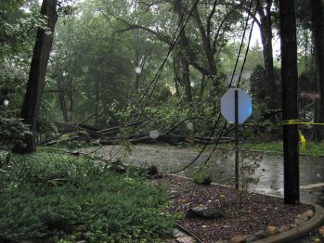
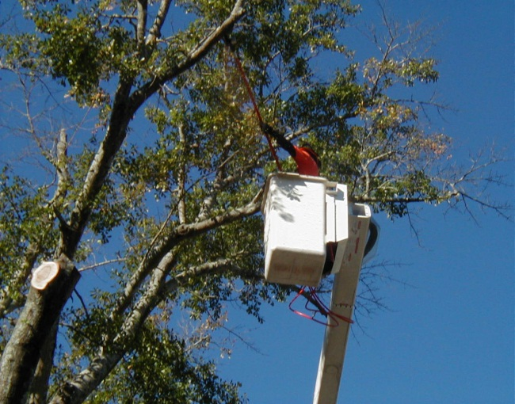
VRMP Template – By Section Step 1 -Introduction
Introduce the VRMP
Tool to assist reduction debris and increase public safety
Urban tree canopy condition
Better management both tree and EM
Notes:
Step 1 in the template is the Introduction. Here the Vegetation Risk Management
Plan (VRMP) and its purpose will be introduced.
The VRMP is developed as a tool to assist in reducing vegetative debris following
a storm event and increase public safety.
The VRMP also aids in maintaining optimum urban tree canopy, promoting tree health,
providing for the management, both emergency and arboriculture, and decreasing
emergency management costs.
The VRMP is a living and dynamic plan that should be reviewed, evaluated, and updated
periodically and especially after major storm events that have altered the tree canopy
in a major or significant manner.
Developing and adopting a VRMP for your community or area of interest will decrease
emergency management costs, reduce the likelihood of damage from tree debris,
and reduce the overall impact of major storms on the urban forest.
Trees and the debris accumulated from their destruction is the number one cost to
emergency management in the aftermath of a storm event.

Slide 8
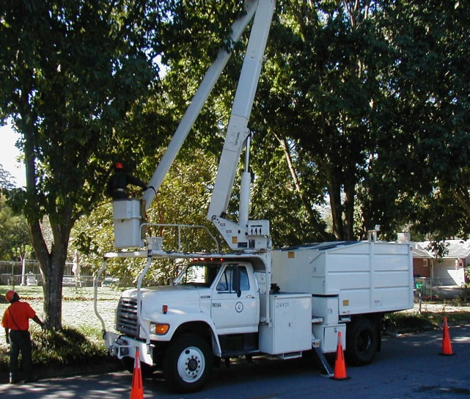
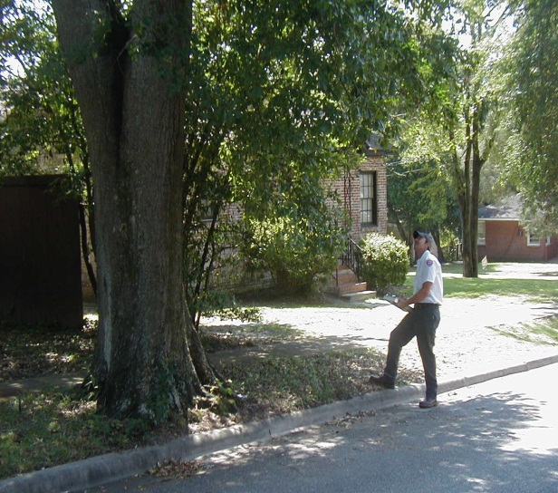
VRMP Template – By Section Step 1 -Introduction
Proactive Approach
Identifying and mitigating
Pruning , removal, or inspection
Establishing inspection schedules
Notes:
The VRMP is a proactive approach to identifying and mitigating trees
that are in need of pruning, removal, or inspection.
This plan will establish a schedule for areas that are most prone to limit
or block access to critical infrastructure located on or associated with major
transportation routes, including areas with the highest population.
The VRMP will be unique for your community or area of interest. All VRMP’s
will share the similarity of identifying the most prone areas as related to Emergency
Management and trees/vegetation. The plan is a beginning to a more detailed
community based urban tree risk management plan.

Slide 9
VRMP Template – By Section Step 2 –Purpose and Need
Describe the purpose and need for the county or area
Identify the sections within the Natural Hazard Mitigation Plan meets goals
Natural Hazard Mitigation Plans (NHMP) can be formatted differently.
Specific or implied
Notes:
Identify the sections within the Natural Hazard Mitigation Plan
where the VRMP can be utilized to meet specific goals outlined within the plan.
NHMP are often formatted differently. This leads to the need for a VRMP being listed
specifically as a mitigation action item or described as an implied need with the VRMP
meeting the needs of a goal.

Slide 10
VRMP Template – By Section Step 2 –Purpose and Need
Definitions:
A Goal is a general guideline that explains a desired result or outcome. Goals are broad policy statements representing global visions with long term results.
An Objective is a strategy or implementation step to attain an identified goal. Objectives are more specific than goals and can be measured.
A Mitigation Action is a specific action that helps achieve identified goals and objectives.
Notes:
The justification for developing a VRMP is often noted within the Natural Hazard
Mitigation Plan as goals, objectives, and mitigation actions.
See the definitions within the template:
Goal
Objective
Mitigation Action
The VRMP is a mitigation action used to implement objectives in Natural Hazard
Mitigation Plans for many US counties to meet the overall goals that they have identified.

Slide 11
Autauga County Hazard Mitigation Plan
Goal
Protect the citizens of Autauga County as well as public and private property from the impacts of natural hazards.
Objective Promote management and regulatory procedures that would reduce the impacts of hazards on public and private property
Action 1 Enforce forest and vegetation management policies.
Action 2 Enforce urban forestry and landscape management policies.
Action 3 Develop and implement a Vegetative/Tree Risk Management Plan
Action 4 Enforce best management practices.
Action 5 Enforce sediment and erosion control regulations.
Action 6 Enforce stream dumping regulations.
Action 7 Enforce wetlands development regulations.
Notes:
The VRMP might be specifically noted in an NHMP or implied . You will need to
search your area or county’s NHMP to find where the VRMP fits. NHMP are often
Shown by county on your states emergency management website. Often they
Are by region… to include several counties… thus our regional planning approach.
Here is an example from Autauga County Alabama’s hazard mitigation plan as
it relates to the natural hazards identified that include tornados, windstorms,
wildfires, thunderstorms and flooding – ravine/flash.
Very Specific

Slide 12
Elmore County, Alabama – 2009 Natural Hazard Mitigation Plan
Implied:
• Goal #1 – Develop and implement programs to keep trees from threatening lives, property, and public infrastructure during events
• Goal #2 – Enhance strategies for debris management events
The Vegetative Risk Management Plan fits as a mitigation action to meet the Immediate Goals
Notes:
Here is one that is implied and the VRMP fits as a mitigation action to meet
The immediate goals identified here….….. Keep trees from threatening lives,
Property, and public infrastructure during events… and enhance strategies
For debris management events.

Slide 13
VRMP Template – By Section Step 3- Overview of County or Area
Wording can often be taken from NHMP
Population
Growth of area over last 10 yrs.
Prior events such as thunderstorms and hurricanes
Take Hazard Exposure profile from NHMP
Include any Urban Forest Management
Notes:
This wording can often be taken from the county’s Natural/Hazard Mitigation Plan.
Items included can be: population, growth over 10 years, future growth potential,
prior events (thunderstorm and hurricane events for example), or similar statistical
information such as a hazard exposure profile – There is an example in the downloadable
Template.
Also include any current urban forest management activity, particularly urban tree risk
management that is being implemented that directly relates to tree risk mitigation and disasters.

Slide 14
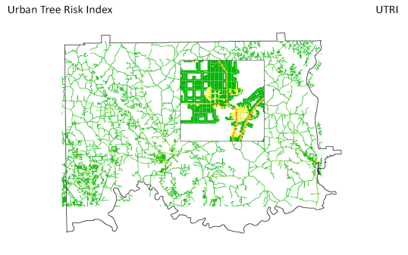
VRMP Template – By Section Step 4- Urban Tree Risk Index (UTRI) Results
3 parts to include
First is: Summary of layers
Notes:
3 parts to include here. Summary of the layers, areas that warrant further
evaluation and assessment for mitigation needs and areas of assessment and mitigation by table
First is the summary of layers.
The picture below is the summary of all layers for Elmore County and also a blow up detail from
downtown Wetumpka, Alabama. It shows the summary combination of all layers – to include
canopy, transportation, critical facilities, and population
The UTRI is color coded with red as the highest potential tree risk during a disaster

Slide 15
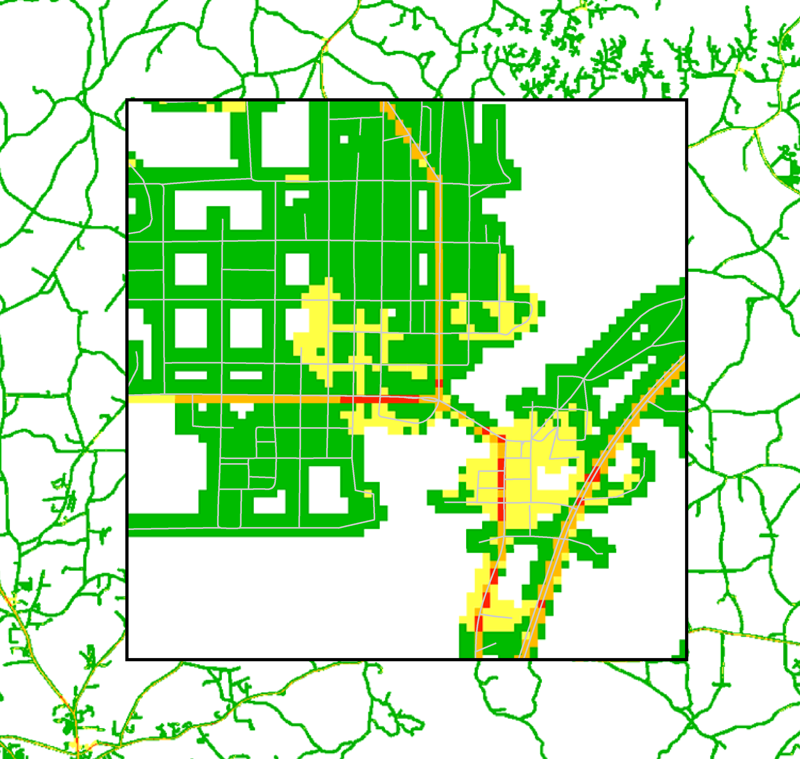
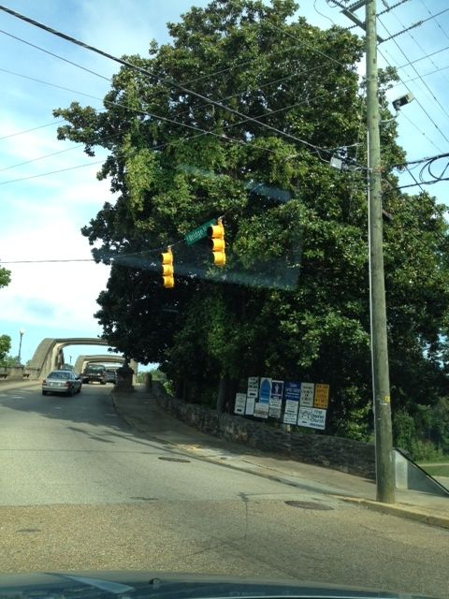
VRMP Template – By Section Step 4- (UTRI) Results
Second : Areas that Warrant Further Evaluation and Assessment for Mitigation Needs
Notes:
Second to include in this section are the areas that Warrant Further Evaluation
and Assessment for Mitigation Needs. Here is an image example.
The image demonstrates the area in Wetumpka that is located near the downtown
business district on a major transportation corridor. This area is a highly populated
area with several critical facilities including the 911 Emergency Management Agency.
Also shown is the presence of tree canopy that has a need for annual inspection to
evaluate the likelihood of tree failure.

Slide 16
VRMP Template – By Section Step 4- (UTRI) Results
Third: Areas of Assessment and Mitigation by Table
Notes:
The last to include in this section are Areas of Assessment and Mitigation by Table.
Explain the table and its use for field verification in this section.
Here is the image of the overall worksheet produced from the information derived from
the UTRI. The user will complete up to the inspection level and include that detailed
Information in the next section.
This table is used during field verification to verify that the UTRI ranking is correct or
not at each location and to notate necessary mitigation required, if any.
If the UTRI ranking is not correct it will be necessary to adjust the ranking to a higher or
lower ranking which in turn will change that road segments’ inspection schedule accordingly.
The worksheet, which includes Right of Way Road Segments listed by priority (very high,
high, moderate, and low), utilizes initial tree evaluations and mitigation steps recommended
and completed.
After field verifications are made, the results for action needed are placed in the Mitigation column
The worksheet therefore guides the mitigation work. Mitigation might include pruning, removing,
or taking no action. Mitigation, if any, will be listed in the Mitigation column. Of course, a detailed
spreadsheet or another mechanism of tracking work planning will need to be developed or tallied to
total number of trees for prunes and removals as well as size of tree by caliper, etc.

Slide 17
VRMP Template – By Section Step 5- Outcomes
❶
First:
Check and verify UTRI index number
If the assessor finds the index to be incorrect when doing a visual assessment in the field, then the new index number is placed here and the corresponding inspection schedules made
Notes:
The Outcomes section consists of the Field Verification part of the worksheet
and the inspection schedule. This section will show the details of the overall
worksheet we just talked about.
The field verification part has three items:
1. Check and verify UTRI index number
2. Field check for mitigation and, if any is necessary, at each road segment
3. The worksheet is used to track the mitigation needed and completion date
So First you go to the field and check and verify the index number. For Example
The UTRI has a road segment coded a 18 for a very high area of risk and calls
For annual inspections. Your field verification determines it to be a moderate
Ranking of 12 which gives it now an inspection schedule of 1-2 years.

Slide 18
VRMP Template – By Section Step 5- Outcomes
❷
Second:
Field check for mitigation and, if any is necessary, at each road segment. The worksheet can be sorted to have each road segment by name, regardless of UTRI ranking, listed together
Results of mitigation will include pruning, removing, or taking no action
Notes:
While in the field verifying the UTRI index the user will check for any mitigation,
if any, at each road segment. Remember the road segments can be sorted by
road name and not just inspection or UTRI ranking for efficiency in the field.
This is where a more detailed record keeping spreadsheet might be useful to the
user so as to maintain by road segment the number of prunes, removals, and further
inspection needs by class size.

Slide 19
VRMP Template – By Section Step 5- Outcomes
❸
Third:
The worksheet is used to track the mitigation needed and completion date
Keep track of dates mitigation is complete
Notes:
The third section allows for the tracking of completion of mitigation

Slide 20
VRMP Template – By Section Step 5- Outcomes
Inspection Schedule
Notes:
The same worksheet will also be placed here with noted frequency of inspection
listed by each.
The areas identified by the UTRI model that are Very High (red) are inspected
yearly with any developments or requirements for mitigation noted and acted upon.
Areas identified as High (orange) are inspected every 1-2 years, Moderate (yellow)
areas every 3-5 years, and Low (green) areas every 5-7 years. Note on the worksheet
that all road segments, at a minimum, get a drive by windshield survey after a severe
storm event. You will most likely find trees in need of removal or pruning during the
scheduled inspections.

Slide 21
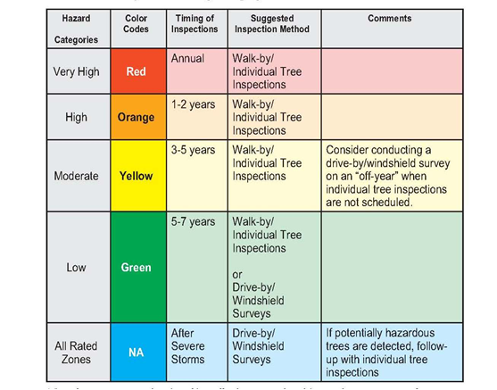
Notes:
You have seen this before in all of the presentations.
The inspection schedules and descriptions of those inspections are derived from
Urban Tree Risk Management – A Community Guide to Program Design and
Implementation developed by the USDA Forest Service
(NA-TP-03-03; 2003, USDA Forest Service, Northeastern Area St, Paul, MN, J
ill D. Pokorny, Editor
You can see from the information so far that the VRMP is a living and dynamic
plan that can change as needed. By following this plan you have identified your
most prone areas as they relate to emergency management, disaster response, and tree risk.
This plan is the beginning to a more detailed community based tree risk management plan.

Slide 22
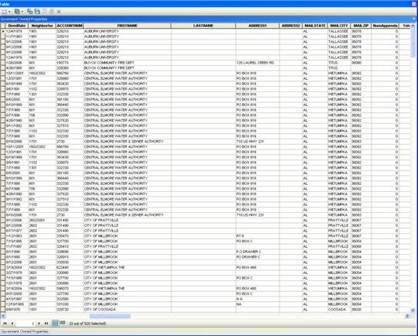
VRMP Template – By Section Step 6- Potential Debris Staging Areas
Notes:
One of the added benefits of utilizing the URTI and its supporting GIS layers
(e.g. parcel file that includes publicly owned property) is developing a portion of a
debris management plan to identify potential staging areas.
Shown here is a parcel file used while developing the UTRI. The parcel file can
identify parcels with any number of considerations. Most common
would be: access, size of parcel, whether it is cleared or wooded, as well as
proximity to areas closest to population centers
and significant areas of highest UTRI risk for tree (debris) failure.
This slide shows an attribute table utilizing a parcel file used to find property
locations within the county that belonged to local, county, state or school boards.
These were then identified in red on the next slide.

Slide 23
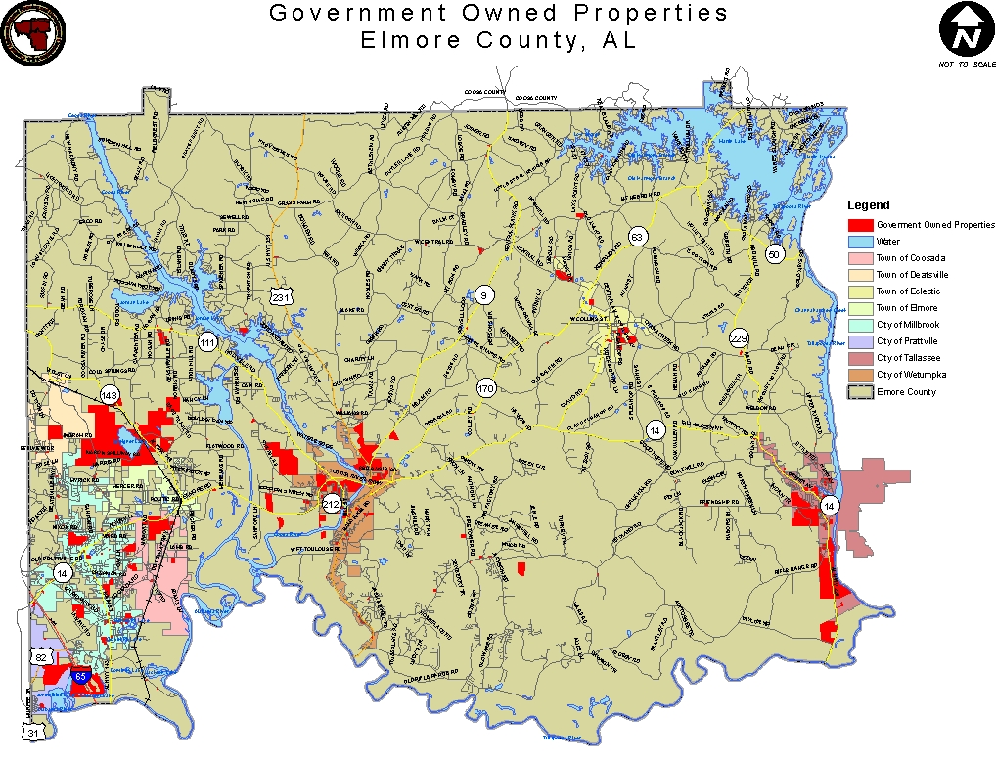
Notes:
In this example: All of the properties in red are local, county, state
or school board owned. The debris staging sites are then linked
to the most populated areas as well as the areas with the most canopy.
Over 12 sites were identified as viable throughout the county.
If public property is not sufficient, then large, suitable tracts of
private property can possibly be located for contracting.

Slide 24
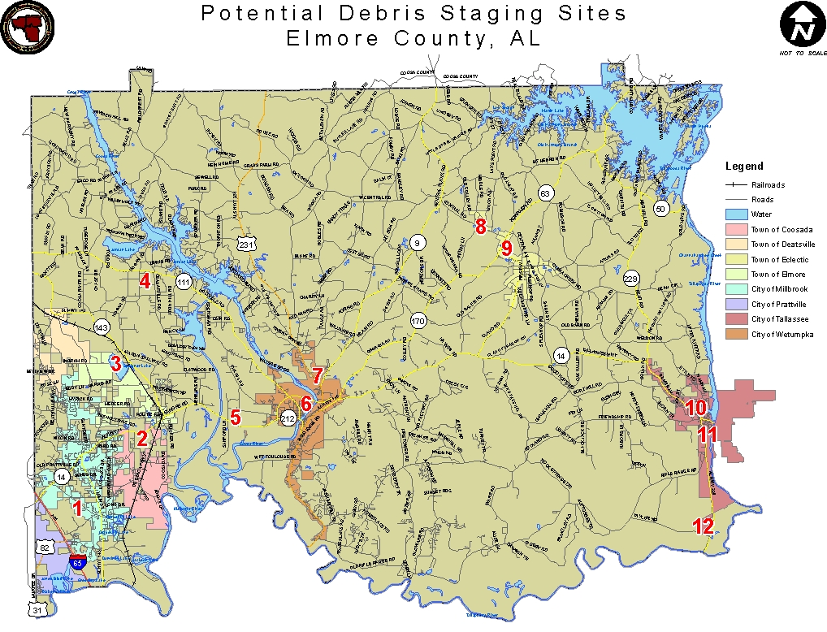
Notes:
This sites shows the 12 most viable debris staging sites that can then
be related to population density, tree canopy, road access, or the UTRI index
by street segment.

Slide 25
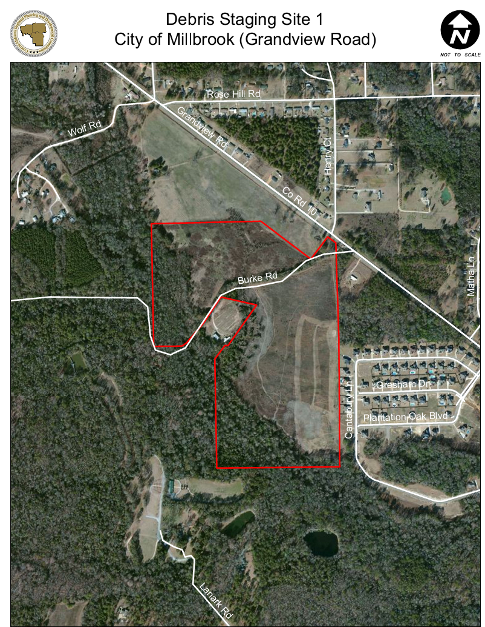
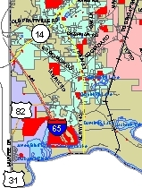
1
Notes:
This is an example within the City of Millbrook. This site is currently
owned by the school board for a future school. It is open pasture
primarily with access to a state highway.

Slide 26
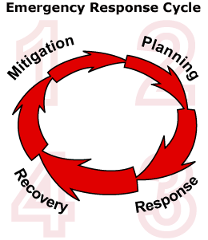

VRMP Template – By Section Step 7- Collaborative Strategies
How to incorporate urban forestry into Emergency Management and Debris Management
Meet FEMA standards for mitigation, planning, response, and recovery AND arboriculture industry performance standards
Notes:
Include in this section additional opportunities for urban forestry professionals
and emergency managers to work together to provide additional benefits to
the VRMP as it relates to mitigation/planning, response, and recovery. Take some
Time to identify programs and processes to work towards and to improve
the UF program while providing added value to Emergency Management.
These collaborative strategies strengthen a community’s emergency management
and urban forest while protecting the citizens as well as public and private property
from the impacts of natural hazards.
The Template has many opportunities identified and listed with explanations.
Also go to Visit the Urban Forestry South website http://www.urbanforestrysouth.org/
and search for “VRMP or Vegetative Risk Management Plan” to find information
and webinars discussing each of the collaboration methods described below.

Slide 27

VRMP Template – By Section Step 8- Next Steps
Update the VRMP every five years
in conjunction with the Natural /Hazard Mitigation Plan
The mitigation planning requirements of 44 Code of Federal Regulations, Section 201.6 (d) (44 CFR 201.6(d) require that local hazard mitigation plans must be reviewed, updated to reflect changes in development, progress in local mitigation efforts, and changes in priorities, and reapproved every five ears for local jurisdiction to be able to receive hazard mitigation funding
Notes:
The last area to highlight includes next steps and in particular, the timing of updating the VRMP
This process fits into the Natural Hazard Mitigation Plan update required every five years.
As populations change, critical infrastructure and the tree canopy change. The VRMP provides
a basis to manage the vegetation as it relates to Emergency Management.
Urban Foresters and Emergency Managers will continue to see changes in their identified needs
as they collaborate and work together to help Emergency Managers meet the overall need of
increasing safety and reducing the cost of clean-up. These changes will ultimately lead to the
improvement of overall health of the urban forest and increasing worth of an Urban Forestry program.
Therefore, the two, the Hazard Mitigation Plan and the VRMP, work hand in hand.

Slide 28
Vegetative Risk Management Plan Template
Details for Development by Section
Notes:
For questions please contact Rachel Barker at RBarker3@arbormetrics.com
“This project was funded in whole or in part by the U. S. Forest Service’s Urban and Community Forestry Challenge Cost Share Grant Program, as recommended by the National Urban and Community Forestry Advisory Council”
“The United States Department of Agriculture (USDA) prohibits discrimination in all its programs and activities on the basis of race, color, national origin, gender, religion, age, disability, political beliefs, sexual orientation, and martial or familial status. (Not all prohibited bases apply to all programs). Persons with disabilities who require alternative means for communication of program information (Braille, large print, audiotape, etc.) should contact USDA’s TARGET Center at 202-720-2600 (voice and TDD).”

