Slide 1



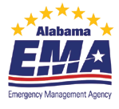
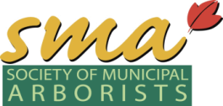
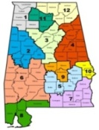

Debris Management
Staging Areas
Utilizing Urban Tree Risk Index (UTRI) GIS Tool
Notes:
This project is a partnership among CARPDC, Alabama Emergency Management Agency (AEMA), Society of Municipal Arborists (SMA) and Alabama Association of Regional Commissions (AARC) with USDA Forest Service providing technical oversight on behalf of NUCFAC. The GIS tool (UTRI) application development by Abi Dhakal – GIS Specialist with the Alabama Forestry Commission – formally with Central Alabama Regional Planning and Development Commission and technical assistance by Reggie Franklin – GIS specialist with Central Alabama Regional Planning and Development Commission. Overall project development by Rachel Barker – Project Manager with ArborMetrics Solutions, Inc. - formally with Central Regional Planning and Development Commission.
This project was recommended for funding by the National Urban and Community Forestry Advisor Council (NUCFAC) and was developed as a collaboration tool to engage UF professionals and EM on a regional level. Regional Planning agencies across the country are often a resource to bring these various professionals together to form collaborative strategies to find solutions for regional initiatives. They also often have on staff the professionals and resources capable of providing the technical expertise required to conduct the GIS application developed and discussed today. In addition, Regional Planning agencies are often involved in developing the required natural hazard mitigation plans for counties in their regions and with the subsequent required five year updates.
“This project was funded in whole or in part by the U. S. Forest Service’s Urban and Community Forestry Challenge Cost Share Grant Program, as recommended by the National Urban and Community Forestry Advisory Council”
“The United States Department of Agriculture (USDA) prohibits discrimination in all its programs and activities on the basis of race, color, national origin, gender, religion, age, disability, political beliefs, sexual orientation, and martial or familial status. (Not all prohibited bases apply to all programs). Persons with disabilities who require alternative means for communication of program information (Braille, large print, audiotape, etc.) should contact USDA’s TARGET Center at 202-720-2600 (voice and TDD).”

Slide 2
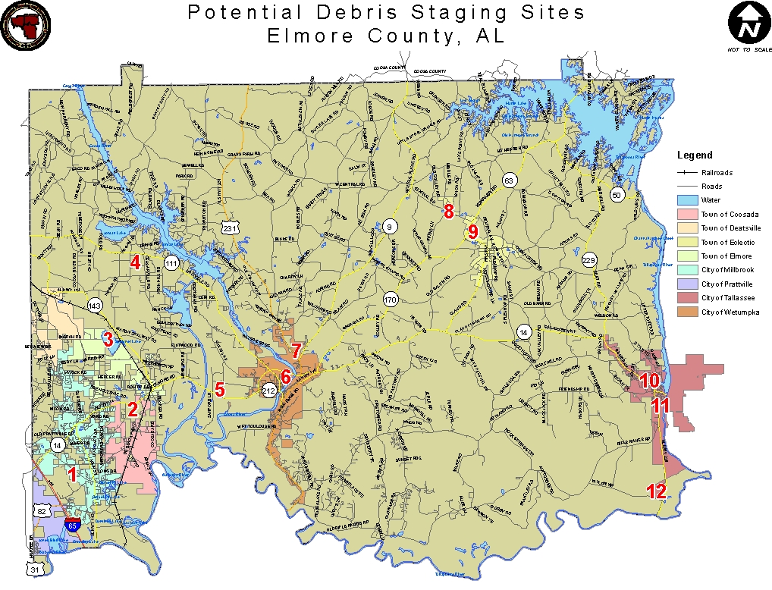
Staging Areas
Notes:
One of the added benefits of utilizing the URTI and its supporting GIS layers
(e.g. parcel file that includes publicly owned property) is developing a portion of a
debris management plan to identify potential staging areas.
Often times the siting of staging areas for debris management is the first
dialogue between Emergency Managers and Urban Forestry professionals as the
opportunities for collaboration and the development of a Vegetative Risk Management
Plan become more apparent. The benefit to both professions and the general
public often become clear as this part of the overall plan is developed.

Slide 3

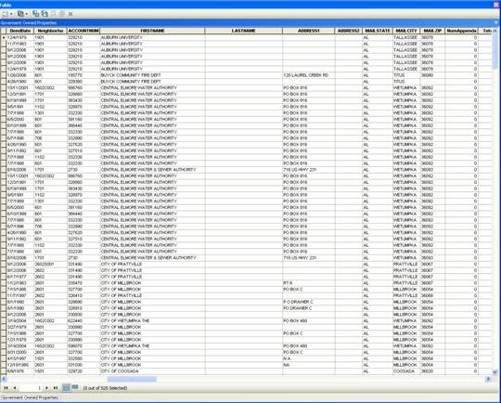
VRMP Template – By Section Step 6- Potential Debris Staging Areas
Notes:
Shown here is a parcel file used while developing the UTRI. The parcel file can
identify parcels with any number of considerations. Most common
would be: access, size of parcel, whether it is cleared or wooded, as well as
proximity to areas closest to population centers
and significant areas of highest UTRI risk for tree (debris) failure.
This slide shows an attribute table utilizing a parcel file used to find property
locations within the county that belonged to local, county, state or school boards.
These were then identified in red on the next slide.
This information is used to develop all of the following maps. Then the process is simple:
It entails convening the appropriate parties and decision makers to simply sit across
the table from each other with this information to select the best areas and
search for possible private property areas that would require further investigation
and subsequent contracts to allow for the staging area.
The point being the simple fact of having this information to make informed decisions
together and BEFORE the storm/event.

Slide 4
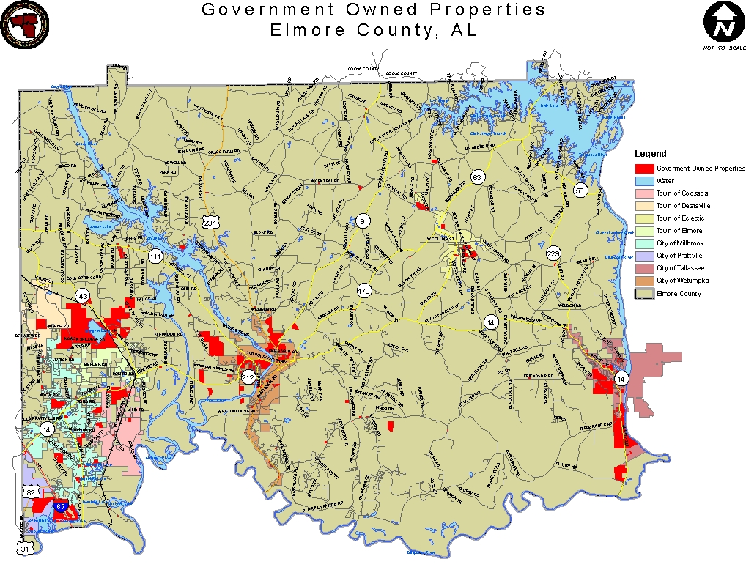
Notes:
In this example: All of the properties in red are local, county, state
or school board owned. The debris staging sites are then linked
to the most populated areas as well as the areas with the most canopy.
Over 12 sites were identified as viable throughout the county.
If public property is not sufficient, then large, suitable tracts of
private property can possibly be located for contracting.

Slide 5
Notes:
After all concerned parties and decision makers convened together to collaborate on the
possible staging sites… this map was developed.
This sites shows the 12 most viable debris staging sites that can then
be related to population density, tree canopy, road access, or the UTRI index
by street segment.

Slide 6
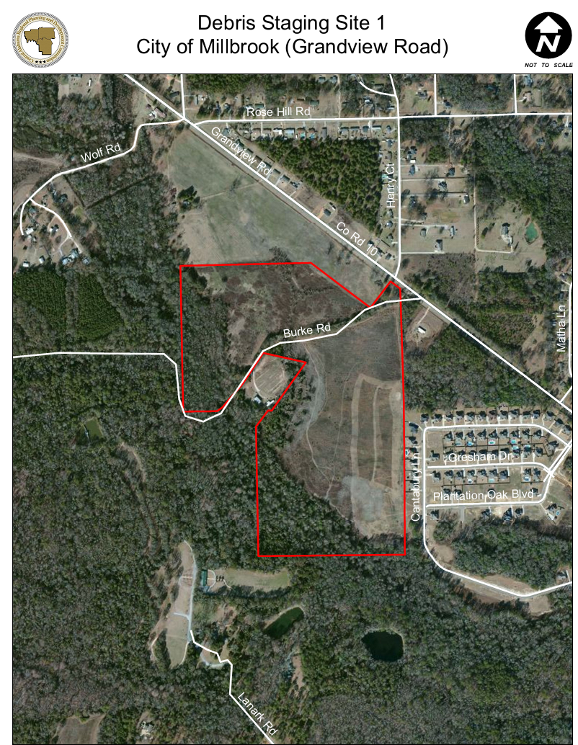
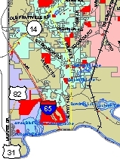
1
Notes:
This shows number 1 blown up with an aerial overlay.
This is an example within the City of Millbrook. This site is currently
owned by the school board for a future school. It is open pasture
primarily with access to a state highway. The group decided on this parcel
as a suitable staging site.

Slide 7
Debris Management
Staging Areas
Utilizing Urban Tree Risk Index (UTRI) GIS Tool
Notes:
For more information on Vegetative Risk Management Plans and the
Urban Tree Risk Index (UTRI) GIS tool :
Please visit the Urban Forestry South
website http://www.urbanforestrysouth.org/ and search for
“VRMP or Vegetative Risk Management Plan” or “UTRI” to find the document
(Urban Tree Risk Index Model & the UTRI Data Process and GIS Tool Description)
with detailed step by step instructions on how to develop the GIS model.
to find information and webinars discussing each.
“This project was funded in whole or in part by the U. S. Forest Service’s Urban and Community Forestry Challenge Cost Share Grant Program, as recommended by the National Urban and Community Forestry Advisory Council”
“The United States Department of Agriculture (USDA) prohibits discrimination in all its programs and activities on the basis of race, color, national origin, gender, religion, age, disability, political beliefs, sexual orientation, and martial or familial status. (Not all prohibited bases apply to all programs). Persons with disabilities who require alternative means for communication of program information (Braille, large print, audiotape, etc.) should contact USDA’s TARGET Center at 202-720-2600 (voice and TDD).”

