Slide 1





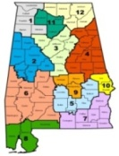
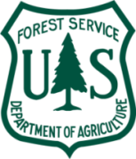
Collaboration Opportunities
Urban Foresters & Emergency Managers
Urban Tree Risk Management
&
Vegetation Risk Management
Notes:
This project is a partnership among CARPDC, Alabama Emergency Management Agency (AEMA), Society of Municipal Arborists (SMA) and Alabama Association of Regional Commissions (AARC) with USDA Forest Service providing technical oversight on behalf of NUCFAC. The GIS tool (UTRI) application development by Abi Dhakal – GIS Specialist with the Alabama Forestry Commission – formally with Central Alabama Regional Planning and Development Commission and technical assistance by Reggie Franklin – GIS specialist with Central Alabama Regional Planning and Development Commission. Overall project development by Rachel Barker – Project Manager with ArborMetrics Solutions, Inc. - formally with Central Regional Planning and Development Commission.
This project was recommended for funding by the National Urban and Community Forestry Advisor Council (NUCFAC) and was developed as a collaboration tool to engage UF professionals and EM on a regional level. Regional Planning agencies across the country are often a resource to bring these various professionals together to form collaborative strategies to find solutions for regional initiatives. They also often have on staff the professionals and resources capable of providing the technical expertise required to conduct the GIS application developed and discussed today. In addition, Regional Planning agencies are often involved in developing the required natural hazard mitigation plans for counties in their regions and with the subsequent required five year updates.
“This project was funded in whole or in part by the U. S. Forest Service’s Urban and Community Forestry Challenge Cost Share Grant Program, as recommended by the National Urban and Community Forestry Advisory Council”
“The United States Department of Agriculture (USDA) prohibits discrimination in all its programs and activities on the basis of race, color, national origin, gender, religion, age, disability, political beliefs, sexual orientation, and martial or familial status. (Not all prohibited bases apply to all programs). Persons with disabilities who require alternative means for communication of program information (Braille, large print, audiotape, etc.) should contact USDA’s TARGET Center at 202-720-2600 (voice and TDD).”

Slide 2

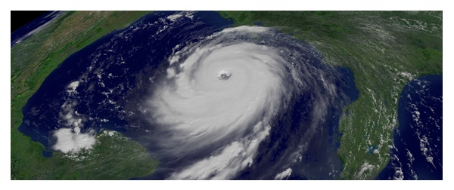
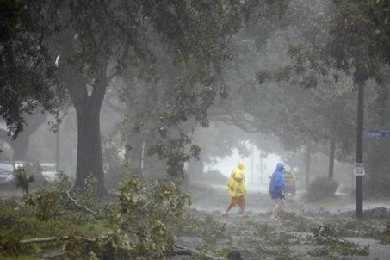
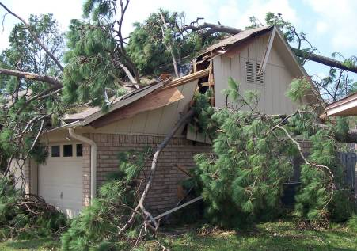
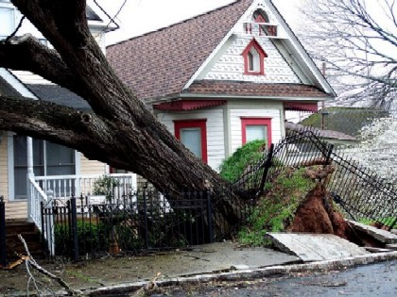
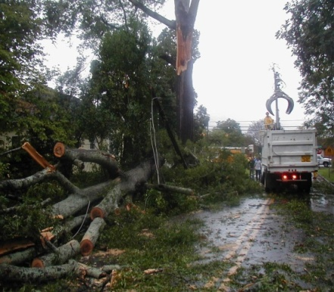
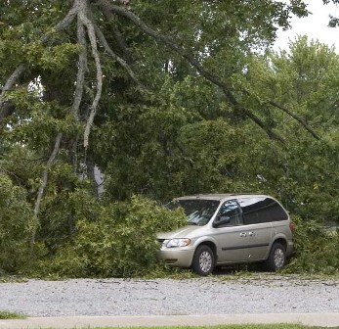
Why? Urban Tree Risk
Management – Vegetation Risk Management
Notes:
Why Urban Tree Risk Management…. I would like for you to ask yourself if you are an urban forester or a city manager or even if help communities manage and plan their natural resources… have you taken steps to reduce or perhaps even eliminate your communities’ urban tree vulnerability in the next big disaster? Why do we need to manage trees for risk? Do urban foresters and Emergency managers work together in your community? Why do we need to manage trees for risk? What is the leading cost to Emergency Managers after an event… you got it! Debris removal costs.

Slide 3
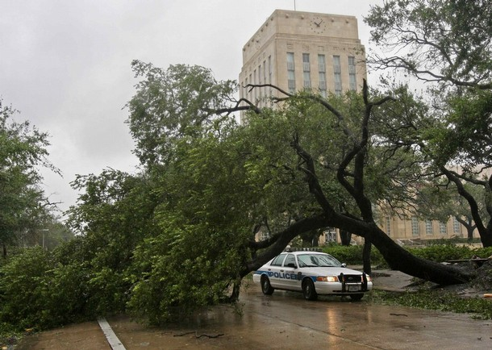
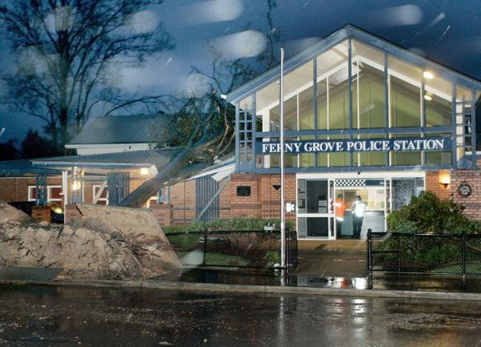
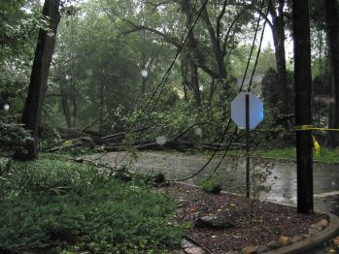
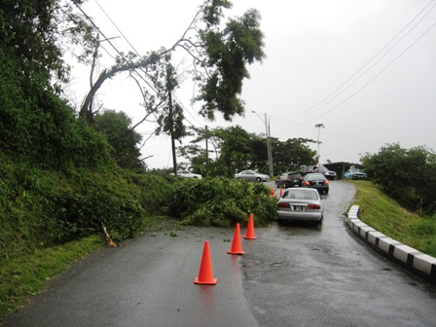
The Need?
Impede 911 and Emergency Response
Structural Damage & Impede access to Critical Infrastructure facilities
Notes:
The fact of the matter is….Urban Forestry meets Emergency Management time and time again.
Although each profession is not totally aware of the other and the role each plays.
The two professions use a different language when referring to the same thing …
The Urban Foresters “Trees” are referred to by Emergency Managers as:
“potential debris” if a standing tree or
“debris” if a tree is on the ground.
The Urban Foresters “Trees” are “vegetation” to the Emergency Manager and are not managed the same by the Emergency Manager as they are by the Urban Forester.
There is a need to build relationships and partnerships with the two professions. They meet time and time again…. In all seasons… at all hours… in all kinds of different situations Trees and Vegetation are their common link.
Trees impede 911 and emergency response. They often damage critical structures and impede access to critical infrastructure facilities. They are often the cause of personal injury and property damage.

Slide 4
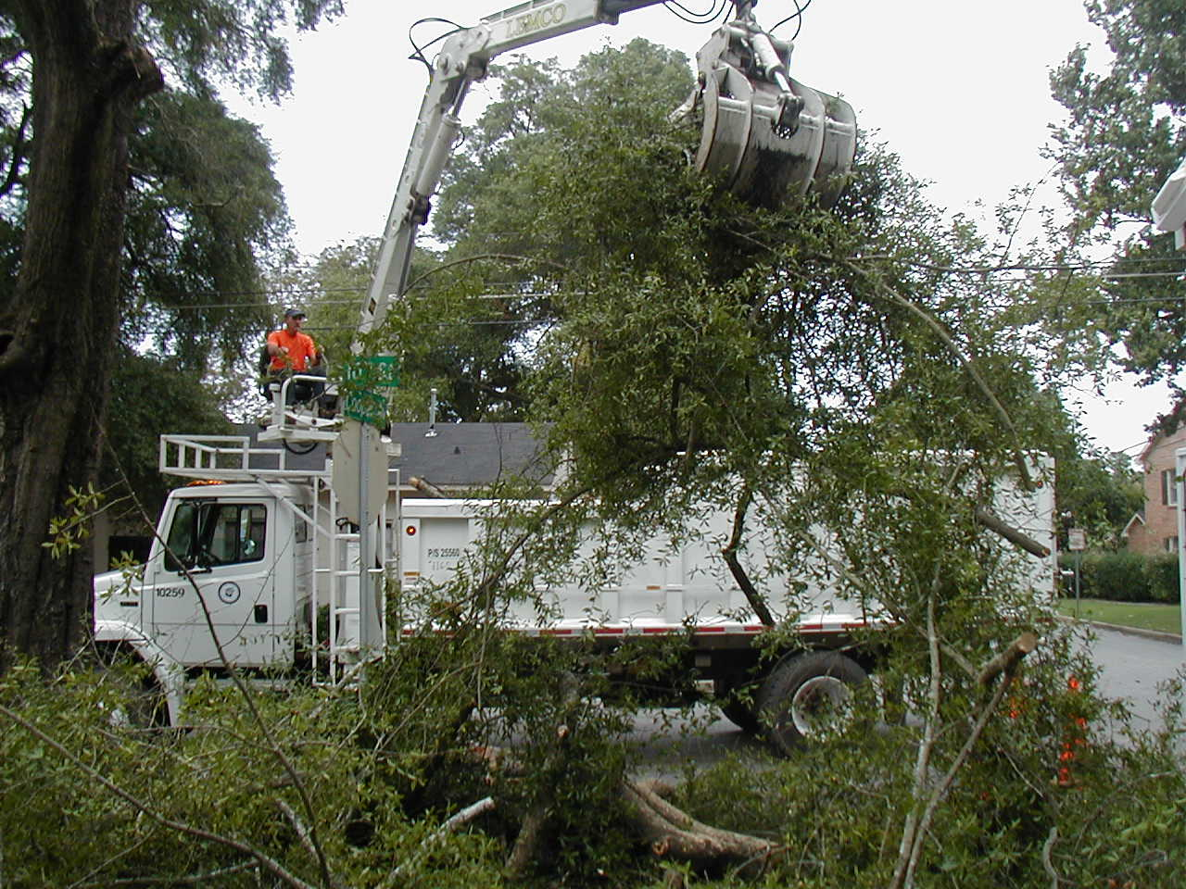

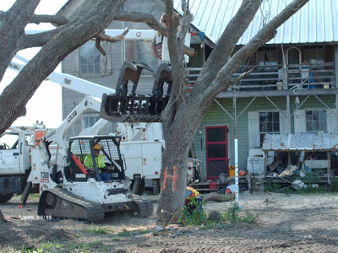
The Need?
Emergency Management Costs
Notes:
Trees and the debris accumulated from their destruction is the major cost to emergency management. How can these professions work together to reduce the amount of debris after an event which in turn will decrease the emergency management costs and reduce the impact of major storms on the urban forest.

Slide 5
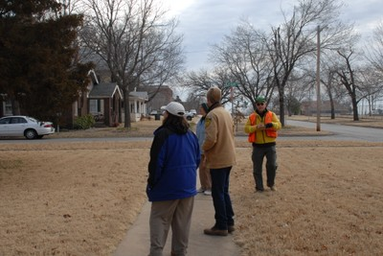
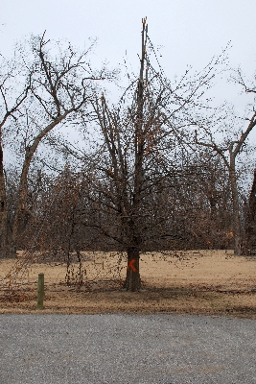


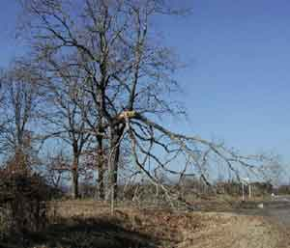
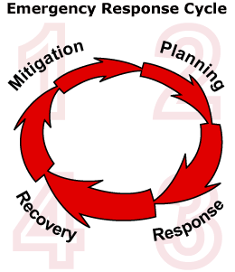
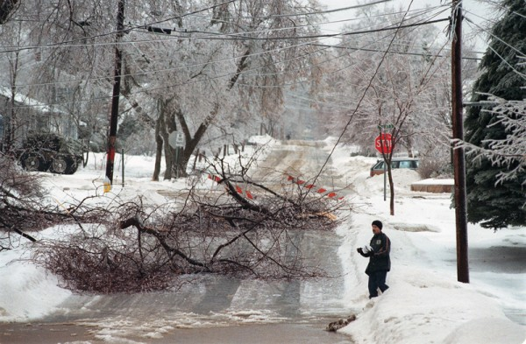
Get Connected with
local Emergency Manager
Notes:
The answer is for Urban Forester and Local Emergency Managers to get connected.
This is a great way to jump start a fledgling UF program or enhance an existing program by building in Urban Tree Risk Management.
An Urban Forester has much to offer an Emergency Manager.
A well managed urban forest can:
reduce injury/claims
limit damage to critical infrastructure
reduce clean up costs
improve overall UF management response (eliminate the “putting out fires” mode)
By developing Urban Tree Risk Management Plans Urban Foresters can bring their profession to the Emergency Managers table to help them meet a need (safety and reduced cost of clean up) while improving the overall health of the urban forest and building the Urban Forestry program’s worth.

Slide 6

Collaborative Strategies
How to incorporate urban forestry into Emergency Management and Debris Management
  Meet FEMA standards for mitigation, planning, response, and recovery AND arboriculture industry performance standards
Notes:
We will now look at collaborative strategies and opportunities to incorporate urban forestry into emergency management and debris management while meeting the industry standards of both professions.

Slide 7
The Big Picture
Structure
Data
Urban Forester Involvement
General
State
Vegetative
Partnership/Planning
Regional
County
Community
Tree Risk
Hands on Implementation
Detail
Notes:
As we began to look at how an urban forester and emergency manager might collaborate we wanted to show exactly where the two might have opportunities to interact in relation to the involvement of an urban forester, or like minded professional, in the care of a communities urban forest. An urban forester is likely to be involved on the state level and regional in a partnership and utilized more likely in the planning phases of how to manage and developing the plan where as the Community level is more likely to be utilized with hands on implementation and overseeing the plan. From a more general role to a more detailed role.
The Vegetative Management Plan and the GIS model (UTRI – Urban Tree Risk Index) ,discussed in this presentation, utilizes the concept of the general overall look at a region… A look at the overall Vegetation vs. the more detailed as utilized in a community Tree risk management plan. The involvement of the urban forester or like minded professional will be similar… from the general partnership/planning involvement to the more hands on the more detailed the plans is … like the tree risk management plan.
An urban forester is likely to be involved on the state level and regional in a partnership and utilized more likely in the planning phases of how to manage and developing the plan where as the Community level is more likely to be utilized with hands on implementation and overseeing the plan.

Slide 8
Opportunities
Examples
Comprehensive Plan
Hazard Mitigation Plan
Emergency Response Plan and Exercises
Debris Management Plan
Vegetative Risk Management (the New link)
UF Management Plan
Tree Risk Management Plan(s)
Notes:
These are some of the plans that are often developed and are shown here on the same scale from a general down to detail. There are plenty of opportunities for collaboration with Urban Foresters and Emergency Managers in all of these with the Vegetative Risk Management Plan being the new link. The link that the two professions can work hand in hand developing.

Slide 9
Risk Mitigation Results
Reduced claims as they relate to trees by 72%
Reduced work order complaints and/or request for services by over 55%
Reduced 911 and overtime expenditures for tree cleanup by over 69%
Five year period 2001-2006
Columbus, Georgia (R. Barker)
Notes:
Here are some measured results from an aggressive tree risk management program in Columbus, Georgia (from Rachel Barker). We show these to demonstrate the measured success a tree risk management plan can have for a community.

Slide 10
Mitigation/Planning
  Identifying critical infrastructure to include vegetation at critical facilities – Evaluate and mitigate as necessary
  GIS mapping – Identify potential high debris and hazard areas. Where is the highest potential for vegetative removal and your hazard areas ranked from highest to lowest
  Debris estimation – Utilizing street segments and random sampling after an event and other methods
  Exercises- Utilize UTRI data & model for disaster exercises – prioritized response for Public Works personnel and prioritization of resources
Notes:
The Emergency Management cycle consists of Mitigation/Planning, Recovery and Response. We have identified several areas where the Urban Forestry profession can collaborate with Emergency Managers. Let’s look at them one by one.
Here are opportunities for collaboration under Mitigation/Planning:

Slide 11
Mitigation/Planning
  Natural and Hazard Mitigation planning – Mitigate by pruning/removal and scheduled inspections of identified areas
  Debris Management Plan – Utilize UTRI GIS tool to identify staging areas for debris that is closest to the areas with most potential for debris (Canopy % by street segment)
  Local ordinances – Analyze and development of ordinances such as tree planting requirements on major corridors and emergency routes
Notes:
Here are a few more under mitigation/planning:

Slide 12
Response
Identifying critical infrastructure- Prioritize response to high hazard areas and routes
Staging areas for debris – Utilize UTRI tool
Debris estimation - Identifying high hazard areas and utilizing street segments for random sampling in debris estimation models
Notes:
Under the Response category we have identified the following areas:

Slide 13
Recovery
Debris management protocol - High Hazard areas will most likely produce highest amounts of debris. Plan accordingly
Insect/disease and invasive species separation and management protocol – Utilize a VRMP and the UTRI model to develop and opportunity to include these protocols
Pruning and/or removal- as determined by identified areas and based off of evaluation and inspection
Notes:
Under the Recovery aspect of Emergency Management we have identified five areas:

Slide 14
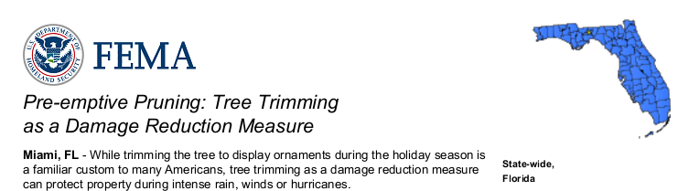
Recovery
Replanting – BMPs for planting the right tree in the right spot
Education – Proper pruning and planting – (See FEMA BMP’s Examples: Pre-emptive Pruning: Tree Trimming as a Damage Reduction Measure and others )
Notes:
Replanting:
Education:

Slide 15
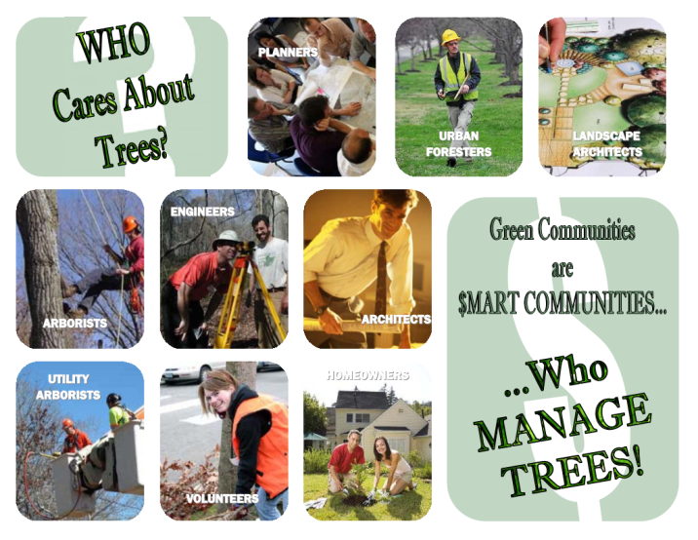
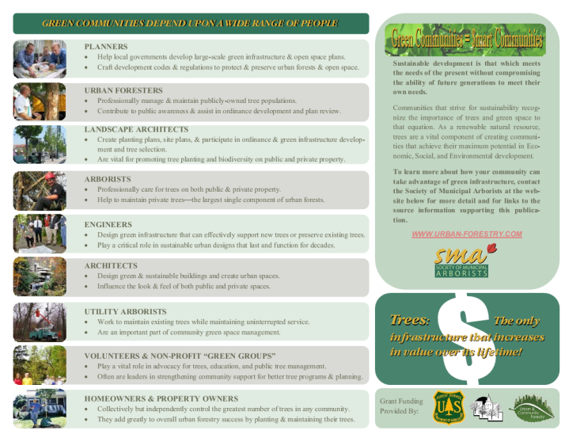
Who Works With & Manages Community Trees
For a comprehensive list of “Who Works With and Manages Community Trees” – See the Society of Municipal Arborists www.urban-forestry.com website and look for the BMP series Green Communities are $mart Communities
Links too!
Notes:
We have talked about Urban Foresters and other like minded professionals. You might be asking where to find these people. The Society of Municipal Arborists, one of our partners on this project, has a comprehensive list of Who Works With & Manages Community Trees on their website at www.urban-forestry.com. There you will find a link to their BMP series… Green Communities are $mart Communities. Each BMP has an associated links sheet with links to resources available to you.

Slide 16
Collaboration Opportunities
Urban Foresters & Emergency Managers
Urban Tree Risk Management
&
Vegetation Risk Management
Notes:
This project is a partnership among CARPDC, Alabama Emergency Management Agency (AEMA), Society of Municipal Arborists (SMA) and Alabama Association of Regional Commissions (AARC) with USDA Forest Service providing technical oversight on behalf of NUCFAC.
For more information on Vegetative Risk Management Plans, Collaboration Opportunities and Debris
Management – Staging Sites as well as detailed instructions to develop the
Urban Tree Risk Index (UTRI) GIS tool :
Please visit the Urban Forestry South
website http://www.urbanforestrysouth.org/ and search for
“VRMP or Vegetative Risk Management Plan” or “UTRI” to find the document
(Urban Tree Risk Index Model & the UTRI Data Process and GIS Tool Description)
with detailed step by step instructions on how to develop the GIS model.
to find information and webinars discussing each.
“This project was funded in whole or in part by the U. S. Forest Service’s Urban and Community Forestry Challenge Cost Share Grant Program, as recommended by the National Urban and Community Forestry Advisory Council”
“The United States Department of Agriculture (USDA) prohibits discrimination in all its programs and activities on the basis of race, color, national origin, gender, religion, age, disability, political beliefs, sexual orientation, and martial or familial status. (Not all prohibited bases apply to all programs). Persons with disabilities who require alternative means for communication of program information (Braille, large print, audiotape, etc.) should contact USDA’s TARGET Center at 202-720-2600 (voice and TDD).”

