Slide 1
Give Me the Numbers: How Trees and Urban Forest Systems Really Affect Stormwater Runoff
Aarin Teague, PhD, PE
Senior Engineer
Watershed Engineering
San Antonio River Authority
ateague@sara-tx.org
Eric Kuehler
Science Delivery/Technology Specialist
USDA Forest Service
ekuehler@fs.fed.us

Slide 2
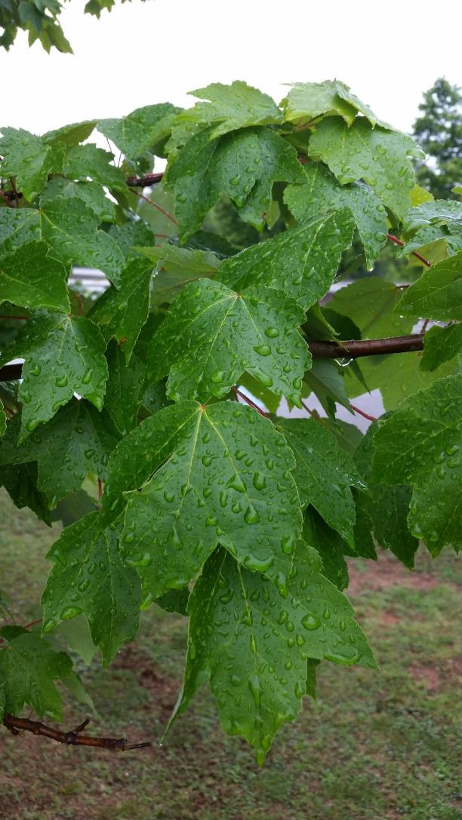
Objectives
Current research
Retention/detention
Rainfall intensity reduction
transpiration
Using data to quantify stormwater benefits
UF management strategies to maximize stormwater benefits
Tools to quantify tree canopy volume
Notes:
Today we would like to share some current research showing how much rainfall trees intercept, retain, detain, transpire, and reduce rainfall intensity.
We will discuss how San Antonio River Authority are using these data to help mitigate stormwater runoff.
If we have time will show how urban forests can be managed in such a way as to maximize stormwater benefits. We will explain some of those strategies.

Slide 3
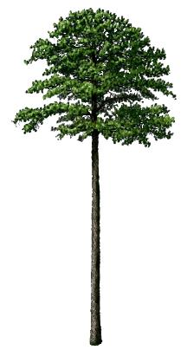
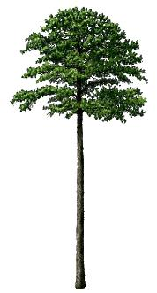
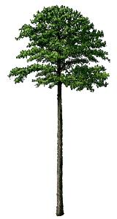
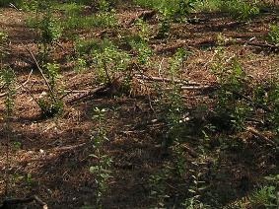
Forests and the Water Cycle:
Interception
Evapotranspiration
Infiltration
Evaporation
Throughfall
Surface
Runoff
Soil Water
Storage
Subsurface Flow
Groundwater
Notes:
Before discussing urban forest systems let’s talk about how pre-development, forest systems work with the water cycle
Forests consist of a vertical component (tree canopy), ground cover (mulch or vegetative), and permeable soil
Rainfall is intercepted by the tree canopy where a portion is retained and evaporated
After the canopy surface area fills, stormwater drips through the crown as throughfall and runs down the stem as stemflow
Ground cover retains and stores a portion of the throughfall
Most of the precipitation that reaches the ground infiltrates into the soil
Forest soils are very porous and permeability because of the high organic matter content, lots of roots connecting the soil to the surface, and the burrowing activities of animals, worms, and insects
Water that infiltrates into the soil either flows through the soil to nearby streams (subsurface flow), is stored in the upper soil surface (and used by plants), or percolates down into the groundwater aquifer
Leaving only a small portion of precipitation for surface runoff
Because of the protective cover and limited surface runoff, very little erosion from forestlands
The system also regulates flows and provides consistent stable baseflows (the groundwater contribution to stream flow)
As trees are removed from the system, this process breaks down. Good to have vertically stratified GI projects. Grass and shrubs are good, but need to include trees in plans

Slide 4
Typical Urban Development
Remove tree canopy cover
Remove ground cover
Vegetative
Detritus (mulch)
Remove permeable top soil
Leaving dense subsoil
Disturb/compact/pave over remaining soil
Grass sod over subsoil
Image courtesy of Google Earth
Notes:
In many places throughout the country urban development begins with the removal of tree canopy and ground cover as well as the rich top soil leaving dense, clayey subsoil.
That remaining subsoil is further disturbed through compaction and paving
So now, instead of rainfall being slowed down by canopy cover and permeable ground cover, it hits these impervious surfaces at terminal velocity causing increased accumulation quickly downstream leading to increased stormwater volume and flooding issues.

Slide 5
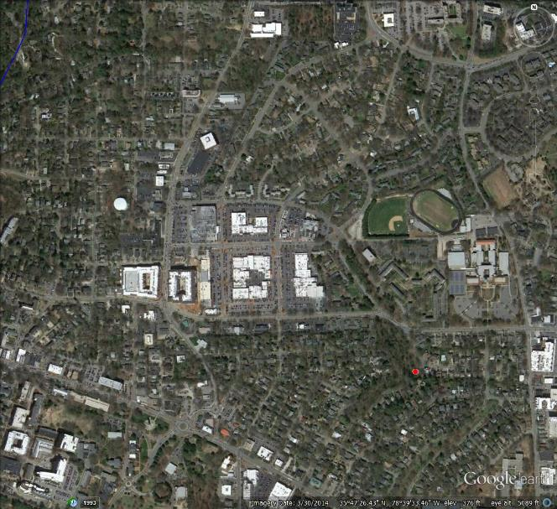
Research Basis for Forest Systems and Stormwater Mitigation
Forest – Flat River Tributary
Urban – Pigeon House Creek
2.95 km² Size 0.70 km²
99% Forest/Open Space 56%
1% Impervious 44%
Peak flow rate:
5.8 (mm/day) 76.6
UR > 13x
Storm flow volume:
7.1 (mm/day) 77.9
UR > 11x
77% Mean ET 58%
Boggs & Sun (2011) Urbanization alters watershed hydrology in the Piedmont of
North Carolina, Ecohydrology, 4, 256-264
Notes:
A comparative watershed study was done in North Carolina comparing stormwater runoff between undisturbed, forested landuse and a highly developed land use.
What does all this mean:
By removing tree canopy cover and ground cover (vegetative and detritus) and covering soil with impervious surfaces (and compacting most of the remaining soil), we have increased water velocity because asphalt and concrete don’t slow the water flow down like ground cover
By covering the soil with asphalt/concrete we are not allowing the water to infiltrate into the soil and so it runoff as overland flow
By removing tree cover, water is not being wicked out of the soil in the urban setting as readily as in forests.

Slide 6
Tree Canopy Retains Rainfall
~20% annual retention under canopy
14 – 61% range depending on region
Depends on volume and intensity
Canopy holds first 2-4 mm of rainfall
Xiao et al. (2000); Livesley et al. (2014)
1 ac @ 25% cover = 71-143 ft³ / event
More leaf area = more retention
Static storage = 0.2 mm m⁻² leaf area
Water held on surface after rain event
Dynamic storage = 0.77 – 1.25 mm m⁻²
Temporary water storage during rain event
Notes:
So let’s look at some of the research regarding tree canopy cover and rainfall retention.
Leaf and branch surface area of tree canopy drive interception.
Xiao, Livesley, and others have found that tree canopy retains the first 2-4 mm of rainfall or up to 3/16”.
For a 1 acre parking lot with 25% canopy cover, we should expect to retain 71-143 ft3 of rainfall in the crowns of trees
Leaf and branch surface area are able to retain rainfall and not allow it to fall to the ground as stormwater runoff through the process of static storage. The average depth of water storage on leaves is approximately 0.2 mm per square meter of leaf area.
During a rainfall event, leaves and branches temporarily store water which eventually drips off. Xiao and McPherson quantified water-holding storage capacities of 20 common street trees in Davis, CA in a rainfall simulation laboratory study.
We can use these values to quantify water storage. Using tools like i-Tree Eco to estimate leaf area of a tree, we can estimate that a 14” hackberry, 50 ft. tall, with a crown spread of 35 ft. has 6927 sq. ft of leaf area. Using 2.53 cu. Ft of H2O retained per 1000 sq. ft. of LA gives us 17.5 ft3 of storage in the crown.
The more surface area there is the greater the interception. Larger trees have greater leaf and branch surface area.
Livesley, S.J., Baudinette, B., and Glover, D. 2014. Rainfall interception and stem flow by eucalypt street trees – the impacts of canopy density and bark type. Urban Forestry & Urban Greening. 13: 192-197
Xiao, Q., McPherson, G., Ustin, S.L., Grismer, M.E., and Simpson, J.R. 2000. Winter rainfall interception by two mature open-grown trees in Davis, California. Hydrological Processes. 14: 763-784.
Xiao, Q. and McPherson, E.G. 2016. Surface water storage capacity of twenty tree species in Davis, California. Journal of Environmental Quality. 45: 188-198.

Slide 7
Tree Canopy Temporarily Detains Rainfall
Delayed throughfall
Via dynamic storage
Depends on storm intensity
Crown surface area
From 10 minutes to >3 hours
Aston (1979) in Australia
Xiao, et al. (2000) in California
Asadian and Weiler (2009) in Vancouver, BC
Can canopy cover increase lag time?
Notes:
With increased rainfall intensity or longer duration of a rain event, leaf surface area fills. When storage capacity reaches its maximum, excess water drips from the canopy.
This throughfall works its way through the crown until it finally drops to the ground. This delay can be as little as 10 minutes in higher intensity storms to longer than 3 hours in very light intensity storms.
We have a research gap in urban systems regarding how much delay there is in peak discharge. Research is on-going to quantify this and develop models to calculate.
Asadian, Y. and Weiler, M. 2009. A new approach in measuring rainfall intercepted by urban trees in coastal British Columbia. Water Qual. Res. J. Can. 44: 16-25.
Aston, A.R. 1979. Rainfall interception by eight small trees. Journal of Hydrology. 42: 383-396.
Xiao, Q., McPherson, G., Ustin, S.L., Grismer, M.E., and Simpson, J.R. 2000. Winter rainfall interception by two mature open-grown trees in Davis, California. Hydrological Processes. 14: 763-784.

Slide 8
Canopy Cover Reduces Rainfall Intensity
15%-21% reduction in rainfall intensity under canopy in forest
Trimble and Weitzman (1954)
21%-52% reduction in Oregon
Keim and Skaugset (2003)
May be greater for urban trees
Increased LA/canopy cover = reduced runoff coefficient
Canopy cover acts as volume control measure
Increases BMP efficiency?
Notes:
In deciduous forests in West Virginia rainfall intensity was shown to be reduced by up to 21%.
Tree canopy cover has been shown to slow rainfall intensity by up to 50% in the pacific NW where rainfall intensity tends to be lighter.
Because urban trees tend to have much greater leaf area than forested trees due to the lack of competition for sunlight, this reduction in rainfall intensity may be greater.
So increased leaf area and canopy cover reduces runoff coefficient and lowers the peak stormwater runoff rate
Through retention and temporary detention tree canopy cover acts to control stormwater volume and intensity which could help to increase the efficiency of stormwater BMPs and reduce their likelihood of inundation.
Trimble, Jr., G.R. and Weitzman, S. 1954. Effect of a hardwood forest canopy on rainfall intensities. Transactions, American Geophysical Union. 35: 226-234
Keim, R.F. and A.E. Skaugset. 2003. Modelling effects of forest canopies on slope stability. Hydrological Processes. 17: 1457-1467

Slide 9
Transpiration Allows More Storage in Soil
Highly dependent on environmental factors and species
~1.5 mm/day/m² projected canopy cover
Chen et al. (2011)
Wang et al. (2012)
0.3 – 2.6 mm/day/m² leaf area
Kjelgren & Montague (1998)
Fair et al. (2012)
1000 ft² crown area = 53 ft³/day
7000 ft² leaf area = 7 - 60 ft³/day
Notes:
Lastly, leaves have hundreds of pores or stomata that allow for gas exchange (CO2 in and H2O out). As water passes through these stomata they pull more water up through the stem from the roots and ultimately from the soil in a process called transpiration. As water is being pulled from the soil more space is being made available in the soil profile to store stormwater.
Transpiration is highly dependent on environmental factors such as heat, light, wind, soil moisture, etc.
In China, researchers found that urban trees transpired approximately 1.5 mm/day/m2 of tree canopy cover.
In a couple of studies in the US, transpiration was found to be vary between 0.3-2.6 mm/day/m2 of leaf area.
So using our 14” hackberry with 35’ crown spread (or 962 ft2 projected crown area) and assuming 1.5 mm/m2 projected crown area/day, we would expect to free up between 7 and 60 ft3.
Chen, L., Zhang, Z., Li, Z., Tang, J., Caldwell, P., and Zhang, W. 2011. Biophysical control of whole tree transpiration under an urban environment in Northern China. Journal of Hydrology. 402: 388-400.
Wang, H., Wang, X., Zhao, P., Zheng, H, Ren, Y, Gao, F., and Ouyang, Z. 2012. Transpiration rates of urban trees, Aesculus chinensis. Journal of Environmental Sciences. 24(7): 1278-1287.
Fair BA, Metzger JD, Vent J. 2012. Characterization of physical, gaseous, and hydrologic properties of compacted subsoil and its effects on growth and transpiration of two maples grown under greenhouse conditions. Arboriculture & Urban Forestry. 38(4) : 151-159.
Kjelgren R, Montague T. 1998. Urban tree transpiration over turf and asphalt surfaces. Atmospheric Environment. 32(1) : 35-41.

Slide 10
Tools for Design
Water Environment Research Foundation (WERF)
Estimates Curve Numbers for BMPs
Site Design of BMPs including Urban Trees and Tree Box Filters
Practice/Land Type | CN
Rain gardens | 35
Infiltration practices | 40
Porous pavement | 40
Soil amendments | 60
Vegetated swales | 60
Tree cover | 70
Rain barrels/cisterns | 75
Vegetated roofs | 75
Downspout disconnection | 80
Filter strips | 80
Pocket wetlands | 80
Tree box filters | 85
Urban area | 90
Impervious area | 98
$$CN=\frac{1}{{Area}_{Total}}\sum_{i}{{CN}_{i}{Area}_{i}}$$
https://www.werf.org/liveablecommunities/toolbox/model.htm
Notes:
WERF has developed the Stormwater BMP Interactive Model to allow users to assess runoff reductions achieved by various stormwater BMPs. The model uses TR-55, SCS curve number method to model the runoff reduction. This method is a familiar engineering model that is commonly used in land development practice.
When assessing the combined effect of a combination of BMPs, the area of each BMP is used with its designated BMP curve number. Then the curve number is area weighted.
The curve number for each BMP is derived from observation of BMP performance.
If you look at the numbers, trees perform slightly better than small scale rain barrels and less than vegetated swales. This is logical when you think of the function and performance of how a tree works.
https://www.werf.org/liveablecommunities/toolbox/model.htm

Slide 11
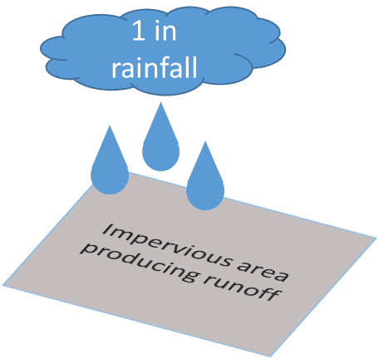
For Example : 10,000 sq ft of impervious cover
Without Trees
With Trees
1 in rainfall
659 cf runoff
3.9 cf runoff
100% Impervious Cover CN = 98
Tree Canopy Area CN = 70
Notes:
Using TR 55, if you were to simulate 1 inch of rainfall on 10,000 square feet of impervious cover, it would produce approximately 659 cubic feet of runoff. In contrast, 1 inch of rainfall on tree canopy produces approximately 3.9 cubic feet of rainfall.
Thus over 10,000 sf, tree canopy would reduce runoff by 655 cubic feet of runoff.

Slide 12
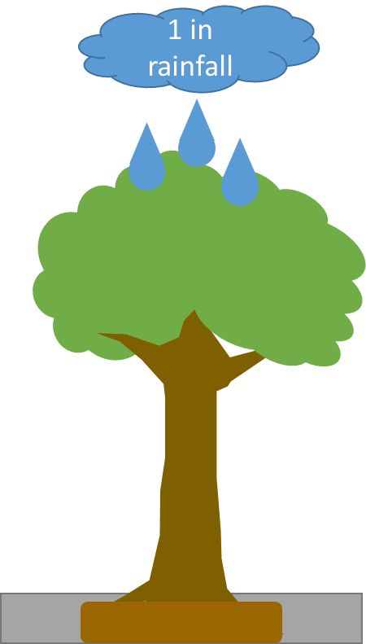
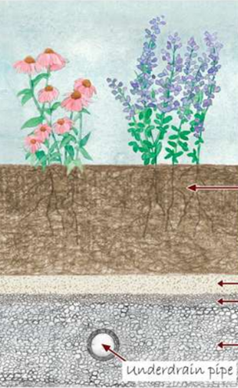
Replacing trees with BMPs
Stormwater BMPs
10,000 sq ft canopy
3 ft Bioretention Media
1 ft Gravel
10,000 sq ft IC
655 cf = 25’x 10’ Bioretention ~ $2,500
Notes:
If you were to try and replicate the function of the tree canopy by replacing the canopy with stormwater BMPs (assuming standard design specifications), it would require 250 square feet of bioretention. This would cost approximately $2,500, using local cost numbers from San Antonio, Texas.

Slide 13
How an urban tree performs
Provides 0.2 to 0.8 inches/unit canopy area initial abstraction
San Antonio Texas = 25% to 70 % of Rainfall Events
Notes:
Using the TR-55 method, it can be assumed that 5% to 20% of sorptivity will be initial abstraction. ** see source below
Therefore, a tree would be able to retain between 0.2 to 0.8 inches of stormwater. When this is compared to the rainfall record of San Antonio, Texas, it shows that tree canopy would retain 25% to 70% of events annually.
Ia = 5% to 20% of Sorptivity based on USGS Hawkins, R.H.; Jiang, R.; Woodward, D.E.; Hjelmfelt, A.T.; Van Mullem, J.A. (2002). "Runoff Curve Number Method: Examination of the Initial Abstraction Ratio". Proceedings of the Second Federal Interagency Hydrologic Modeling Conference, Las Vegas, Nevada. U.S. Geological Survey. doi:10.1111/j.1752-1688.2006.tb04481.x. Retrieved 24 November 2013.

Slide 14
Using Trees in Urban BMPs
Preservation
Bioretention
Tree Wells /Structural Cells
Where possible preserve existing trees
Typically larger trees and provide more benefits than new smaller trees
Incorporate Trees into BMPs such as bioretention, wetlands, etc
Break up paving surfaces with tree wells
Notes:
So if you want to use trees to capture and treat stormwater, there is a hierarchy of methods.
First, the preference is to preserve trees, especially groupings of trees, whenever possible. This takes advantage of established trees, which is important because tree function improves with the size and establishment of the trees.
Second, where possible, incorporate trees into BMPs. North Carolina guidelines require that every bioretention unit incorporate a tree. This enhances both the BMP and the tree by combining the function of each.
Third, when not possible to achieve the first two, generally where there is substantial impervious cover, tree wells or structural tree cells can be used. These BMPs will break up impervious cover providing pockets of treatment.

Slide 15
Tree BMP Guidance
North Carolina
“A minimum of one (1) tree, three (3) shrubs, and three (3) herbaceous species should be incorporated in the bioretention planting plan unless it is a grassed cell.”
Minnesota
“Incorporating trees into traditional bioretention practices is Highly Recommended.” (http://stormwater.pca.state.mn.us/index.php/Types_of_tree_BMPs)
Notes:
Various entities have recognized the value of using trees in conjunction with stormwater BMPs.
Minnesota and North Carolina require or highly recommend that trees be incorporated into bioretention.

Slide 16
Using Trees to Meet Stormwater Credit
Portland, OR
2004 Stormwater Management Manual
Subtract Impervious Cover under trees within 25 feet of impervious cover that meets certain criteria
Indianapolis, IN
2007 Stormwater Green Infrastructure Supplemental Document
Credits for new or exiting tree canopy within 20 feet of impervious surfaces.
Pine Lake, GA
2003 Ordinance
Trees count towards site runoff requirements
1 tree= 100 ft² of Impervious Cover
Existing Tree = 50% of Existing Canopy, New Trees = 100 to 200 ft² of impervious cover
Trees = 10 to 20 gallons/in DBH
Minnesota
Volume, TSS, Phosphorus Credit
Based on interception, evaporation, and infiltration
Example : Mature Red Maple with infiltration area= 340 cf
Philadelphia, PA
2011 Stormwater Manual
Reduction in impervious area
Washington, DC
2013 Guidebook
Trees receive retention value
Preserved Trees = 20ft^{3;} New Trees = 10 ft³
Notes:
http://stormwater.pca.state.mn.us/index.php/Calculating_credits_for_tree_trenches_and_tree_boxes
http://dec.vermont.gov/sites/dec/files/wsm/stormwater/docs/ManualUpdate/sw_White_Paper_site_scale_credits_2014_0_%2006_draft.pdf
Moreover, municipalities and states across the US have recognized that trees are valuable stormwater BMPs by allocating credit within their stormwater ordinances. Most ordinances give a greater amount of credit to existing trees. Many ordinances use impervious cover offsets or stormwater treatment volume credits.

Slide 17
Using BMPs to meet Tree Canopy Credit
Incentives for Using Stormwater BMPs
San Antonio, TX – Stormwater BMPs can count towards Tree Canopy Requirements with an additional 50% incentive
Notes:
Recognizing the function of trees to mitigate the impacts of stormwater, the City of San Antonio gives credit to stormwater BMPs under the tree ordinance. The credit structure calculates the stormwater function of the tree canopy and allows the implementation of BMPs in lieu of the required canopy coverage.

Slide 18
Urban Forest Management Strategies to Maximize Stormwater Mitigation
Layered structure mimics forest systems (reduce/delay runoff)
Over story canopy
Dominant species
Mid-story canopy
Shade tolerant species
Ground cover (veg/mulch)
Provide adequate rooting volume for growth and health
Suspended pavement systems
Gravel under pavement?
Notes:
We can manage our urban forest systems to maximize runoff mitigation.
If we can increase the amount of vegetation on undeveloped land by layering the canopy cover into over-story, mid-story, and ground cover, we can mimic forest structure and thus increase rainfall retention, reduce rainfall intensity, delay throughfall, increase lag time, and increase transpiration.
The key to this is providing adequate rooting volume for growth and tree health.
Suspended pavement systems such as SilvaCells or using structural soils can provide needed rooting volume.
We are experimenting with planting trees in mineral soil beds adjacent to parking lots using gravel under pavement or as parking stalls.

Slide 19
Co-benefits of Urban Forest Systems (Triple Bottom Line)
Economic
Energy conservation
CC 10%, T 1.2º C, e⁻ use ~15%
Huang et al. 1987
Increased property value (~7%)
Social
Positive relationship with human health
http://www.naturewithin.info/urban.html
Environmental
Air pollution removal/avoidance
i-Tree tools to quantify
www.itreetools.org
Notes:
Urban forest systems contribute to the triple bottom line.
They provide economic benefits by conserving energy through direct shading of buildings and through climate effects.
Huang et al found that for every 10% increase in tree canopy cover ambient air temperature is reduced by 1.2 C and electricity use is reduced by approx. 15%
Trees generally increase property values by about 7% (+/-).
There is a generally positive relationship between trees/urban forest systems and human health. Kathy Wolf has compiled much of the research on her website
Environmental benefits include the filtering of particulates from the air, dry deposition of gaseous pollutants onto/into leaves, and avoiding pollution formation by cooling the atmosphere and reducing sunlight.
The Forest Service’s i-Tree tools allow you to quantify environmental benefits.

Slide 20
Conclusion
Tree canopy retains rainfall
~20% annual rainfall under canopy
First 2-4 mm of rainfall
0.2 mm per m² of leaf area
Canopy cover reduces rainfall intensity
Deciduous canopy 15 – 21%
Coniferous canopy 21 – 52%
Trees transpire
~1.5mm/day/m² canopy cover
0.3 – 2.6 mm/day/ m² leaf area
Species and microclimate dependent

Slide 21
Give Me the Numbers: How Trees and Urban Forest Systems Really Affect Stormwater Runoff
Aarin Teague, PhD, PE
Senior Engineer
Watershed Engineering
San Antonio River Authority
ateague@sara-tx.org
Eric Kuehler
Science Delivery/Technology Specialist
USDA Forest Service
ekuehler@fs.fed.us
Notes:
After thinking about the title of this presentation we thought that individual trees are of limited value for stormwater runoff mitigation as you will see in a moment, so we decided to change the title of this presentation to Augmenting Your Stormwater Runoff Mitigation Goals Using Urban Forest Systems.
We hope to show how conserving and managing urban forest systems could be one tool in your toolbox to help you manage your municipal stormwater runoff.

