Slide 1
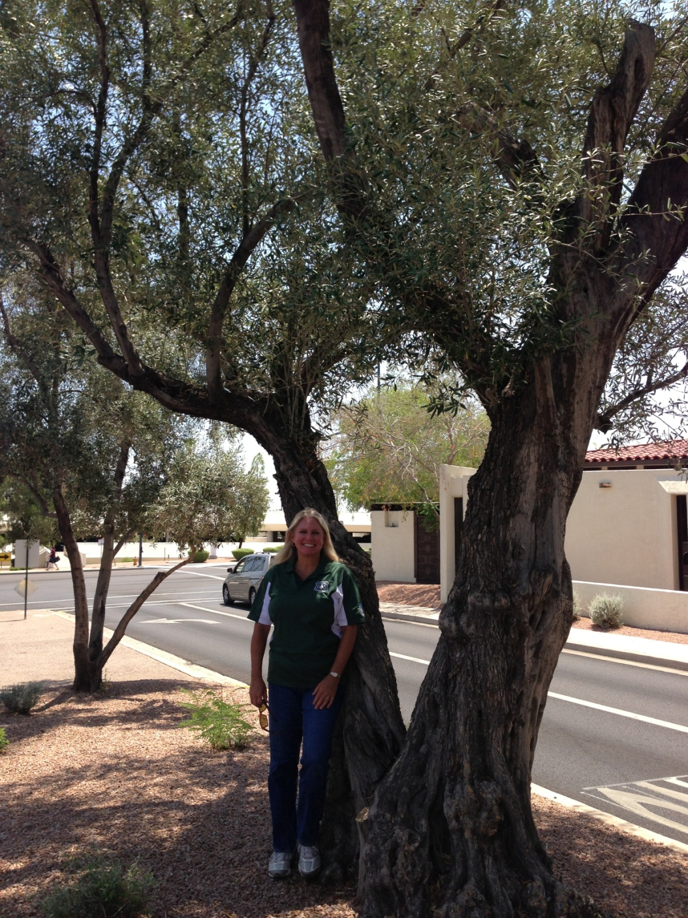
WO OVERVIEW
Jan Davis
Assistant Director Cooperative Forestry
State & Private Forestry
National Urban & Community Forestry Program
USDA Forest Service
Washington, DC
jkdavis@fs.fed.us
“Scott’s Trees” - Scottsdale, AZ 2013

Slide 2
WO Overview
Playing Field
Positions
Budget
National Partners
Emerging Work

Slide 3
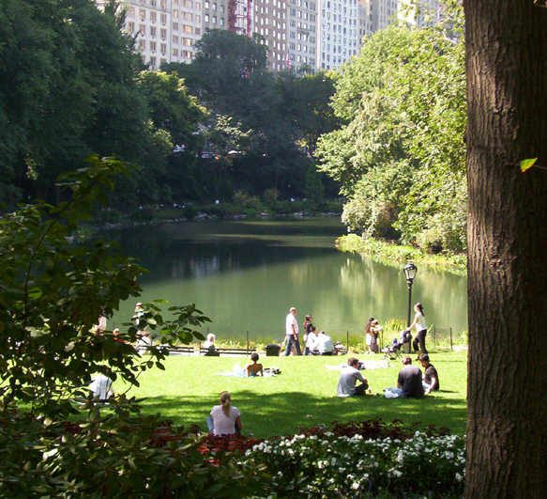
1. Playing Field
FS Primer
Alignment
Farm Bill
NUCFAC
Guidelines
Strategic Plan(s)
Budget Direction
2. Positions
UCF Staff
WO Leadership
3. Budget

Slide 4
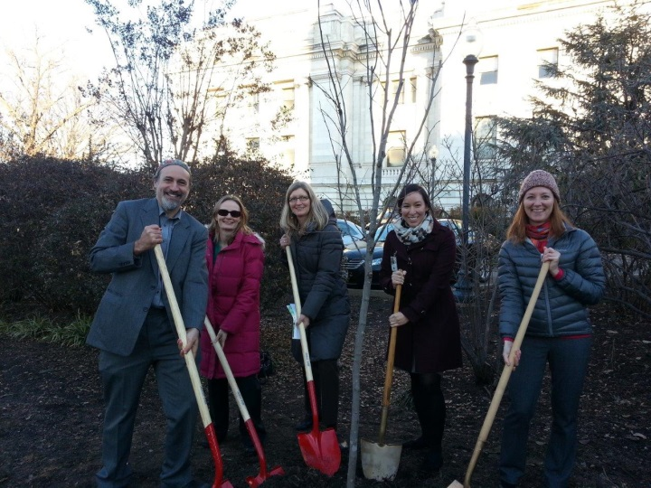
4. National Partners
NASF ADF APA?
NUCFAC ACTrees CDC?
UWFP ISA
SUFC Davey: i-Tree
TNC
AF
AFF
5. Emerging Work
Strategic Framework
Performance Measures
State Action Plans New Section
Landscape Scale Conservation
Workforce Planning

Slide 5
Questions?
Jan Davis
jkdavis@fs.fed.us
202-401-4416

