Slide 1
What is a Watershed?
More Kids in the Woods

Slide 2
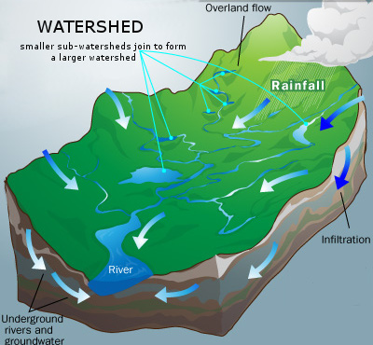
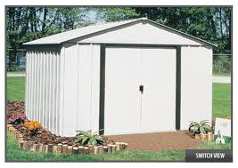
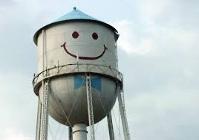
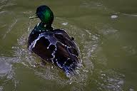
Is it?
NO!
NO!
Close!
Notes:
So we have just watched a great movie all about the Hogtown Creek watershed. Lets talk a little bit more about exactly WHAT a watershed is. Is it (click). NO. it is not a shed that is full of water. How about (Click). Nope this either although it holds water. How about this? (click). Not really but if we remember that scientists study at different scales, oh wait can you guys tell me what I mean by scale? That is right it is like on google earth when you zoom in or out on a map. So scientists can study small microscopic organisms or they can study whole ecosystems. So what does this have to do with a Duck you may be thinking. Well if you think about a watershed being an area where water drains then we could pretend that this duck’s back is a watershed. However that area studied should be an area of land. So this is a watershed! You can see that the water flows down hill and the smaller creeks join together in the valleys. How is this watershed a little different than our watersheds in Florida? That is right here we do not have such extreme elevation changes, but we have some elevation differences so that will define the boundaries for our watersheds.

Slide 3
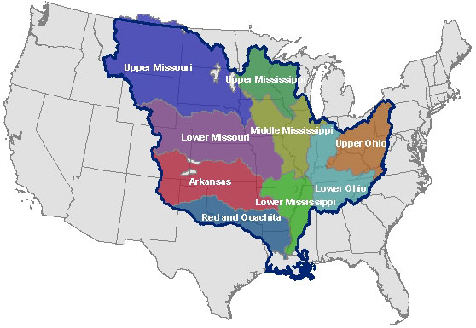
Parts of a watershed
Notes:
If we keep thinking about scales we can see that watersheds can be on many scales as well. A lot of time we can talk about a creek that flows into a bigger creek that eventually makes it to the ocean. So we could talk about the Watershed of the MISsissippi river which is a huge part of the country or the area of land that drains to specific rivers.

Slide 4
Parts of a watershed
Headwater
Middle section
Mouth/ sink
Notes:
Or if we think about it like this then we see that we can start with little creeks that feed into larger one. So as scientists there are different things that you could compare among all 5 tributaries of this system or you may want to study the entire system. At the mouth or sink. One thing that is really cool about the watershed we are in now is that it does not directly make it to the ocean. Instead it joins our groundwater in a sinkhole.

Slide 5
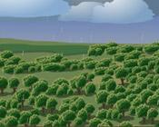
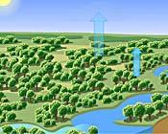
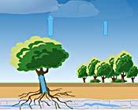
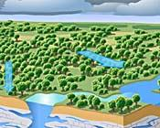
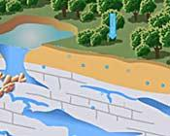
How does water move through a watershed?
Rainfall
Evaporation
Transpiration
Rain Falls Again
Runoff
Percolation
Notes:
Now that we know What a watershed is, lets talk about how water moves through a watershed. These are the steps in the water cycle. Which of these depicts how water makes its way to creeks and lakes? That is right it moves over the ground by Runoff especially in area where the water can not soak into the ground. It also moves by soaking into the ground and moving underground to creeks, rivers, or lakes through percolation . Percolation is especially important here since we have lots of limestone which allows water to move through it easily.

Slide 6
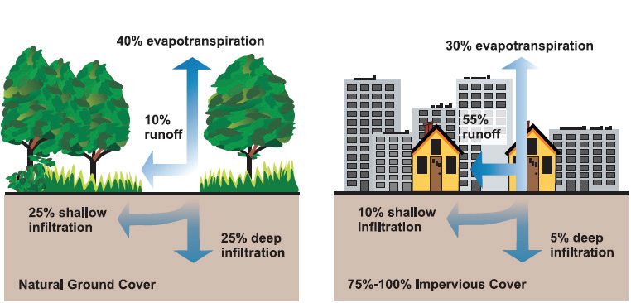
Where does the water go?
Notes:
So now that we know the two methods which water moves in a watershed lets talk about how humans have influenced the amount of water that moves through the various methods. In a natural system there is only 10% run off while in a city or where there are IMPERVIOUS surfaces there is up to 55% run off. What do you think an impervious surface is? That is right a surface which water can not travel through Can you give me an example? Roads, roofs, parking lots. SO there is more runoff when there are more impervious surfaces. What about infiltration how is that different when we have roads and buildings? That is right there is a lot less infiltration because the buildings are not allowing water to go through them to soak into the ground. This means that when it rains water will move a lot quicker in the area with roads and buildings since it is moving as runoff, while in the natural system it will move much slower to the creeks.

Slide 7
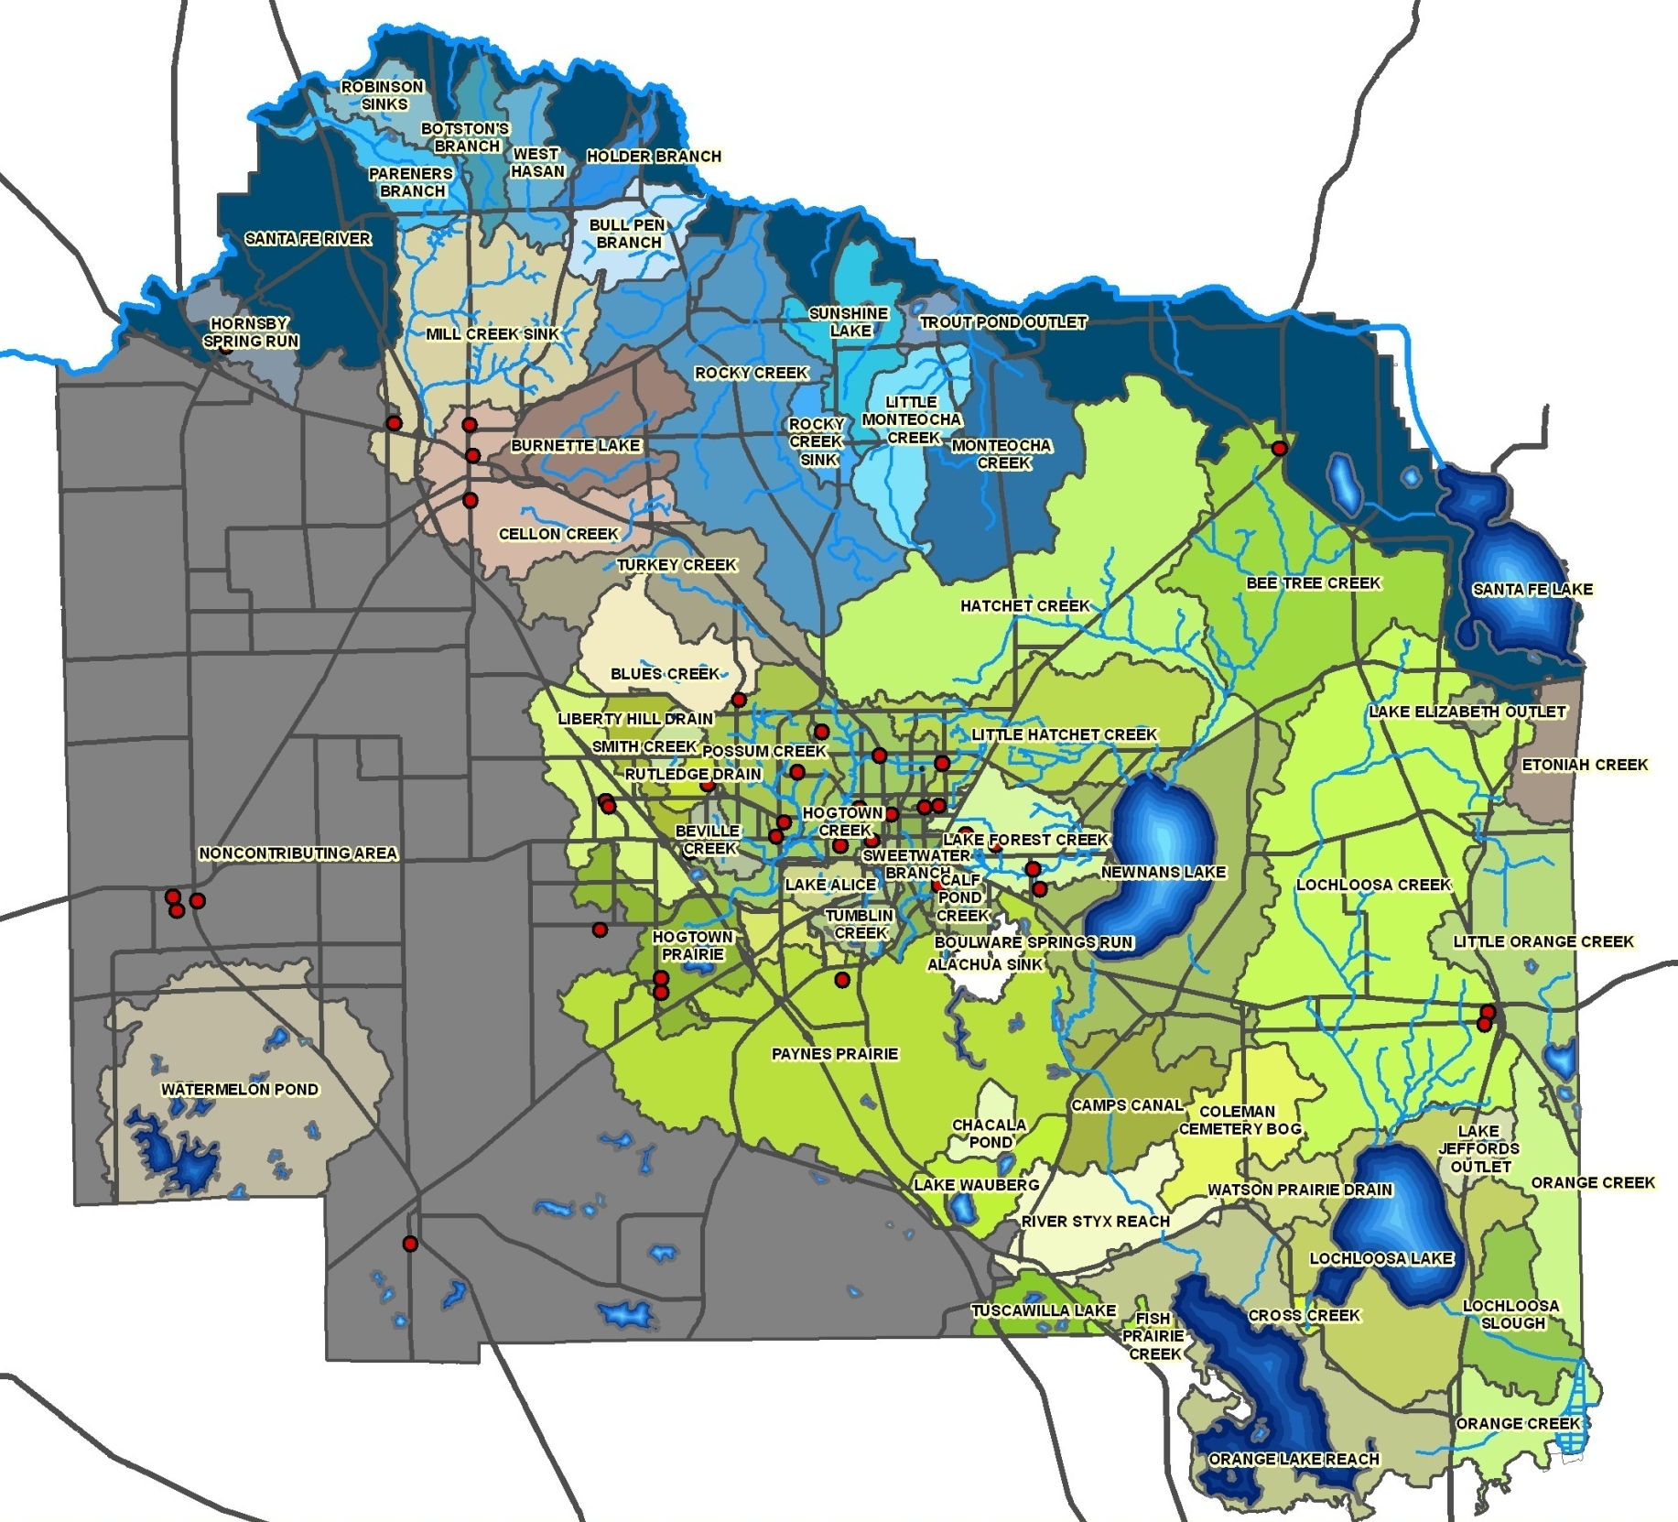
Lets zoom in!
Notes:
Remember how we talked about scientists thinking about different scales. We are going to move from the county scale to the smaller individual creek watershed scale. Lets zoom in!

Slide 8
Local Watersheds!
Lets find out what watershed we are in now!
Hogtown Creek
Watershed!!
Notes:
So what watershed are we in again? That is right the Hogtown creek Watershed. Let go look at the Enviroscape and see how water moves in our watersheds.

