Slide 1
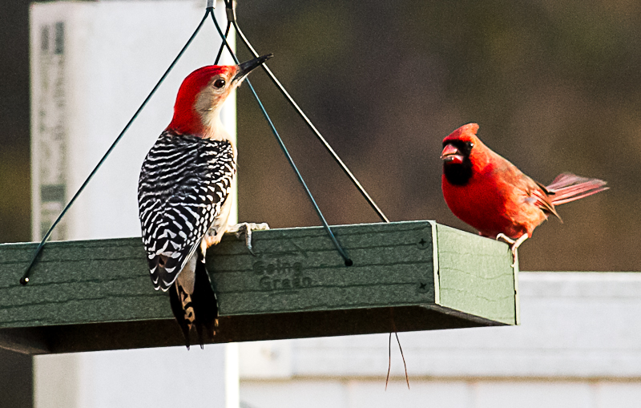
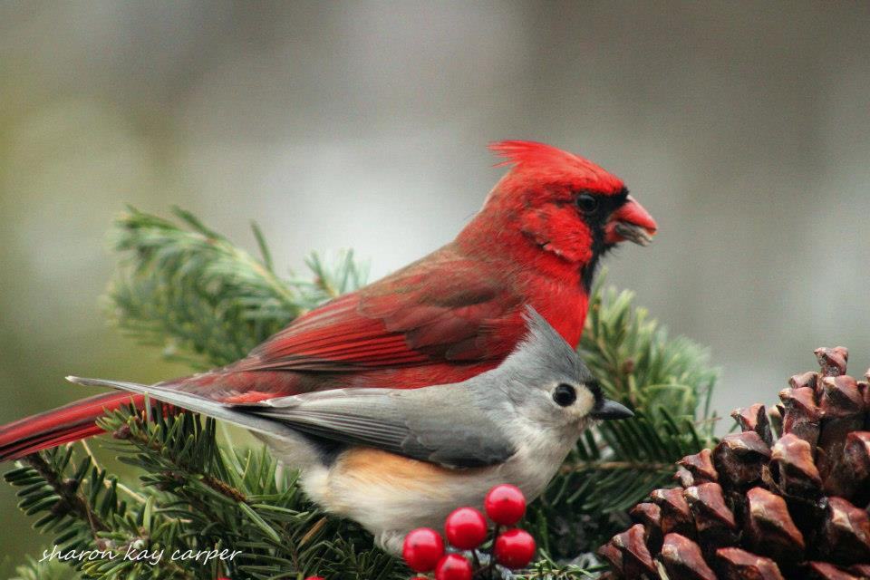
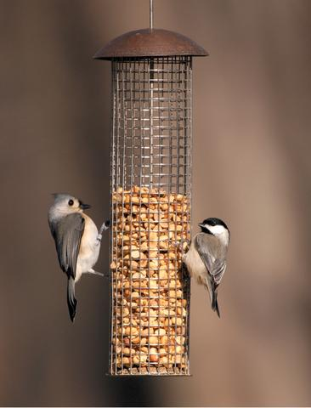
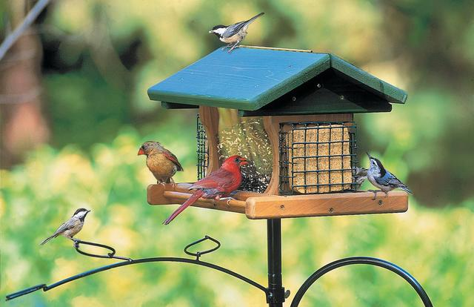
Florida Common Backyard Birds

Slide 2
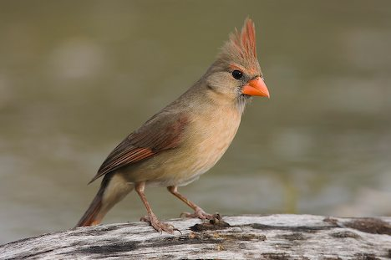
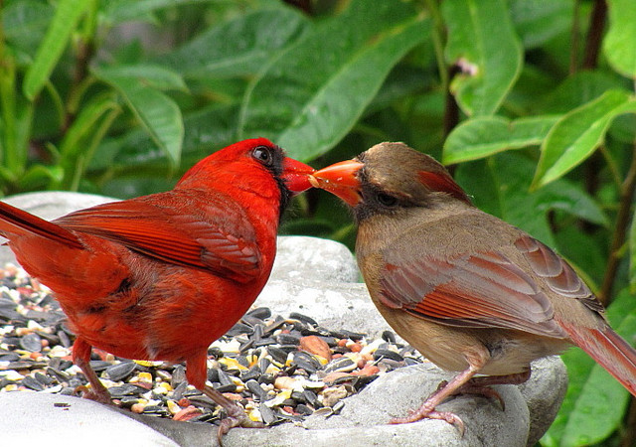
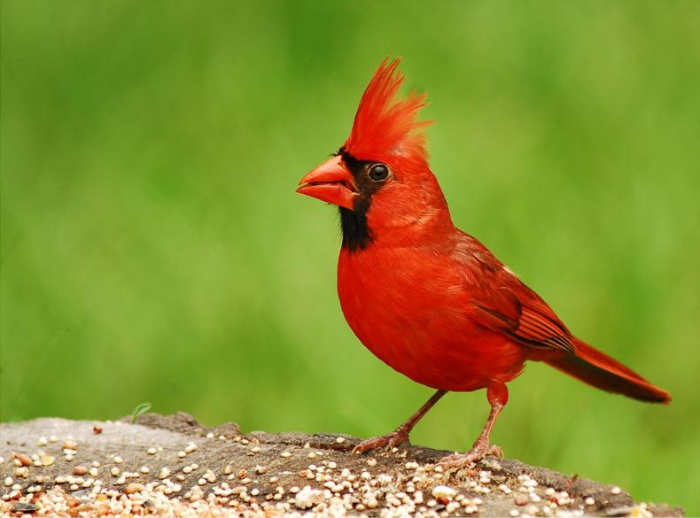
Cardinal
female
male
Notes:
http://www.allaboutbirds.org/guide/Northern_Cardinal/sounds

Slide 3
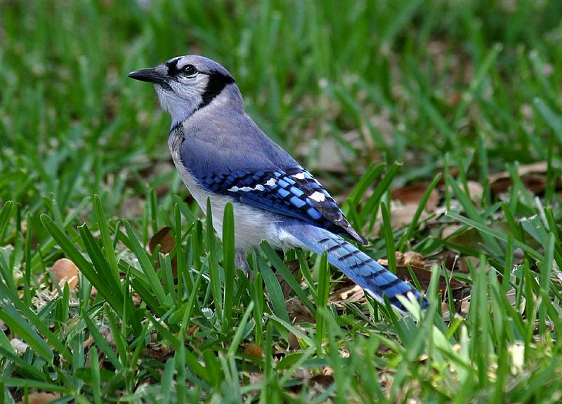
Blue Jay
Notes:
http://www.allaboutbirds.org/guide/Blue_Jay/sounds

Slide 4
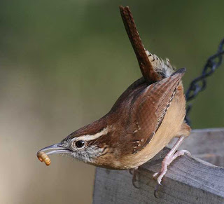
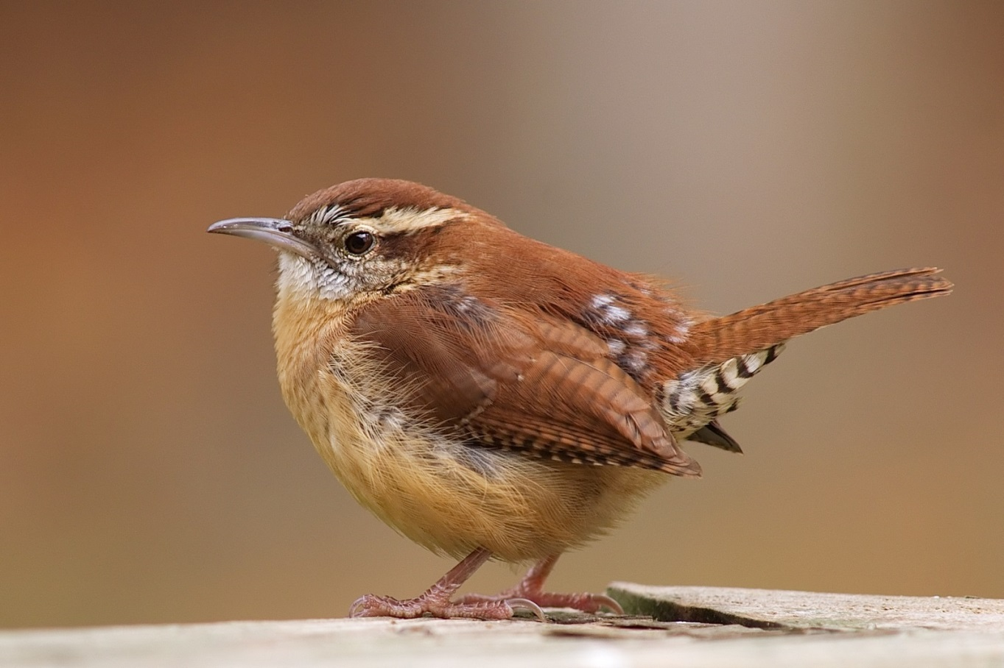
Carolina Wren
Notes:
http://www.allaboutbirds.org/guide/Carolina_Wren/sounds

Slide 5
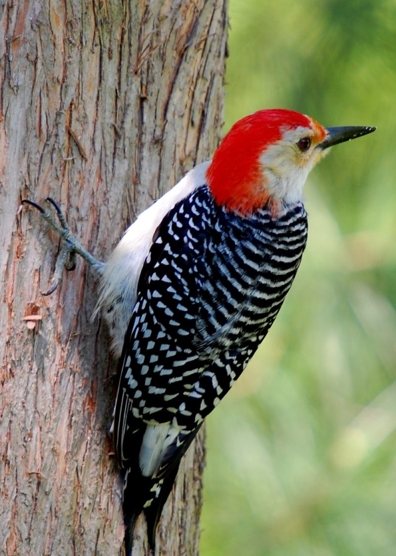
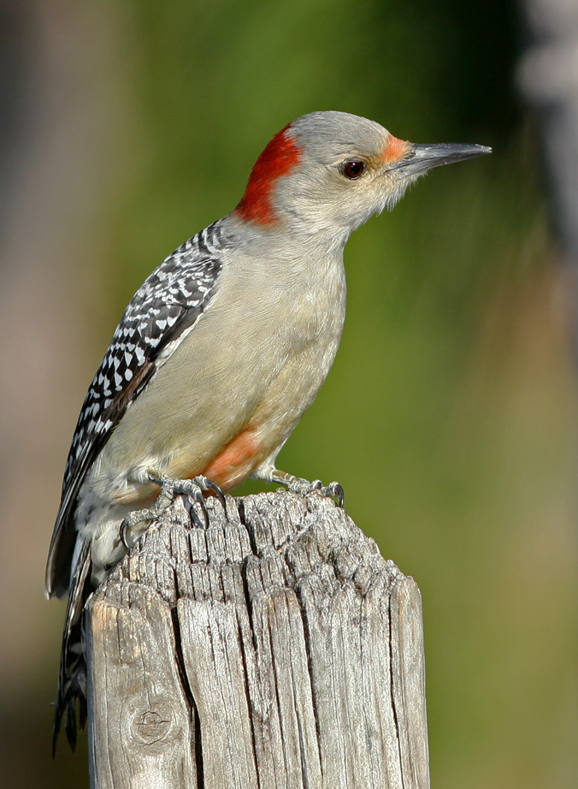
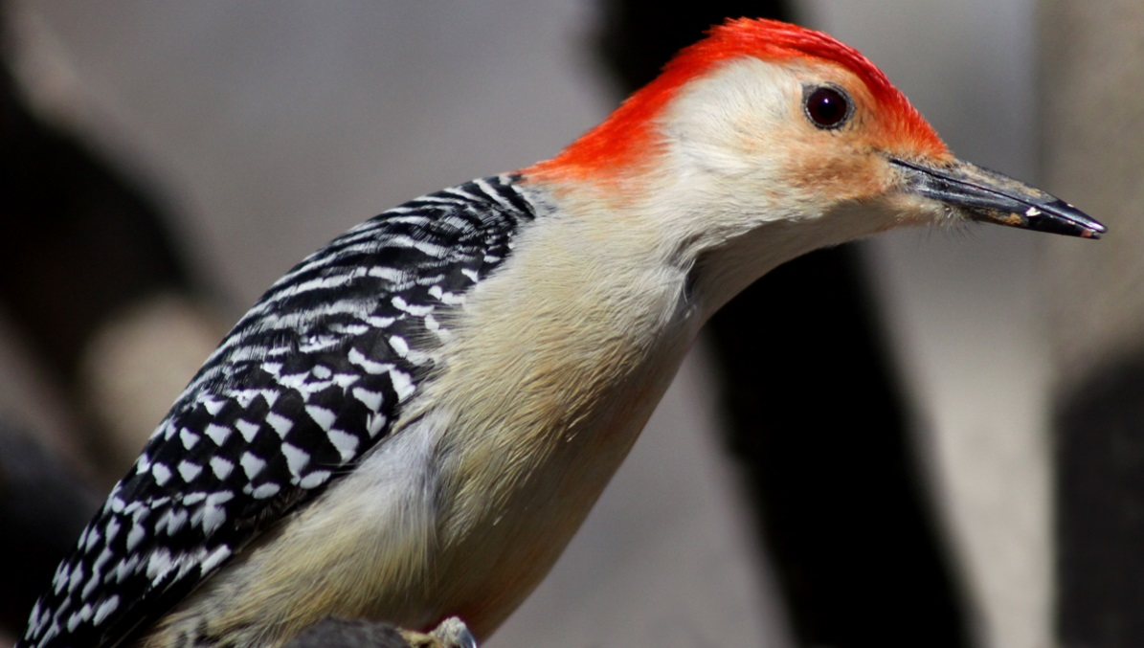
Red Bellied Woodpecker
Notes:
http://www.allaboutbirds.org/guide/red-bellied_woodpecker/sounds

Slide 6
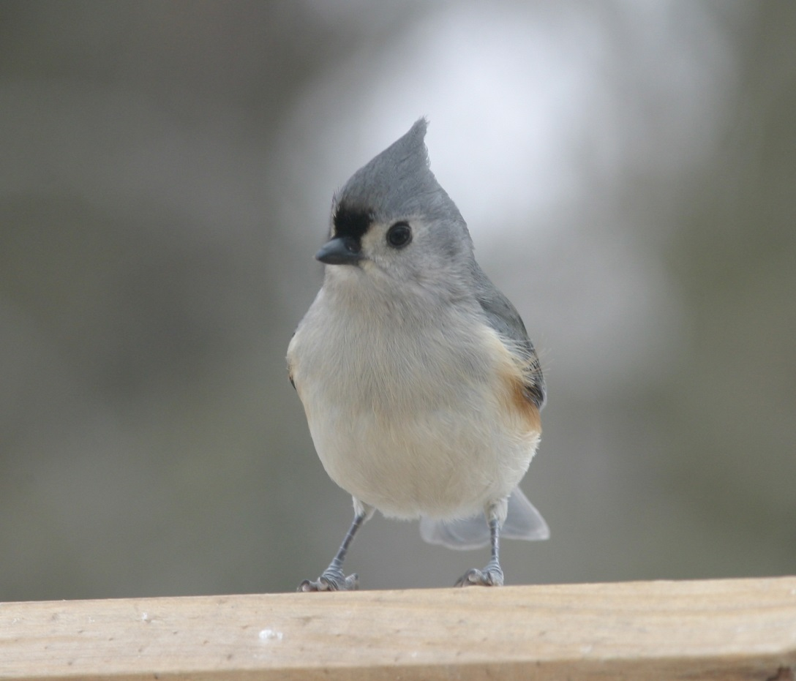
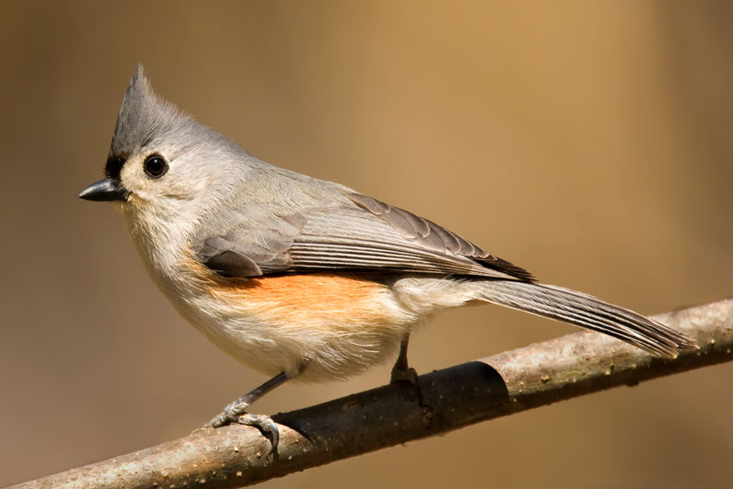
Tufted Titmouse
Notes:
http://www.allaboutbirds.org/guide/Tufted_Titmouse/sounds

Slide 7
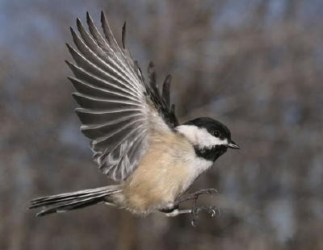
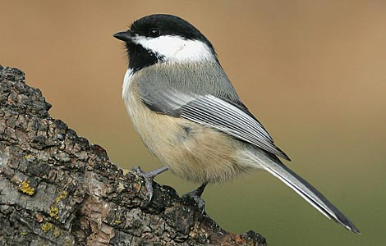
Carolina Chickadee
Notes:
http://www.allaboutbirds.org/guide/Carolina_Chickadee/sounds

Slide 8
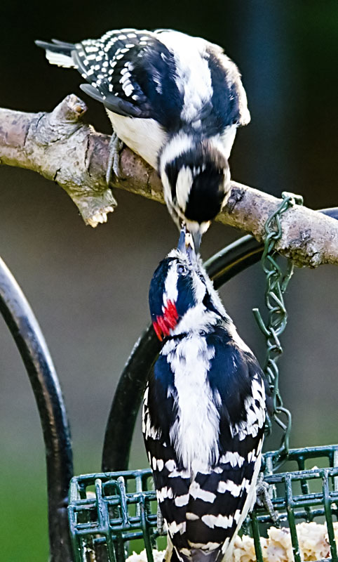
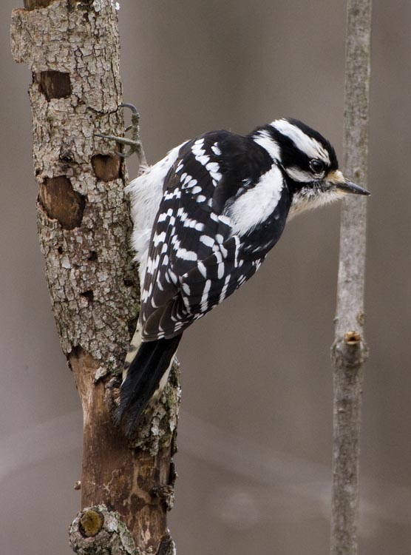
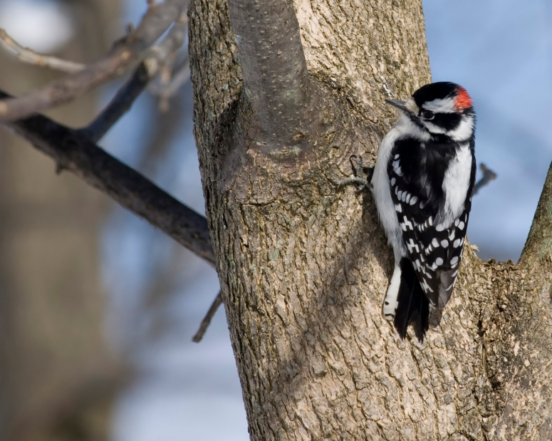
Downy Woodpecker
female
male
Notes:
http://www.allaboutbirds.org/guide/Downy_Woodpecker/sounds

Slide 9
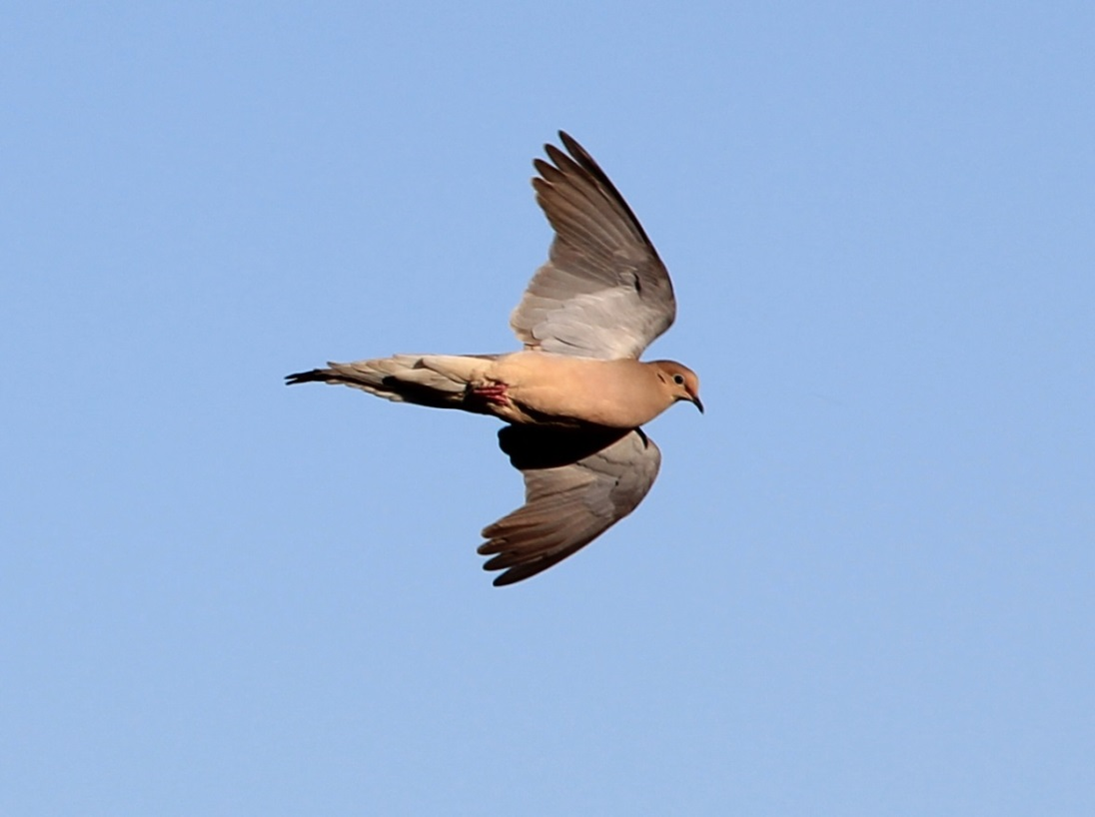
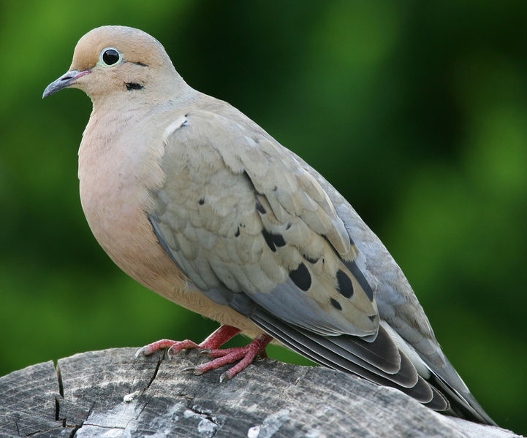
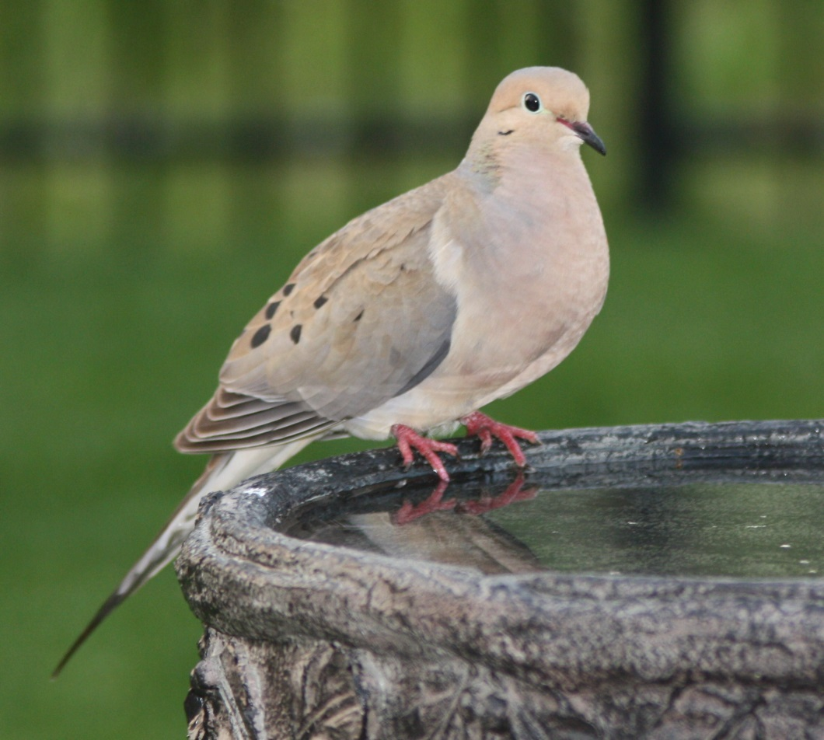
Mourning Dove
Notes:
http://www.allaboutbirds.org/guide/Mourning_Dove/sounds

Slide 10
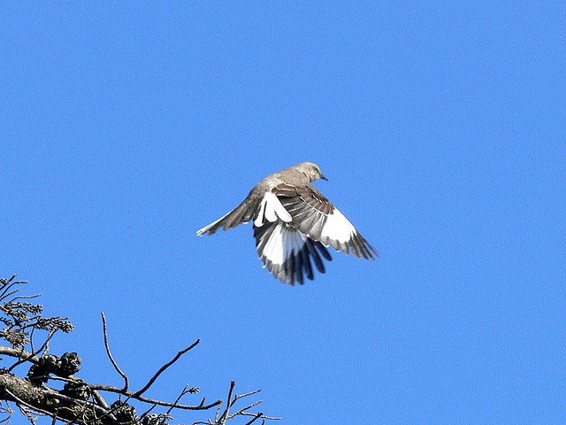
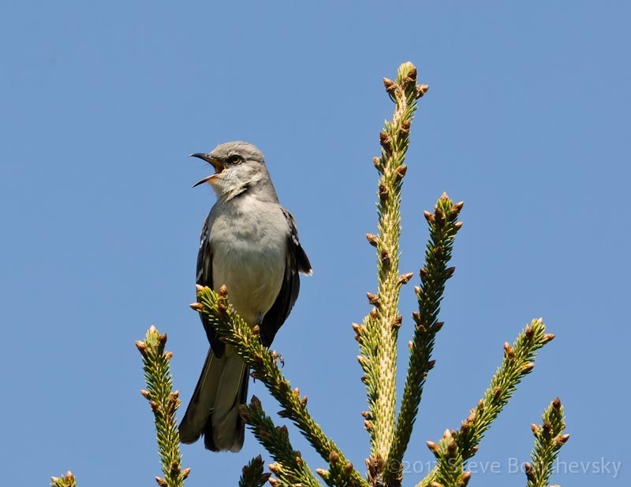
Northern Mockingbird

Slide 11
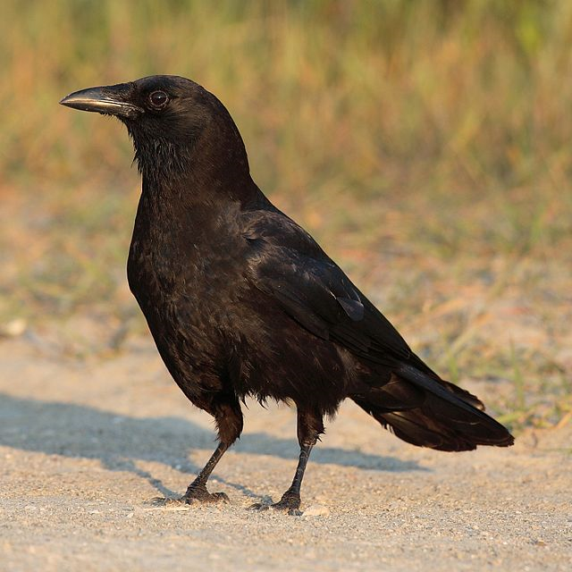
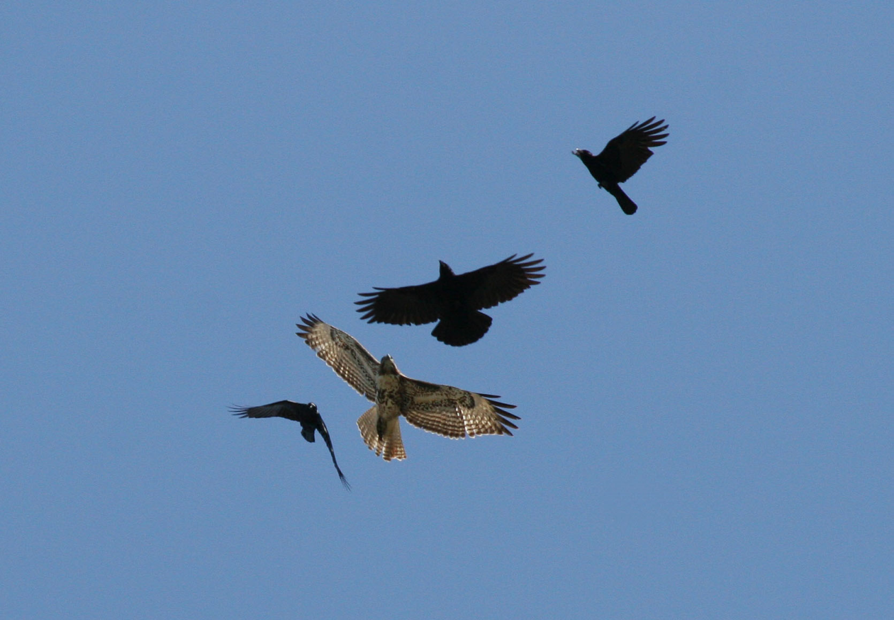
American Crow

Slide 12
Red Shouldered Hawk

Slide 13
Red Tailed Hawk

